Slide 1


Building a Data-Driven Procurement Hub:
A Blueprint for Operational Excellence and Strategic Impact
Susanna Kwon

Slide 2

What road do I take?
I don’t know.
Well, where are you going?
Then it doesn’t matter.
If you don’t know where you are going. Any road will take you there.
Notes:
We are faced with an array of constraints. Whether it is the constraints of our available resources, capabilities, time, or everyone’s favorite – budgets

Slide 3
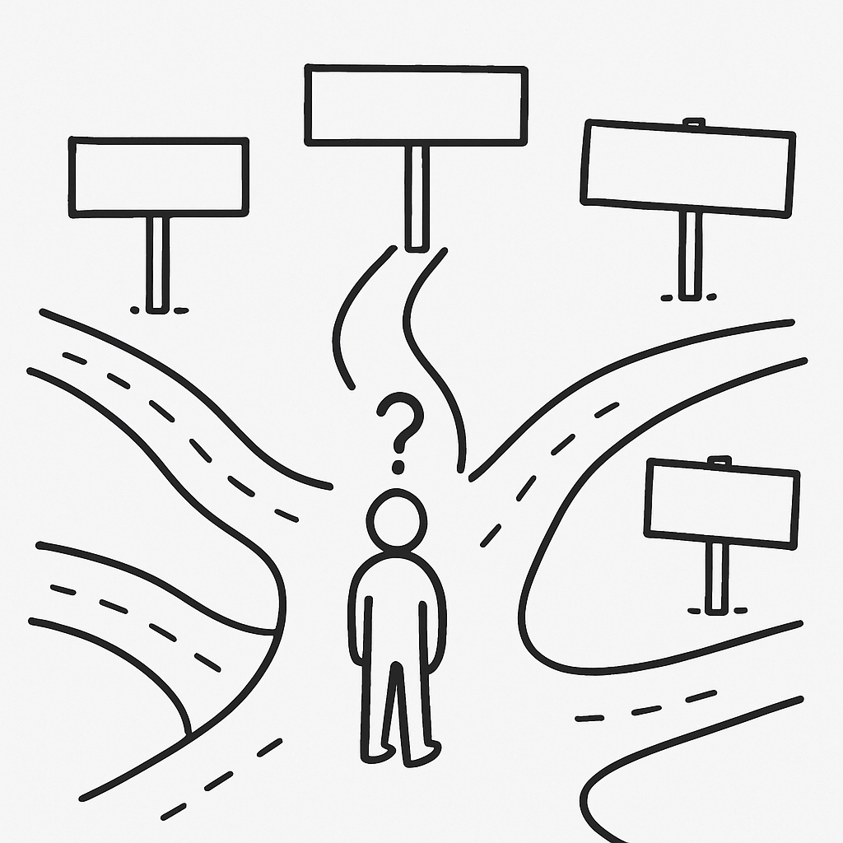
Notes:
If you don’t know where you are going, any road will take you there
Set bigger sights and hairy, audacious goals

Slide 4
If you were entering a motor race as Audi, how would you go about winning?
Notes:
Make it go faster, you would tell yourself. Just beat everyone as fast as possible.

Slide 5

Winner: The car that covers the greatest distance in 24 hours
Notes:
Run since 1923, it is the oldest active endurance racing event in the world. Unlike fixed-distance races whose winner is determined by minimum time, the 24 Hours of Le Mans is won by the car that covers the greatest distance in 24 hours.

Slide 6
How about now?
How would you go about winning?
Does your answer change?
Notes:
.

Slide 7
Faster Car
Better Driver
Team Communication
Constraints
Options

Slide 8
Constraint (noun):
something that limits or restricts someone or something.

Slide 9
Audi Chief Engineer in 2006:
“How could we win Le Mans if our car could go no faster than anyone else’s?”
Constraint Of Speed

Slide 10
Every system has a constraint.
Identify that single constraint holds the key to practicing “right action, right time.”
How do I achieve “the goal” without acquiring more of the limiting resource (constraint)?
Beauty of Constraint
Notes:
If we’re not fast enough, we should look at what we’re failing to automate well – the interaction of process and technology. Automation is a prerequisite to machine learning and AI – if we haven’t learned how to automate, we won’t use machine learning effectively.
If we’re not efficient enough, we should look at what we’re failing to scale – the interaction of people and process.
If we’re not creating new value, it’s because we’re failing to innovate – we haven’t used scale and automation to free up the time we need to innovate.
Consider any problem you face in business, in marketing, in work with this framework to uncover not only what’s wrong, but where to start fixing it.

Slide 11
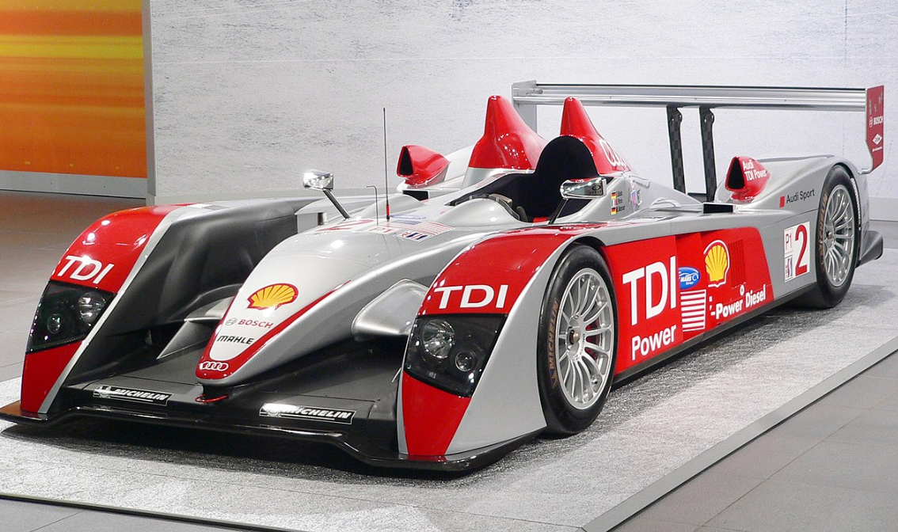
R10 TDI
First-ever diesel technology car. The answer was fuel efficiency.
By making fewer pit stops, the Audi car didn’t go faster, it merely lasted longer
Like an airplane at a gate, a race car at a pitstop consumes valuable time
Winning Le Mans 3 years in a row
Notes:
This propelling question tied a bold ambition with a significant constraint to push the Audi team to develop their first-ever diesel technology car—the R10 TDI. The answer was fuel efficiency. By making fewer pit stops, the Audi car didn’t go faster, it merely lasted longer. The R10 TDI placed first in Le Mans for the next three years.
By putting diesel technology into their race cars, Audi reduced the number of pitstops their car had to make, which was the edge they needed to win. Like an airplane at a gate, a race car at a pitstop consumes valuable time.
https://www.psychologytoday.com/us/blog/habits-not-hacks/201510/constraints-are-beautiful-thing-heres-why
Building a faster car is a typical first approach, but when developing a car for the famous 24-hour Le Mans race in 2006, the chief engineer of Audi asked a brilliant question instead: “How could we win Le Mans if our car could go no faster than anyone else’s?” If it couldn’t go faster, how did they expect to win?
This propelling question tied a bold ambition with a significant constraint to push the Audi team to develop their first-ever diesel technology car—the R10 TDI. The answer was fuel efficiency. By making fewer pit stops, the Audi car didn’t go faster, it merely lasted longer. The R10 TDI placed first in Le Mans for the next three years.

Slide 12
People
Who do stuff
Process
How we do stuff
Technology
What we do stuff with
Innovate
Scale
WIN
Automate
Notes:
What’s the Problem Statement?
Are we not fast enough?
Are we not efficient enough?
Are we not good enough?
Can we see where we are going?
Who are we in this game? In our business? In our industry?

Slide 13
First Things first… we must choose our own destiny
☹ Victim - Lower ambition when faced with a constraint. Give up!
😐 Neutralizer - Refuse to lower the ambition but finds a different way to deliver the ambition instead.
☺ Transformer - Find ways to use a constraint as an opportunity, possibly even increasing ambitions along the way
To shift from one mindset to the next requires self-awareness.
Only after we identify the dominant story can we change our mindset & reality!

Slide 14
Then Ask Propelling Questions to move forward
When faced with a particular limitation or constraint, begin with asking propelling questions to remove the frames you’ve placed around the problem.
A Beauty of Constraint, by Barden and Morgan:
“Propelling questions bind a bold ambition to a significant constraint. The solution has to make use of the constraint, denying us what would make the answer easier, ensuring that we address real challenges and not indulge in blue-sky fantasies. A propelling question is most powerful when it has specificity, legitimacy, and authority.”

Slide 15
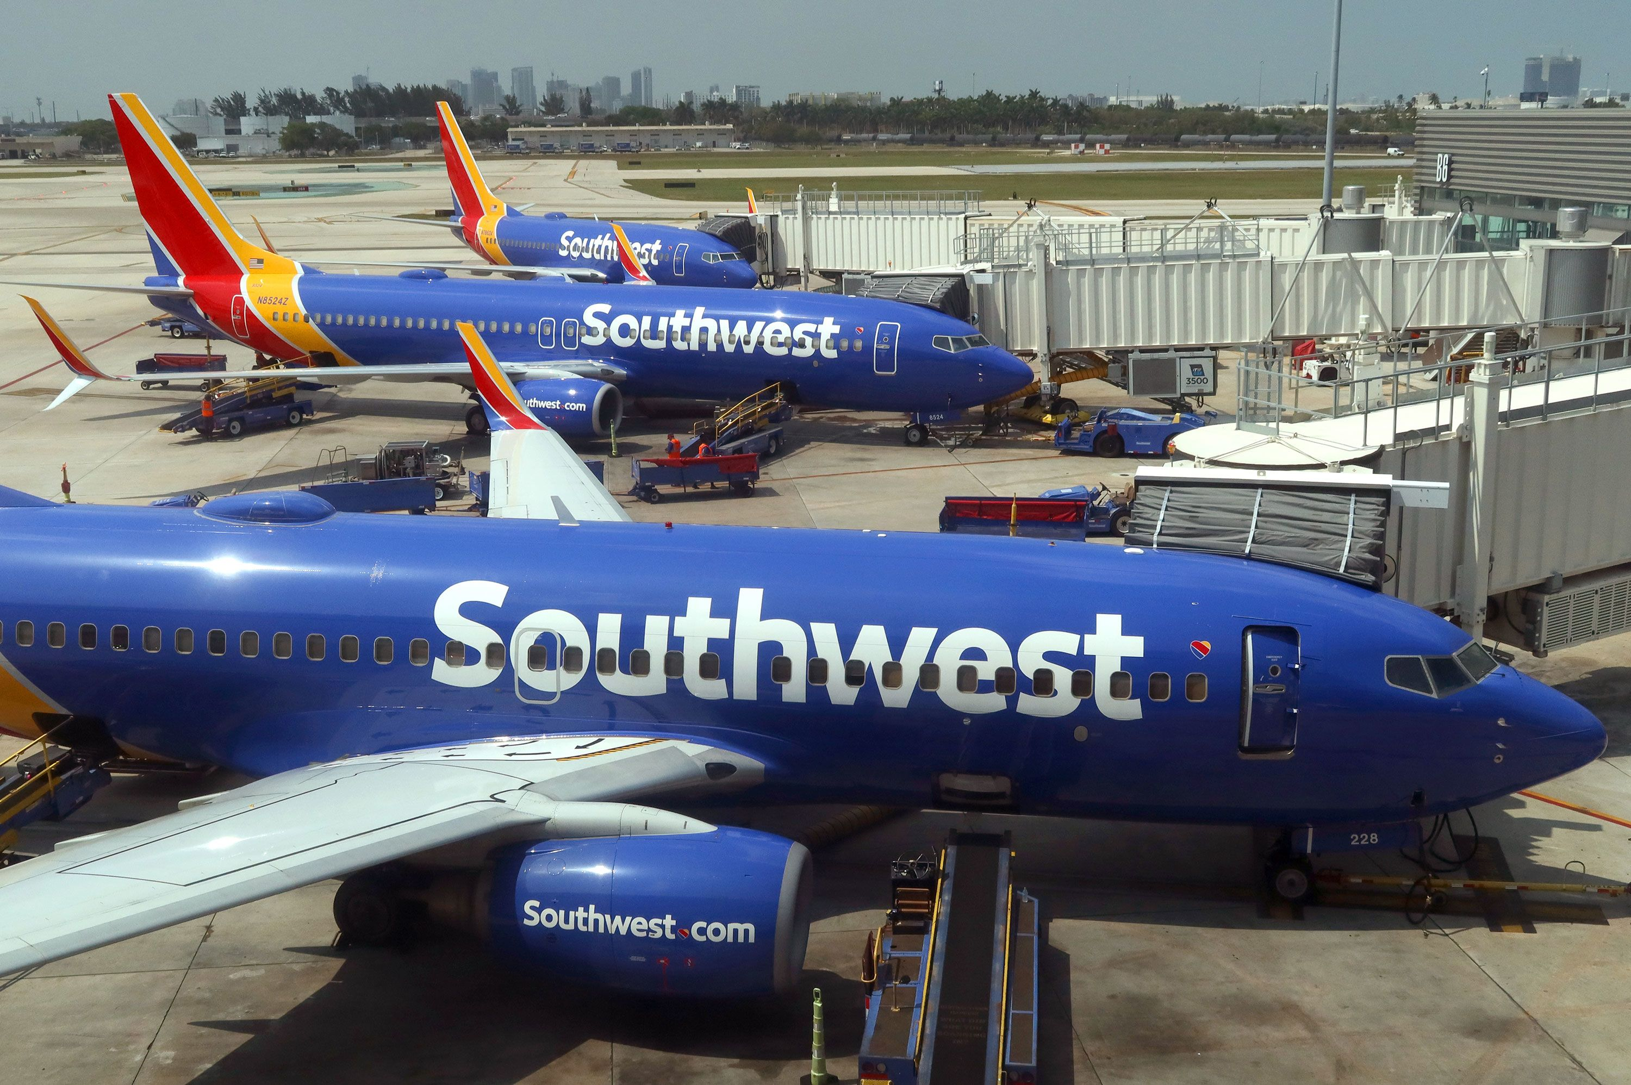
Southwest Airlines had to sell one of its planes or face bankruptcy
Notes:
When most people get hit with a constraint of limited resources like this one, they either fall victim to the constraint and revise their ambition downwards, or they confront it head-on and look for ways to brute-force it.
Southwest Airlines could have similarly fallen victim by accepting downsizing, or they could have confronted the constraint head-on by knocking on many more investor doors.
They found a way to achieve their goal of keeping their existing routes with three planes instead of four planes. They did this not by brute force but by embracing their constraint. Here’s how.
Instead of focusing on the obvious resource limitation (the number of planes), they turned their attention elsewhere. They noticed that the average gate turnaround time for their planes was about 60 minutes. The plane was cleaned, serviced, and refueled during this time, while meals, luggage, and passengers were boarded. Every minute a plane (the bottlenecked resource) spent idle on the ground costs them valuable time.
They calculated that if they could shrink their gate turnaround time from 60 minutes to 10 minutes, they could fly all their current routes with one less plane. Further analysis showed that the passenger boarding process was the biggest contributor to this gate turnaround time. They took on the challenge and introduced a radical new boarding process with no assigned seating. As a result, they managed to keep all their routes with one less plane.

Slide 16
A bottlenecked resource's time is the most valuable resource to optimize because it restricts overall workflow and efficiency. By focusing on optimizing the bottleneck, you can improve capacity, reduce lead times, and minimize inventory.
Reduced Lead Times
Gate turnaround time* from 60 to 10 mins
Streamlining the bottlenecked area leads to faster overall process completion times
Enhanced Efficiency
No Assigned Seating to manage biggest bottleneck with passenger boarding process
Improve overall efficiency and productivity, reducing waste and delays.
Increased Profitability
Only fly short point-to-point
Increased profitability due to reduced costs and increased throughput.
Quality Improvement
Policy to fly a single type of aircraft (Boeing 737s)
Fewer errors and defects, ultimately improving the quality of products or services.
Reduced Inventory
3 planes provide the same capacity as 4
Reduces work-in-process, leading to less inventory holding costs.
*The plane was cleaned, serviced, and refueled during this time, while meals, luggage, and passengers were boarded. Every minute a plane (the bottlenecked resource) spent idle on the ground costs them valuable time.

Slide 17
People
Who do stuff
Southwest:
“We are the only short haul, low fare, high frequency, point-to-point carrier in the U.S.”.
Constraints Create Space for Innovation, leading to Operational Excellence!
Process
How we do stuff
Technology
What we do stuff with
Innovate
Scale
WIN
Automate

Slide 18

“How to increase barley yield and quality while reducing water consumption by 10%?”
“They spoke to Barley farmers and found that barley growth has three distinct stages. Reduced water in the middle stage promotes growth. The new approach reduced water consumption by 48%, yet increased yield (with a reduced cost per hectare of $40).
Notes:
They spoke to Barley farmers and found that barley growth has three distinct stages. Reduced water in the middle stage promotes growth. The new approach reduced water consumption by 48%, yet increased yield (with a reduced cost per hectare of $40).

Slide 19
People
Who do stuff
Process
How we do stuff
Technology
What we do stuff with
Innovate
Scale
WIN
Automate

Slide 20

Had a problem with workers not wearing face masks to protect from the toxic fumes from the glue.
“How do we improve the safety of our staff?”
Rather than monitor them 24 hours a day, they instead developed a less harmful glue.
Notes:
Rather than monitor them 24 hours a day, they instead developed a less harmful glue.

Slide 21
People
Who do stuff
Process
How we do stuff
Technology
What we do stuff with
Innovate
Scale
WIN
Automate
Notes:
What’s the Problem Statement?
Are we not fast enough?
Are we not efficient enough?
Are we not good enough?
Can we see where we are going?
Who are we in this game? In our business? In our industry?

Slide 22
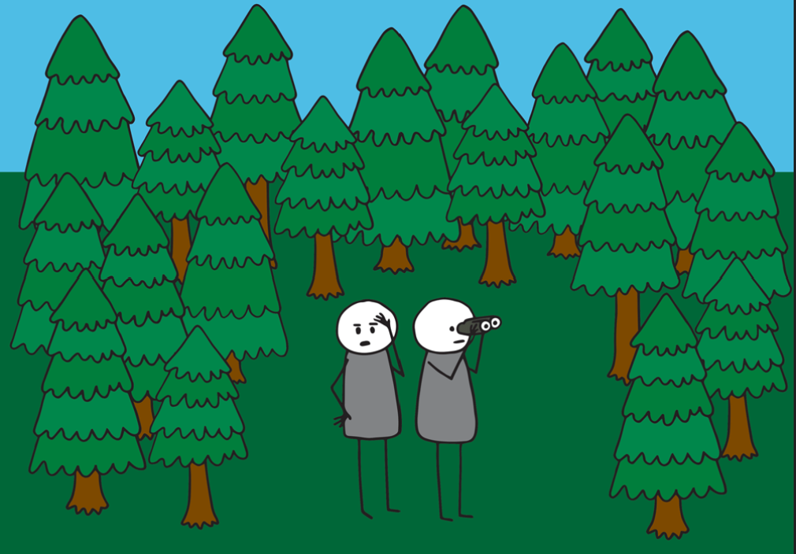
Notes:
The phrase "can't see the wood for the trees" is an idiom that means you're so focused on the details of a situation that you can't grasp the overall picture. It's like being so engrossed in individual trees that you miss the forest they make up. Essentially, it means you're not able to understand a larger situation or problem because you're only looking at the smaller parts.

Slide 23






What business are we in, and what role do we play?
Notes:
When we think about any kind of work, from strategy to marketing to manufacturing, we want three fundamental outcomes:
Faster
More Efficient
Better
Many of us recognize the business joke, “Fast, cheap, good: choose any two”. Prior to the era of highly accessible technology, that was true.
Today, thanks to machine learning and AI, it’s possible to achieve all three.
Because machines (properly designed and run) are faster than people, scale better than people, and once deployed tend to be cheaper than people, we can achieve fast, cheap, and good.
The largest technology companies in the world stay that way precisely because they’ve achieved these machine-led economies of scale.

Slide 24
Define Role of Procurement…
“Uber, the world’s largest taxi company, owns no vehicles.
Facebook, the world’s most popular media owner, creates no content.
Alibaba, the most valuable retailer, has no inventory.
And Airbnb, the world’s largest accommodation provider, owns no real estate.”
TechTarget’s Tom Goodwin
Procurement owns no companywide budget

Slide 25

According to CIPS… Top skills of Procurement…
1. Work on your soft skills to connect better with your people
2. Develop green skills to stay relevant and effective
3. Master digital technology and ensure it’s a job-enabler - procurement leaders will need to work with technology to ensure it’s an enabler and not a job-destroyer. This includes making sure your people have the right skills for any new jobs created by increased automation.
4. Be a role model of good professional practice
5. Hone your influencing skills to drive lasting change
6. Know how to maintain advantage in supplier relationships
7. Navigate internal relationships better to drive high performance
Source: CIPS 2024 Procurement & Supply Salary Guide
Notes:
If you don’t know where you are going, any road will take you there

Slide 26
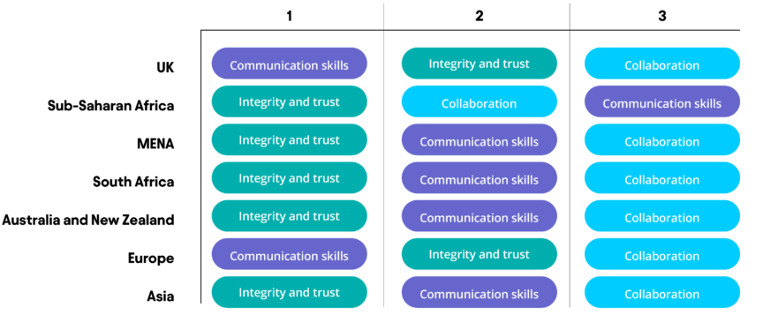
Top Characteristics of Leaders Over the next 10 years by region
Source: CIPS 2024 Procurement & Supply Salary Guide
Notes:
If you don’t know where you are going, any road will take you there

Slide 27
People
Who do stuff
Procurement Function as Enablers and Accelerators guided by Data & Analytics
Process
How we do stuff
Technology
What we do stuff with
Innovate
Scale
WIN
Automate

Slide 28

People
Get to know our business and align to changing strategies & structures
Understand our business and roles
Create and Monitor Service Level Agreements (SLAs)
Translate Procurement Strategy to Structure (distinct service lines)
Right People on the Right vehicle, on the Right Seat
Define Objective and Key Results (OKRs)

Slide 29
Process – Know where you are and where you want to go
Charter the Final Destination and make changes as we go
Map out end to end processes (As Is Baseline)
Identify Bottlenecks
Eliminate Waste
Measure actual time to complete vs. target
Define
Measure
Analyze
Improve
Control
Some Efficiency Tools
6 Sigma, Lean Engineering, TIMWOOD, DMAIC, Fishbone, FMEA, and etc…

Slide 30
Technology & Data
Invest in the Right Technology with Positive ROI (Ariba, PowerBI, Python…)
Extract, Transform and Load (ETL) the right source data & automate to create meaningful KPIs and Dashboards to drive Insights
Enable with AI tools

Slide 31
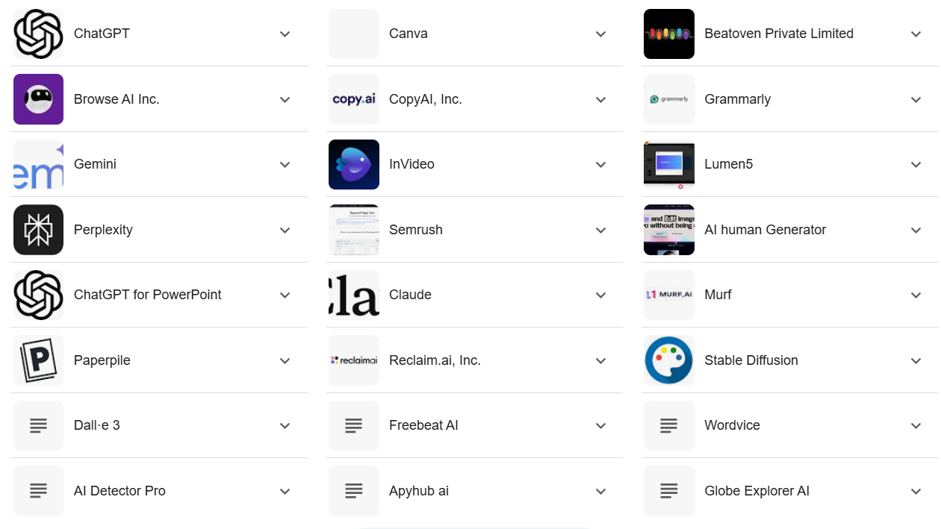
Over 10,000 Free AI tools… and they grow
Because machines (properly designed and run) are faster than people, scale better than people, and once deployed tend to be cheaper than people, we can achieve fast, cheap, and good.

Slide 32
One Company, One Policy, One Language
Best Practice
Every Rand Matters
According to Best-in-Class Benchmark:
87% have formal, documented procurement policy
Regular Policy Updates are the Norm (1-3 years)
Better cost controls, efficiencies & compliance
Leverage best way of work for Operational Excellence and Strategic Impact
Drive Every Day Lost Cost to Invest in Price
Unbeatable Together
Powered by Walmart
Authored and reviewed by 100+ people
Formalizes and Simplifies how we work together
Incorporating real time feedback to enable, align and support business operations
ONE policy means ONE common language, so we can all work together with more ease and speed
Aligned to Walmart International Policy and Consultancy Policy
No PO, No Pay

Slide 33
Governed by Group Indirect Spend Procurement Policy
Source to Contract
Procure to Pay
Who
Procurement, Cost Centre, Legal
Master Data
Cost Centre Owner
Supplier
Receiver
(Cost Centre Owner)
Supplier
Accounts Payable
What
Sourcing Process
1. Scoping
2. Demand Planning
3. Market Analysis
4. Develop Sourcing Strategy
5. Supplier Selection (RFx, IB)
6. Negotiation and Contracting
7. Implementation & Tracking
Receive required documents
Budget and cost centre approval
Receive PO
Goods receipt / confirm work done
Submit invoice post work done
Receive and post invoice
Ensure compliance & Completeness
Send Purchase Order
Do work or provide goods
Make payment if requirement is met
Notify goods or work was delivered
Output
Contracted
Vendor created
PO
Goods or services delivered
Acknowledge work done (Goods Receipt)
Invoice Submitted
Invoice Paid

Slide 34
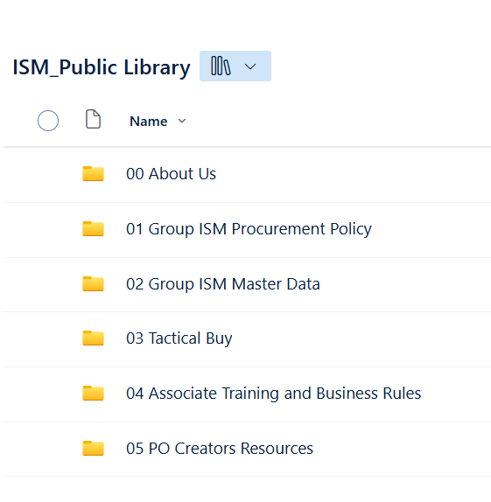
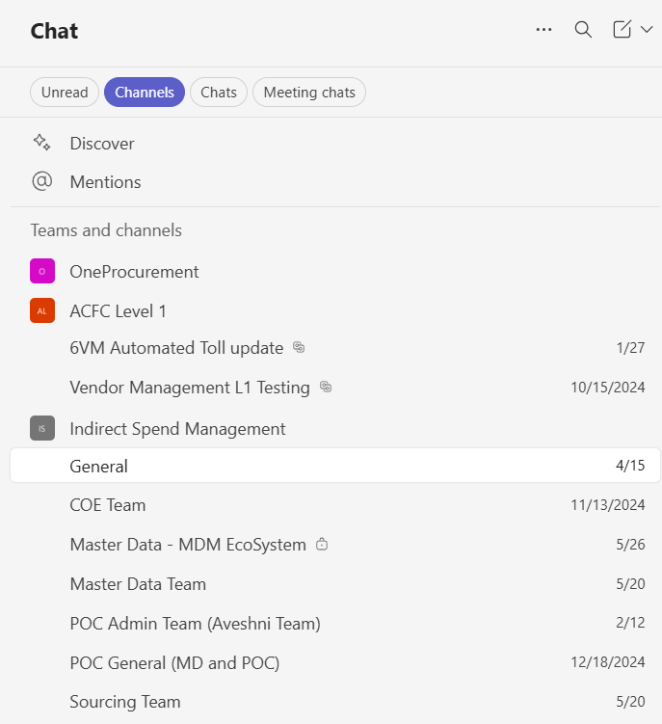
Better Communications Channels & Collaborations

Slide 35
Focused Workforce of the Future Skillsets
1. Communication: Clean and open communication with Effective Storytelling with right tools and Lego blocks
A strategic leader must be able to communicate their processes and objectives to key stakeholders and the wider team as a whole to ensure success and communicate the value of Procurement to the business
2. Influencing: Guide others without alienating
Help the entire procurement function work towards the same goals.
3. Relationship management leads to better business outcome
Focus on both suppliers and internal customers
4. Change management: Prepare to be flexible & drive change
Strategic sourcing, change and transformation projects are taking place across all sectors.
5. Negotiation: Find ways to achieve the best solution with Win/Win Mindset
Being able to discover and articulate the best solution to a challenge is a crucial skill to have as a senior leader. A great negotiation is one where all parties are satisfied with the outcome.
“49% of employers surveyed for the CIPS/Hays Procurement Salary Guide and Insights 2022 said that communication and soft skills were their top-rated requirement from a procurement professional.”

Slide 36
Drive Virtuous cycle of improvements → Operational Excellence
Monitor
Detect
Type
New
Existing
Close out
SOP
Define
Measure
Analyse
Improve
New SOP
Issue list
Prioritise
Change

Slide 37
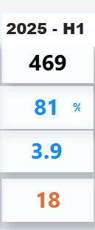
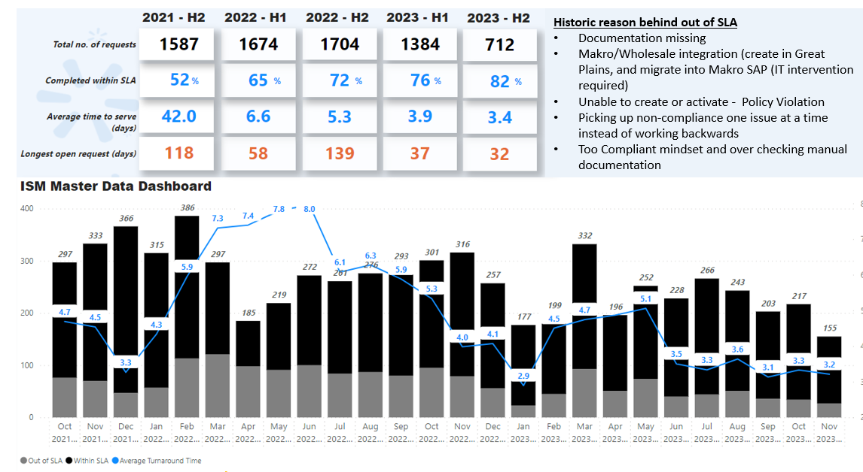

Use Data & Dashboards to tell the story quickly!
Improved Time to Serve by 90%
Within SLA 81% of the time, compared to 52%
First In, First Out (FIFO)

Slide 38
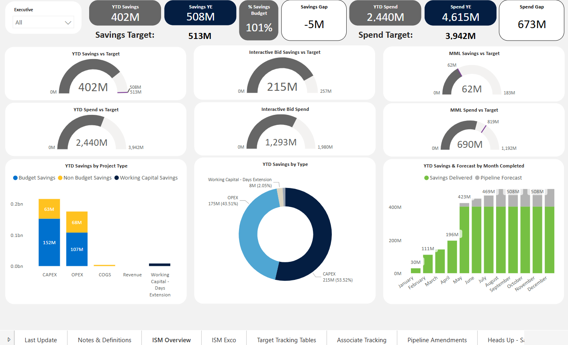
Sourcing Dashboard

Slide 39
Key Frameworks used to drive Operational Excellence
One Language
Group Policy Defining Rules of Engagements
Engage Procurement as early as possible
Better cost controls, efficiencies & compliance
One Way of Working
Define and Measure Clear Procurement Services with the Source to Pay Value Chain
Reduces work-in-process, leading to less inventory holding costs & predictable outcomes.
Make it Visible & Sticky
Leverage use of Online Tools: MS365, PowerBI, SAP Ariba for Sourcing
Measures against benchmarks (Hackett & other markets)
Use Market Intelligence and Insights to drive action instead of chasing data & spreadsheets
Embed ourselves into our business
Part of Business Discussions from ideation/proof of concepts
Improve overall efficiency and productivity, reducing waste and delays.
Work Force of Future
Impactful and Value-Adding Storytelling
Community of Practices
All Master Data Transactions from 42 to 5 days
43 Days from Source to Contract
Holistic Approach with People, Process, Technology, informed by Data & Analytics

Slide 40
Key Takeaways
Celebrate Beauty of Constraint
Ask Propelling Questions (How can we move faster?)
Lead the Change with Transformer Mindset
People
Who do stuff
Technology
What we do stuff with
Process
How we do stuff
Innovate
Scale
WIN
Automate

Slide 41
Procurement
What road do I take?
Business
We need to drive Operational Excellence and Strategic Impact to improve our sales!
Well, where are you going?
Notes:
We are faced with an array of constraints. Whether it is the constraints of our available resources, capabilities, time, or everyone’s favorite – budgets

Slide 42

Get on the Road towards Operational Excellence and Strategic Impact with Procurement

Slide 43


