Slide 1


Procurement for Prosperity
Santie Roy
Empowering Communities Through Strategic Sourcing

Slide 2

Prosperity
Empowerment
Communities
Strategic Sourcing

Slide 3
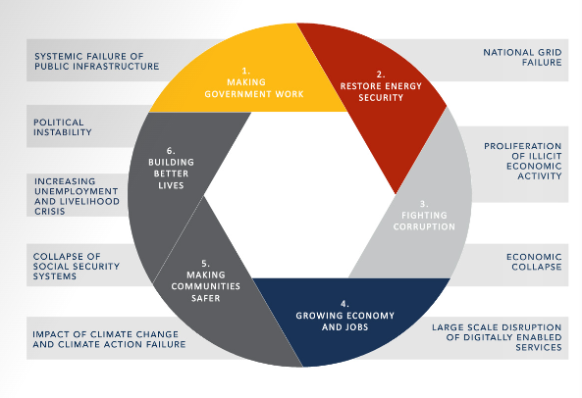
SA Risks linked to Government Priorities

Slide 4
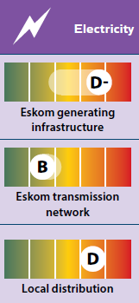
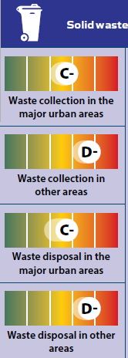
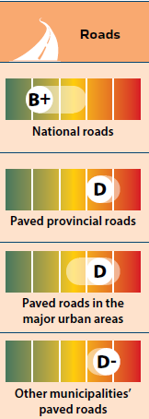
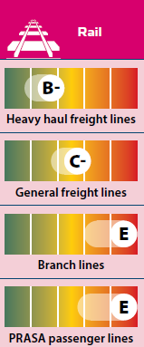
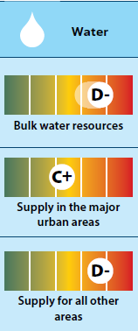
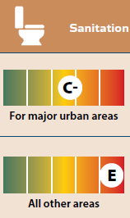
SAICE 2022 Infrastructure Report Card
A World Class | B Fit for the Future | C Satisfactory for now | D At risk of failure | E Unfit for purpose
Comparable to the best, excellent condition, well maintained, will endure unusual pressure | Good condition, well maintained, will deal with current demand and minor incidents | Stressed at peak periods, needs MTEF period investment to avoid serious deficiencies | Not coping, poorly maintained, danger or severe inconvenience without prompt action | Failed or failing, creating health & safety hazards. Immediate action required
Source: https://saice.org.za/downloads/SAICE-2022-Infrastructure-Report-Card.pdf

Slide 5

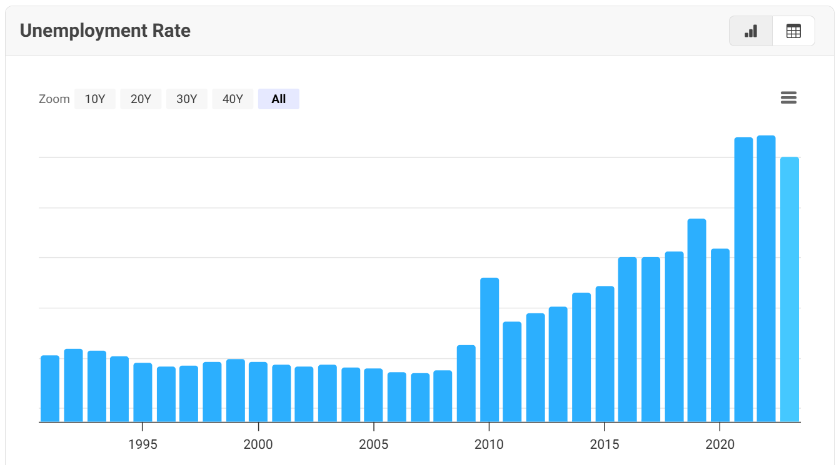
Top 49 companies in SA employ just over 901K people
SA Govt employs over 1,3m people
31.9% unemployment (Q4 2024)
65m
https://www.macrotrends.net/global-metrics/countries/zaf/south-africa/unemployment-rate

Slide 6

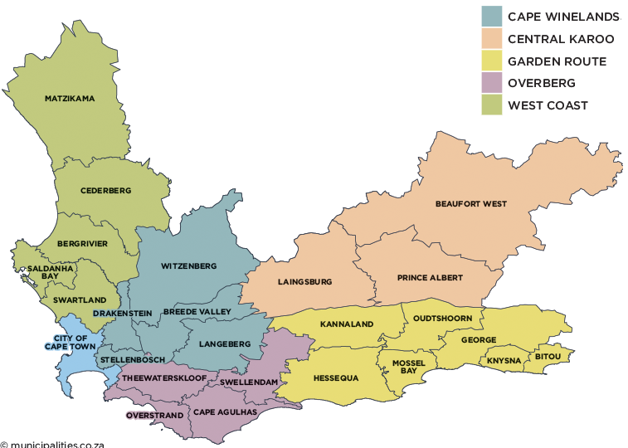
Western Cape Procurable Expenditure
R90bn

Slide 7
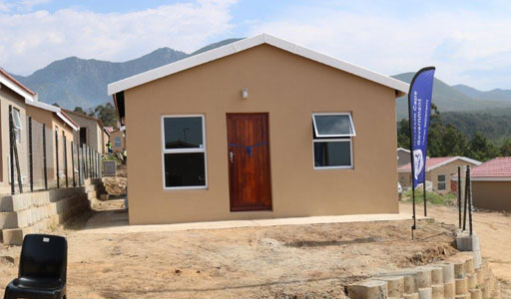
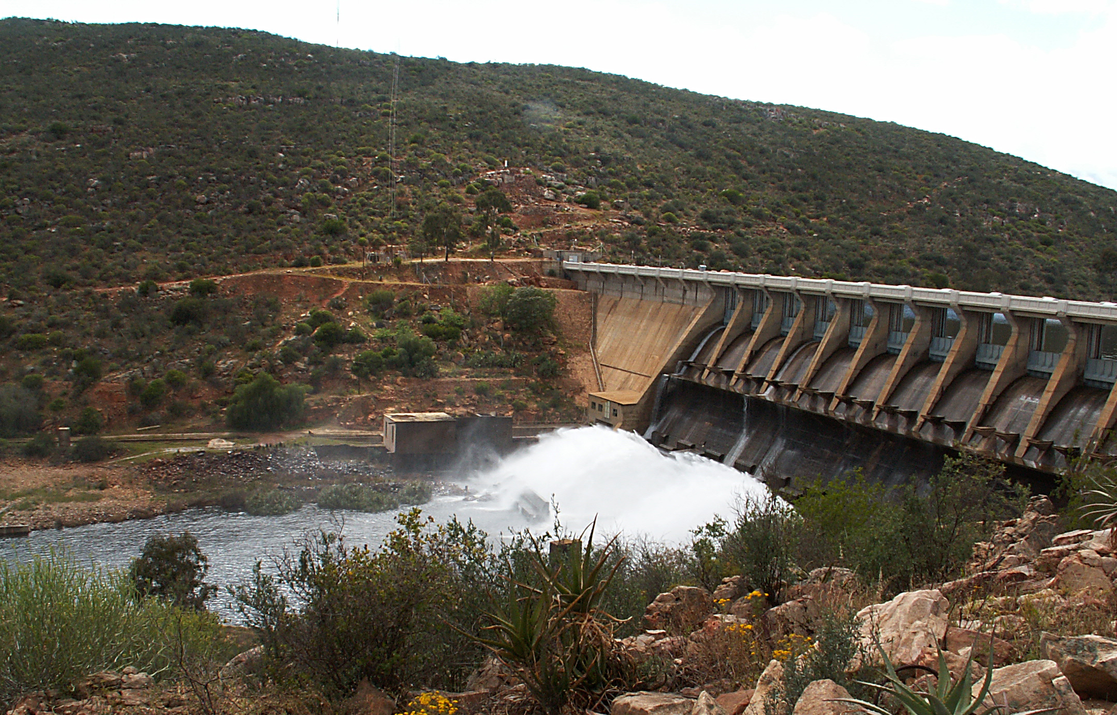


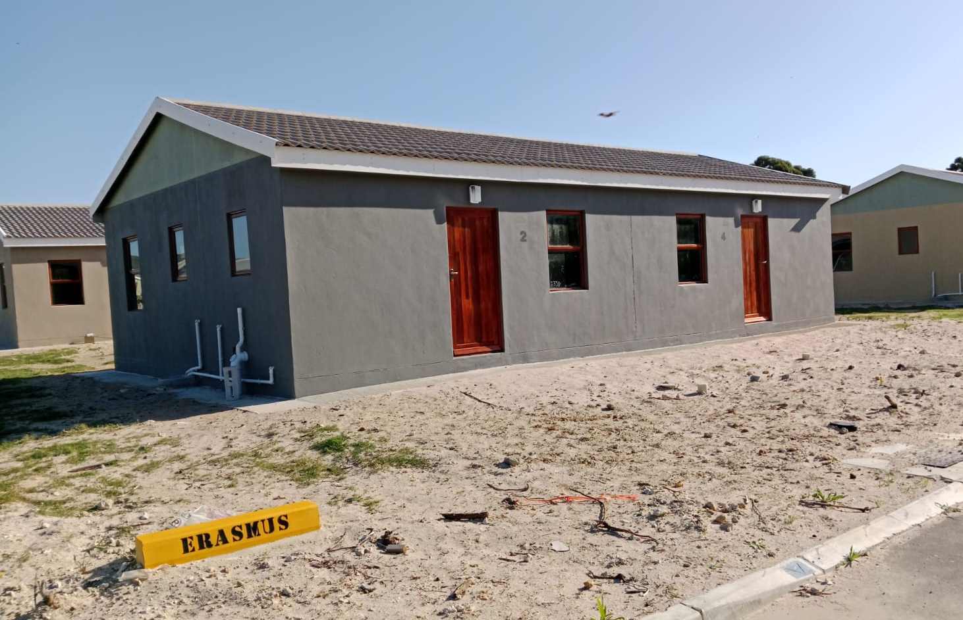
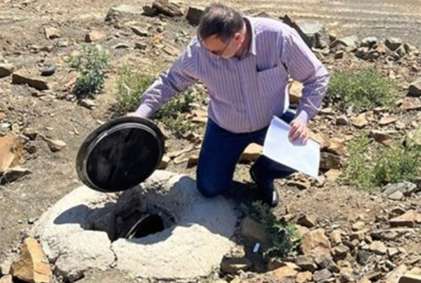
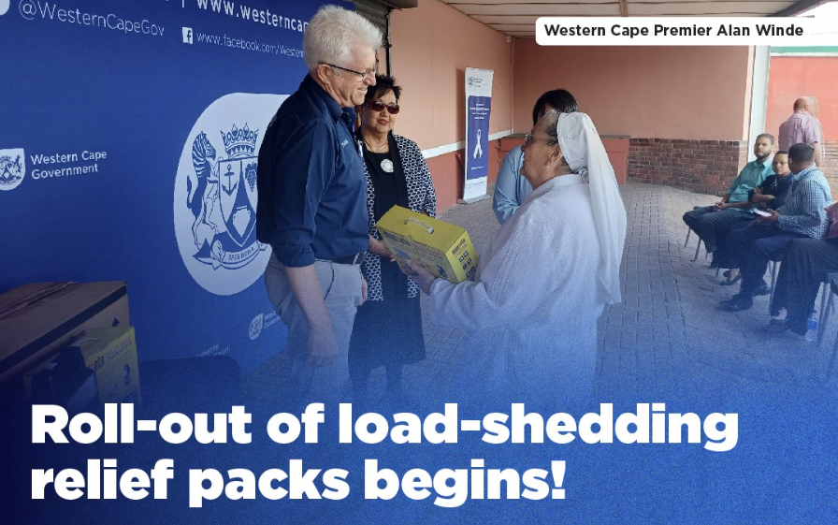
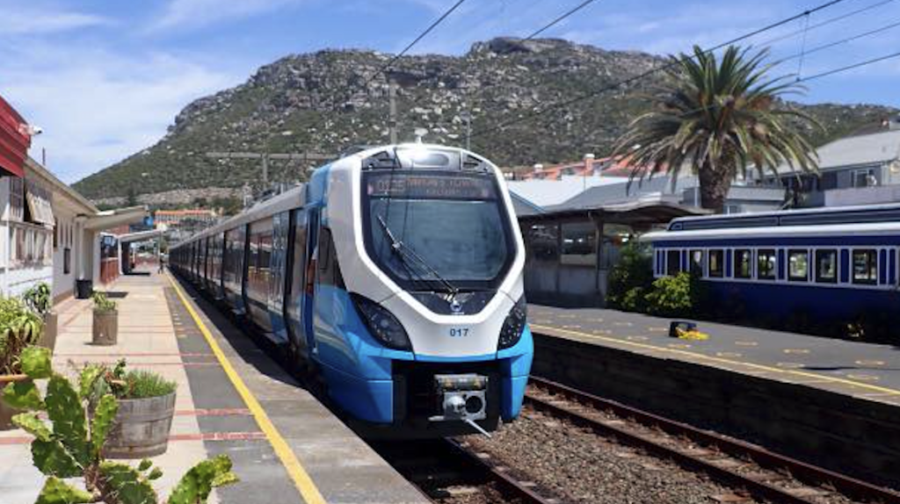
Economic Empowerment of Communities through Basic Services
Hessequa Solar PV
Golden Valley, George
Clanwilliam Dam
Stanford
Leeu
Gamka
PRASA Blue Train
Source: Oudtshoorn Courant
Source: capetownetc.com | Picture: Fish Hoek Beach/Facebook
Housing
Water & Sanitation
Electricity
Public Transport

Slide 8



What are we trying to do?
people
risk

Slide 9
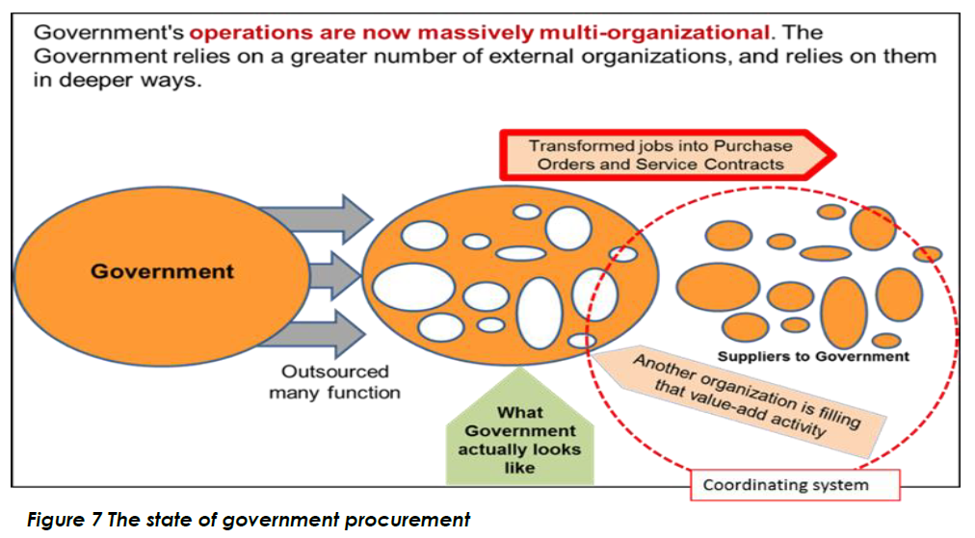
What are we actually buying?
The supply of goods and services which government could manufacture or provide directly
Outsourcing test criteria
Efficiency
Expertise
Access to resources
Quality
Customer satisfaction
Overall cost reduction
Core activity

Slide 10
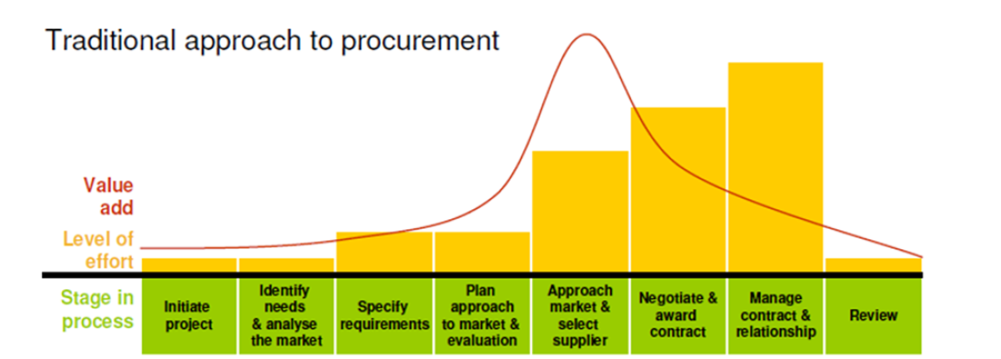
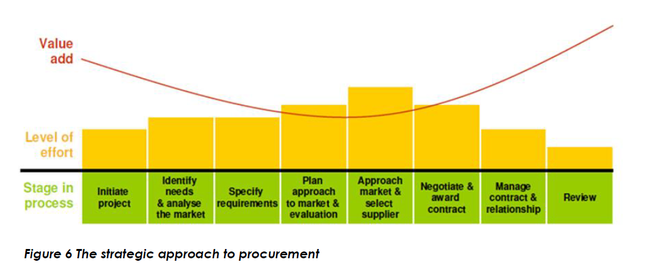
Traditional vs strategic procurement
Traditional
Strategic
Source: National Treasury, Strategic Procurement Framework v2.0, Feb 2024

Slide 11



Preparation
Internal & external analysis
  Data analysis
  Stakeholder relationship management
  Market research
Awareness of private sector commercial practices
  For-profit imperatives
  Sectoral business practices
  Relative value/importance of government business
Risk management
  Risk identification
  Risk prioritisation to enable effective decision-making

Slide 12






What do we want to improve through Strategic Procurement?
    Project delays
    Poor process implementation
    Exorbitant cost & lack of value-add
    Contract management
    Contractor performance
Notes:
Procurement failures lead to project delays or even loss of funding: Inherently lengthy processes, BxC meetings cancelled, non-responsive processes require cancellation & readvertisement
Poorly implemented processes: Regulations inconsistent with contract docs; poor stakeholder collaboration; SCM perceived as obstructive at worst or ineffective at best
Exorbitant tender prices: Scope creep & cost escalations
Contract management: Contract variations poorly managed; contract expiry = irregular expenditure
Contractor performance: Difficult (impossible?) to restrict poorly performing contractors; complicated processes to monitor & report non-performance

Slide 13
Spectrum of procurement deliverables
People
Stakeholder engagement
x-functional teams
Basic service delivery
Economic development
Client satisfaction
Quality
Fit for purpose
Contractor performance
Timeous completion
Contractor relationship
Asset management
Process
Maintain compliance (audit outcomes)
Administrative efficiency
Alignment to organisational strategy
Avoidance of reputational risk
Execution of planned objectives
Cost
Value for money
Lifecycle costing
Spend (v.) budget
Negotiation

Slide 14

Some private sector practices

Slide 15

Rationalisation
Key questions asked using available data
How much do you spend?
How many suppliers do you have?
How much did you spend with each supplier?
How many line items are on the average order?
How much is the average invoice value?
How much does it cost to raise an order?
How much does it cost to pay an invoice?
Data analysis enables rationalisation which allows organisations to place fewer orders with fewer suppliers for fewer items (in larger quantities) … This allows buyers to:
Increase buying power
Reduce administration cost
Free up available funding to contribute directly to increasing profit

Slide 16
Savings Targets
Savings targets are the norm for private sector buyers
For example:
Reduce annual expenditure within category by 10%
Save 3x annual salary
Reduce variable costs in service contracts by 20%
How does the private sector achieve savings?
NEGOTIATION

Slide 17

Supplier Relationship Management
  Multiple suppliers
Adversarial
Arm’s length
Transactional
Closer tactical
Single-sourced
Outsourcing
Partnership
Co-destiny
Strategic alliance
<5 suppliers
1 supplier
Correlation in reduction of suppliers

Slide 18
Cross-functional provincial team
Strategic Procurement Projects
Municipality or Department
District Coordinators
Provincial Treasury
Other agencies
(NT, SITA, MISA, DBSA)
Sector Departments
Dept of Economic Development
(DEDAT)
Dept of the Premier
(Legal Svcs)

Slide 19
Local cross-functional team
Local teams
End users
SCM
Senior Management
Planning
Local Economic Development
Political roleplayers
Legal

Slide 20
Which commodities?
Disaster response?
Goods
Chemicals
Construction materials
Electrical components
Fleet
Fuel Water supply + plumbing components
Maintenance supplies
Promotional materials
Stationery
Tools
Uniform, PPE + safety eqpt
Services
Animal welfare
Banking
Catering
Cleaning
Finance
Gardening & landscaping
Media advertising
Printing services
Recruitment verification
Security
Social media management
Telecommunications
Training
Travel
Website management
Consultants
Contractor management
Consulting Engineers: design, specify, evaluate
Environmental Impact Assessments (EIAs)
Forensic investigations
Legal Services
Project management
Site management
Social facilitation
Transaction Advisory Services for PPPs
Construction & maintenance
Asset-specific planned & reactive maintenance
Civils (CE)
Electrical works (EB + EP)
General Building (GB)
Management contractors
Mechanical works (ME)
Specialist works:
  Asphalt (SB)
  Fencing (SQ)
  Fire (SF)
  Glazing (SG)
  Road markings & signage (SK)
  Steelwork & scaffolding (SL)
  Wet works/plumbing (SO)

Slide 21

How do we assess the viability and output of Strategic Procurement?
Value
(Cost)
Risk
Complexity
Frequency
Users
How much?
Risk?
Complex?
How often?
Who?
SP Output
Example 1
Build Materials
Low-value
Low
Simple
Daily
All
Local supply agreement
Example 2
Animal welfare
Low-value
Low
Simple
Daily
All
Generic specifications
Example 3
EIA
High-value
High
Simple
2-3 p.a.
All
Panel agreement
Example 4
Civil Engineering
High-value
High
Complex
Daily
All
Framework agreement
Notes:
There are many methods to assess expenditure or planned activities to determine project priority, including e.g. Kraljic matrix which assesses expenditure based on value vs risk.
However, given the breadth & scope of municipal requirements, I like this model – which is not exhaustive!
Crucial to remember that this approach identifies that various assessment criteria will have different weights across various municipalities at various times, so the examples we are going to work through reflect are examples of what could be achieved through strategic procurement interventions.

Slide 22
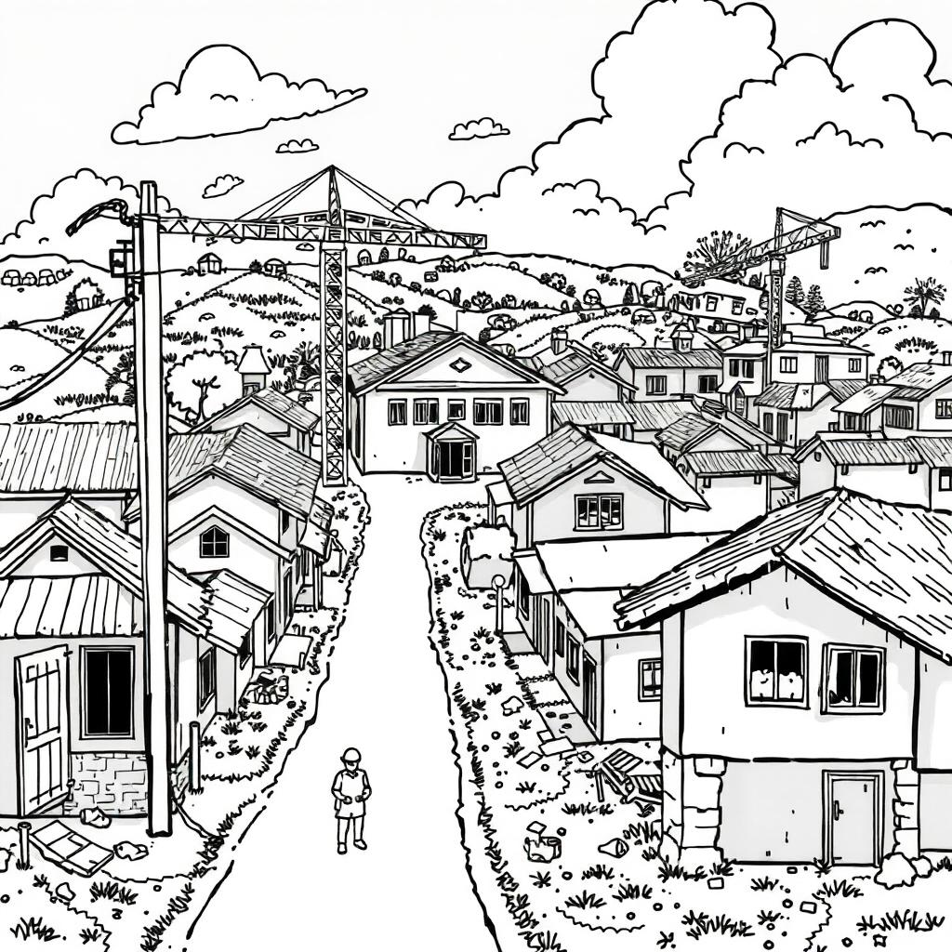
Strategic Procurement Outcomes
Compliant procurement
Local economic development
    Phased employment per ward
    Local manufacturing
    Locality assessment
Value for money
    Benchmarked prices
    Balanced promotion of SMMEs with affordability
    Negotiation of aggregated demand
Contractor performance management
Rotation mechanisms
    Capacity assessment
    Fair distribution of workload

Slide 23



Public Procurement Act
Enacted by the President on 23 July 2024
Status quo remains until regulations are promulgated
Largely reinstates repealed Preferential Procurement Regulations, 2017
>50 aspects to be dealt with in regulations
    >30 mandatory provisions
    Many other discretionary provisions
Read me
PPA 28 of 2024
Read me
Media Stmt

Slide 24








Provincial Strategic Procurement
Situational analysis to lead to development of a strategic procurement toolkit: suite of contracts & interventions
Infrastructure
Fleet
Goods
ICT
Framework Agreements
Civil engineering
Electrical eng
Mechanical eng
General Building
Specialist Works
Consulting engineers
Parts & Spares
Building materials
RT45 Parts & Spares
RT46 Fleet Mgmt (fuel purchases)
RT57 Vehicles
RT70 Fuel
Other?
Convenience contracts
Local suppliers
Negotiated rates
Low MOQs
SITA Hardware
SITA/Ce-I MS Enterprise Agreements
SITA Services Panel agreements
mSCOA ERP Systems
Ongoing promotion of other existing contracts for uptake by municipalities

Slide 25


Slide 26
Existing Contracts: NT
RT # | SITA Description | RT # | RT Description
RT5 | Couriers | RT46 | Vehicle Fleet Services
RT8 | Cargo & furniture relocations | RT50 | Industrial gases
RT10 | Veterinary remedies | RT51 | LPG
RT11 | Animal feed | RT57 | Vehicles incl. yellow fleet
RT12 | Pesticides, herbicides, agr vaccines | RT60 | Fabric & towelling
RT14 | Toilet paper and tissues | RT61 | Aircraft & helicopters
RT15 | Mobile Comms | RT64 | Clothing
RT23 | Lubricating oils & grease | RT67 | Liquid Chlorine gas
RT26 | Blankets & household textiles | RT69 | Tyres & tubes
RT27 | Debt collection services | RT70 | Fuel
RT29 | Smart Meters + TID conversion for prepaid meters | RT74 | Prefabricated shelving
RT37 | Air quality monitoring | RT81 | Buliding Material
RT44 | B-BBEE Verification Audit services | RT274 | Hearing aids
RT45 | Automotive parts, spares & tools

Slide 27
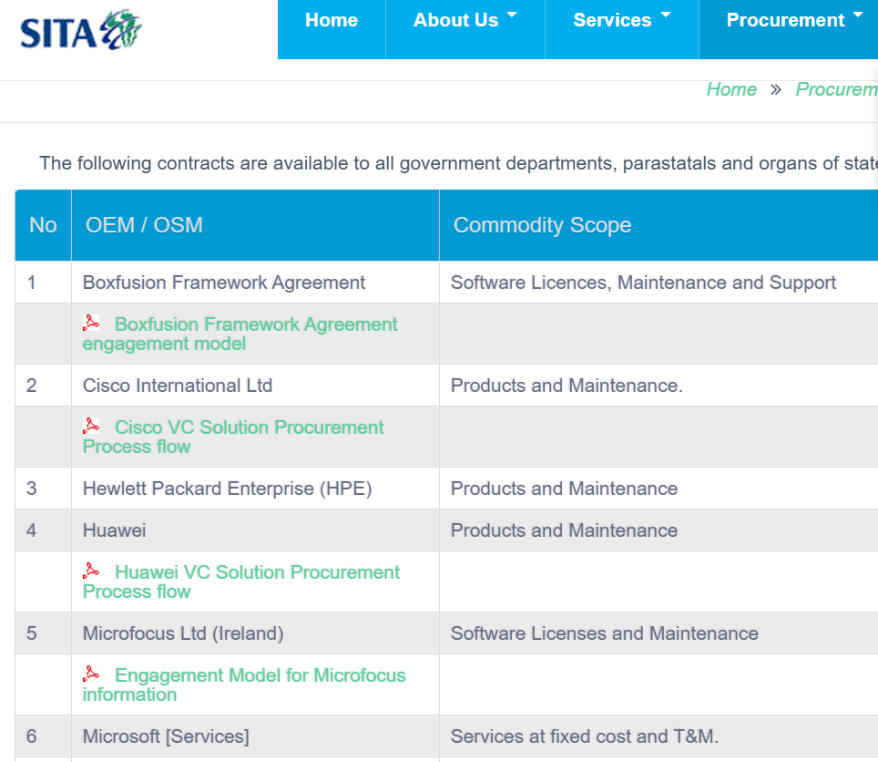
Existing Contracts: SITA
SITA # | SITA Description
 | Microsoft Enterprise Agreement
RFB 740 | Personal Computers, Mobile Devices and Services, Computer Peripherals, Consumables and Services
1183 | ICT Management Services, Business Planning & Development, Business Solutions Delivery Services, Information Security Services, Business Solution Implementation Services, Applications Development Services, ICT Services support management, Data Centre services, Communication network, LAN & desktop, Planning & Organisation
RFB 1626 | Training Providers Database
RFA 1880 | Panel for Provision of Network Connectivity
RFA 2306/2020 | Supply, installation & configuration of CCTV and access control, incl. maintenance & support
RFA 2501-2021 | Design, supply, installation, support & maintenance of Unified Communication (UC), Video Conferencing solutions (VC) and services
RFA 928 | Migrate SITA clients’ applications, databases and servers to the Government Private Cloud Eco-System (GPCE)
RFA 2494-2021 | Supply, install & configure Information Security Products and Services, incl. software licenses

Slide 28
Sources
https://www.wits.ac.za/ipdm/guides/sipdm-guidelines/
https://applj.journals.ac.za/pub/article/download/30/23
http://ocpo.treasury.gov.za/Resource_Centre/Legislation/Annexure%20A%20-%20Standard%20for%20Infrastructure%20Procurement%20and%20Delivery%20Management.pdf
https://cdn.ymaws.com/www.safcec.org.za/resource/resmgr/construction_legislation/fipdm/fipdm_2019.pdf
https://www.dhet.gov.za/Manuals/Annexure%2021%20-%20Procurement%20Guidelines.pdf

