Slide 1
Treasury
Innovation in Procurement: Reducing Red Tape, Increasing Impact
Leveraging innovative tools and technology to streamline procurement processes, cut bureaucracy, and maximize public sector impact
29 May 2025
Notes:
Good morning/afternoon, everyone! I’m Nadia Ebrahim, and it’s a pleasure to be here today at the WC Smart Procurement Conference 2025. My session is titled ‘Innovation in Procurement: Reducing Red Tape, Increasing Impact.’ Today, we’ll explore how we can move procurement forward—cutting through bureaucracy and embracing innovation to deliver greater value, especially in the public sector. Let’s begin by setting the scene with our guiding theme.

Slide 2
Outline
Introduction
The Need for Innovation
Emerging Technologies
Cultivating an Innovative Mindset
Reducing Red Tape
Key Takeaway
Notes:
This presentation cover a brief introduction to the theme, the need for innovation, emerging technologies, cultivating an innovative mindset, reducing red tape and ending with key takeaways of the session

Slide 3

Introduction – the Starry Night Metaphor
"Guiding Through the Dark: Procurement's Role in Navigating Complexity"
Stars as Guides: Just as stars have guided explorers through the night, procurement professionals lead organizations through complex, ever-changing landscapes.
Procurement as a Navigator: Procurement professionals light the path forward, helping businesses and public sector organizations reduce inefficiencies, cut red tape, and deliver impact.
WC Smart Procurement Conference 2025
Notes:
“The starry night theme symbolizes how procurement professionals guide their organizations through uncertainty. Like stars lighting the path for travelers, we too provide direction—navigating regulations, overcoming inefficiencies, and unlocking value. In this session, we’ll explore how innovation can be our compass, helping us steer through complexity and toward impact.”

Slide 4
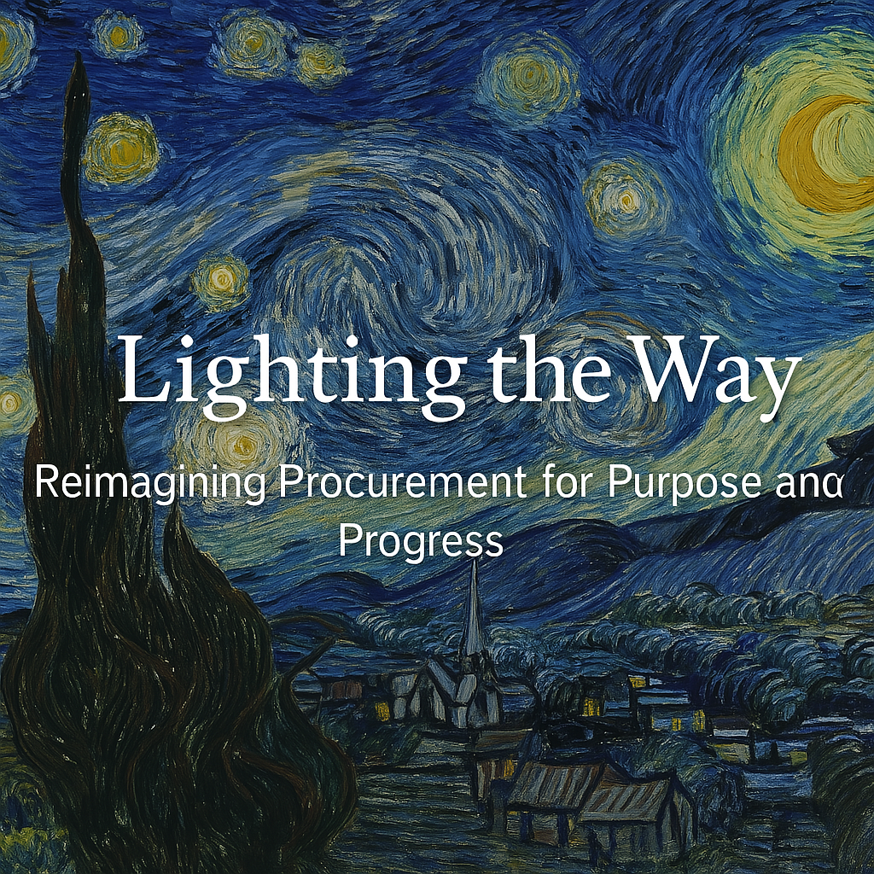

Slide 5

The Need for Change in Procurement
Breaking Through Red Tape in Public Sector Procurement
Current Challenges: Slow, cumbersome processes; opaque decision-making; fragmented systems.
Impact on Public Services: Delayed projects, missed opportunities for innovation, and increased costs.
The Opportunity: Innovative strategies and technologies can streamline procurement, increase transparency, and unlock greater public sector impact.
W Smart Procurement Conference 2025
Notes:
“Procurement in the public sector faces significant challenges—complex regulations, slow-moving processes, and high levels of bureaucracy often get in the way of timely service delivery. The reality is, these inefficiencies often result in delayed projects, frustrated suppliers, and missed opportunities for innovation. The good news is that there’s a huge opportunity here: by adopting innovative tools and processes, we can reduce red tape, speed up decision-making, and ultimately create more impactful public services.”

Slide 6
Shining a Light on Emerging Trends & Technologies
"Innovation Lighting the Way, While Managing Risks"
Risk: Uncertain long-term financial benefits of decisions, especially in the short term.
Risk: Bias in AI algorithms; over-reliance on automation - errors or inefficiencies.
Risk: Technology complexity and the initial cost of integration in legacy systems.
Risk Mitigation: Start small with specific, high-value use cases (e.g., contract transparency or traceability) before scaling.
AI in Procurement
Blockchain for Transparency
Sustainability in Procurement
Risk Mitigation: Ensure AI systems are transparent, ethical, and regularly reviewed for bias. Train procurement teams to understand and interpret AI-generated insights.
Risk-Averse Culture: Experiment with AI in controlled pilots- test and adapt before full-scale implementation.
Risk-Averse Culture: Advocate for a growth mindset—help users to see blockchain’s value as a strategic investment in efficiency and security.
Risk Mitigation: Use data analytics to measure potential ROI e.g., reduced energy consumption / supplier diversification.
Risk-Averse Culture: Align with public sector goals (e.g., carbon neutrality, community well-being) and foster collaboration across departments to support initiatives.
Notes:
“Now, let’s shine a light on some of the emerging trends and technologies that can transform procurement, especially in the public sector. First, AI is playing a key role by automating repetitive tasks like vendor selection or invoice processing, allowing procurement teams to focus on strategic activities. However, we need to ensure that AI is transparent and ethical—it's important that we train our teams to oversee AI systems and avoid over-reliance.
•Blockchain, on the other hand, can bring transparency and security to contracts. For example, it allows us to trace every step of a contract, ensuring that nothing is tampered with. While blockchain technology may seem complex, starting small with specific applications like contract transparency can offer huge rewards.
•Lastly, sustainability is becoming a crucial part of procurement strategy. Governments, for instance, are increasingly adopting green procurement policies, focusing on eco-friendly materials and ethical labor. This not only aligns with broader public sector goals but also addresses the growing demand for responsible sourcing.”
• ________________________________________

Slide 7
The Visionary Mindset in Procurement
"Leading with Vision, Not Fear: Mitigating Risks While Embracing Innovation"
Procurement Comes with Risk — But Risk Can Be Managed.
Types of Risk: Financial (cost overruns), reputational (supplier issues), operational (disruptions), and compliance (regulatory missteps).
Smart Strategies:
Diversify: Don’t rely on one supplier — balance cost, reliability, and sustainability.
Do Your Homework: Vet suppliers carefully to avoid fraud or failure.
Plan for the Unexpected: Include contract flexibility and backup supply options.
Avoiding a Culture of Fear:
Make Space for Innovation:
Encourage trying new ideas, even if they don’t work out right away.
Safe-to-Fail Pilots: Start small with new tech or suppliers.
Learn, adapt, and scale what works.
Notes:
“Innovation starts with mindset. It’s not just about adopting tools—it’s about seeing procurement as a driver of value and change.
Procurement leaders must think beyond savings and compliance.. Procurement teams need to be strategic leaders, helping their organizations navigate complex global supply chains, identify opportunities for value creation, and align procurement strategies with broader organizational goals.
•In the public sector, procurement can uplift communities, promote equity, and support sustainability. By viewing procurement as a tool for positive change, we can break away from traditional approaches and truly create value for the community.”

Slide 8
Key Players in the Industry: Stars Leading Change
"Spotlight on Procurement Leaders"
SAP Ariba:
Leading with AI, blockchain, and data-driven procurement processes.
Unilever:
A champion of sustainable sourcing and transparency in procurement.
Amazon:
Pioneering AI, robotics, and supply chain automation in procurement.
The City of Toronto: Using AI and predictive analytics for smarter, more responsive procurement.
UK Government:
Modernized public procurement with digital platforms like the Digital Marketplace, reducing red tape. Prioritises agile procurement for fast, efficient public sector purchasing.
United Nations Procurement Division (UNPD)
Manages procurement for UN agencies worldwide, emphasizing sustainability and transparency. Focuses on fair competition and supplier diversity.
European Union Public Procurement System:
Integrates Green Public Procurement (GPP) to prioritize sustainability. Promotes cross-border digital procurement using blockchain and AI.
Australian Government (Aus Tender & Digital Sourcing Framework):
Established digital procurement platforms for open, transparent bidding. Focuses on SME-friendly procurement processes through simplified contracts
RSA
National Treasury: Procurement Digitalization Efforts - Rolling out e-Tender portals to centralize procurement opportunities.
Western Cape Government’s eProcurement Solution (ePS):
Digital procurement system reducing manual paperwork. Enhances transparency, efficiency, and supplier accessibility for public tenders.
W Smart Procurement Conference 2025
Notes:
“Just as stars light the way for travelers, some key players in the procurement world are leading the way in innovation. Let’s look at a few shining examples. SAP Ariba, for instance, has revolutionized procurement with its use of AI and blockchain to automate processes, ensure transparency, and provide data-driven insights. Then there’s Unilever, which has embedded sustainability into its procurement practices, ensuring ethical sourcing while reducing environmental impact.
In the public sector, we can look to examples like the UK government’s National Procurement Service, which has streamlined procurement across departments, reducing costs and increasing efficiency. In RSA the NT focuses on digitization through the eTenders Portal and our own WCG ePS has stood the test of time and revolutionised tendering through a digital platform. These organizations and individuals are helping guide the rest of us toward more efficient, transparent, and impactful procurement processes.”

Slide 9
Public Sector Innovations: Real-World Examples
"Government as a Beacon of Change—Balancing Risk and Reward"
"Government as a Beacon of Change -
Balancing Risk and Reward"
GOVERNMENT DIGITAL SERVICES (GDS):
Digital transformation can fail if not implemented properly
Create change management programs and collaborate with consultants and key stakeholders to ensure smooth transitions.
Prioritise building a culture of learning and innovation. Embrace digital tools in stages, maintaining flexibility and adaptability, and allowing employees to learn on the job
1
BLOCKCHAIN IN PUBLIC CONTRACTS:
Uncertain scalability and integration with existing systems - Start with small-scale blockchain applications, such as in specific contracts or pilot projects.
Its important to view blockchain as a future-proof investment that brings both transparency and efficiency, making incremental adoption key to minimizing risks.
2
Notes:
“Now, let’s look at some public sector innovations. Across the globe, governments are stepping up: The Government Digital Services (GDS) initiative in the UK is a great example of how technology can simplify procurement processes across government departments. By implementing digital platforms, GDS has reduced paperwork and sped up procurement cycles.
In Australia, the government is using blockchain technology for public contracts, ensuring greater transparency and reducing the risk of fraud. Locally, many governments are focusing on sustainable procurement, prioritizing eco-friendly suppliers and materials in their projects. These examples show how the public sector can lead the charge in adopting innovation—not just in technology, but also in how we approach procurement strategically.”

Slide 10
Clarity Amidst Complexity – Tools for Navigating Procurement
“Empowering Teams to Manage Risks while Seizing Opportunities"
Risk: The short-term cost of sustainability initiatives may appear prohibitive.
Risk: Reliance on algorithms that could miss human judgment or lead to inaccurate recommendations.
Risk: Technology is still evolving, and some government systems may not be fully compatible with blockchain.
AI in Data Analytics
Blockchain for Secure Contracts
Sustainability Matrics
.
Combine AI with human oversight. Ensure that procurement teams can understand and adjust AI-driven insights.
Use AI as a tool for decision support rather than decision-making alone. This maintains human judgment and accountability in the procurement process.
Collaborate with tech experts and start with modular solutions that don’t disrupt existing systems.
Champion the concept of “slow innovation” in the public sector—gradually adopting new technology rather than avoiding it due to potential risks.
Create long-term cost-benefit analyses that showcase the true value of sustainability in procurement, such as cost savings from energy efficiency and brand reputation.
Encourage public procurement teams to integrate sustainability into their core values, viewing it as an essential, not optional, goal.
Notes:
“Now, let’s talk about how we can make sense of the complexity in procurement. One key tool is AI and data analytics. AI helps procurement teams make sense of large amounts of data, allowing them to make more informed, predictive decisions, reducing risks and inefficiencies. For example, AI can help forecast price changes or supply chain disruptions, enabling proactive action.
Blockchain can also help bring clarity, especially in contract management. By providing secure, tamper-proof records, blockchain ensures that both the public sector and suppliers can trust the procurement process. Lastly, sustainability matrics are becoming an important part of procurement decision-making, ensuring that public sector projects align with long-term environmental and social goals.”

Slide 11
Cultivating an Innovative Mindset in Procurement
THE POWER OF MINDSET:
Innovation begins with how procurement teams think—being curious, open to change, and willing to experiment. In the public sector, this means shifting from rigid processes to an entrepreneurial, problem-solving approach.
HOW TO FOSTER INNOVATION:
Break Down Silos: Encourage collaboration across procurement, finance, legal, and other teams to unlock diverse thinking.
Embrace Smart Risk-Taking: Create a culture where it’s safe to experiment and learn from failure.
Lead by Example: Innovation starts at the top. Leaders must model and support new ways of thinking.
Invest in People: Offer training that builds creative thinking, leadership skills, and awareness of emerging trends—not just tech.
"Shining with Creativity and Innovation: A Mindset, Not Just a Tool"
WC Smart Procurement Conference 2025
Notes:
“An innovative mindset in procurement doesn’t just come from adopting new technologies; it’s about fostering a culture of creativity, experimentation, and openness. To cultivate this mindset, procurement leaders must encourage cross-functional collaboration. When different departments work together—procurement, finance, legal, and others—they can bring diverse perspectives and produce more creative solutions.
We must also create a ‘fail forward’ culture. In other words, we shouldn’t fear failure; we should see it as a learning opportunity. For example, piloting new procurement models on a small scale allows teams to test ideas, learn from mistakes, and adjust as needed. Importantly, leadership must support this cultural shift. When senior leaders model a growth mindset and promote innovation, teams will follow suit.”

Slide 12
Reducing Red Tape & Administrative Burdens
How to Cut Through the Red Tape
Simplify the Paperwork: Use standardized, digital forms to reduce time spent on repetitive tasks.
Empower Decision-Making: Allow teams to make appropriate decisions without excessive approval layers.
Automate the Routine: Leverage tech to handle tasks like data entry, compliance checks, and contract management—freeing up time for strategic work.
Clarify the Process: Clear, consistent guidelines help teams act with confidence and reduce unnecessary holdups.
Streamline Workflows: Review and remove steps that don’t add value—like redundant approvals or overly complex vendor criteria.
Use Frameworks: Set up agreements with preferred suppliers to avoid starting from scratch every time and build long-term partnerships.
The Red Tape Challenge
Public sector procurement often gets bogged down by complex rules, strict compliance, and slow approvals—leading to delays, inefficiencies, and frustration for teams and suppliers.
Notes:
“Red tape and administrative burdens are a major pain point in public sector procurement. But these can be reduced by simplifying processes and adopting leaner methods. For example, we can simplify paperwork by standardizing forms and templates, reducing the time spent on repetitive documentation. Moving to digital forms wherever possible cuts down on manual work.
Empowering teams to make decisions at lower levels can also reduce the need for multiple layers of approval, speeding up the procurement process. Additionally, we can automate routine tasks like data entry or contract management, freeing up procurement professionals to focus on more strategic work. Lastly, by reviewing and streamlining the entire procurement process, we can eliminate steps that don’t add value and focus on delivering outcomes efficiently.”

Slide 13
Innovation Beyond Technology
Innovation Doesn’t Always Mean High-Tech Solutions
Innovation can be as simple as rethinking how we work. Small changes in process, mindset, or relationships can drive big impact—with no tech required.
Low-Tech Ways to Innovate
1. Collaborative Sourcing: Involve stakeholders early to co-create solutions and build stronger supplier partnerships.
1
2. Supplier Development: Help suppliers improve performance to reduce delays and boost quality.
2
3.Lean Procurement: Cut out waste and focus on what truly adds value.
3
4. Simplified Engagement: Make it easier for suppliers to work with you through faster, clearer communication.
4
"Innovation is More Than Technology: Creative Approaches to Procurement"
Notes:
“Not all innovation in procurement needs to be driven by technology. Innovation can also be found in how we approach processes and relationships. For example, collaborative sourcing allows teams to co-create solutions with suppliers, ensuring that both parties are aligned and can deliver maximum value. Similarly, developing supplier programs where we invest in improving supplier capabilities not only strengthens relationships but also improves overall procurement outcomes.
Lean procurement is another non-tech approach. By applying lean principles, we can eliminate waste and ensure that every step in the procurement process adds value. Finally, by developing streamlined supplier engagement processes, we can reduce the time and effort spent on managing vendor relationships, improving communication, and ultimately increasing efficiency.”

Slide 14
Building an Innovative Procurement Culture—A Summary
"From Red Tape to Opportunity: Leading the Way to Simplified, Efficient Procurement"
Cultivating an innovative mindset requires a shift from fear of failure to a culture of experimentation, creativity, and learning.
1
Not all innovation is technology-driven—streamlining processes and fostering collaboration can drive as much impact as technological change.
2
Reducing administrative burdens can be achieved through simplification, automation, and empowerment, enabling procurement professionals to focus on value-driven decisions.
3
"Stars don’t shine by standing still. Let’s navigate procurement toward a brighter, simpler, and more impactful future."
Notes:
“Building an innovative procurement culture requires a shift in mindset—one where creativity, experimentation, and collaboration are valued. It also involves simplifying processes, reducing administrative burdens, and empowering teams to make decisions. By embracing both technological and non-technological innovations, we can create a procurement process that is not only more efficient but also more impactful, particularly in the public sector. Let’s leave today with a sense of purpose—innovation is the path to a brighter future for procurement!”

Slide 15

Notes:
“I’d love to hear from you all—what challenges are you facing in fostering innovation within your procurement processes? What steps have you taken to reduce red tape and streamline administrative burdens? Let’s have an open discussion and learn from each other’s experiences.”

Slide 16
Nadia Ebrahim
Head Asset Management
021 483 4748
nadia.ebrahim@westerncape.gov.za
1st Floor, 4 Dorp Street, Cape Town, 7441

