Slide 1
Department of Health and Wellness
Innovations in the Department of Health and Wellness
Sub-title
28 May 2025

Slide 2
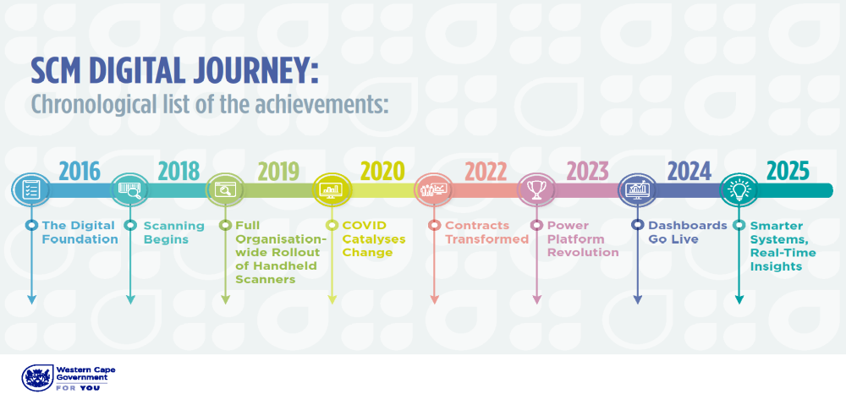
Timeline Digital Journey

Slide 3

Welcome to the Innovations Journey
    Innovation in Action: The Digital Transformation Journey
    Real-world case studies from the Department of Health and Wellness
    Turning supply chain challenges into smart, scalable solutions
    From fragmented systems to integrated digital platforms
    Driving impact through innovation, data, and technology
    Delivering better public health outcomes with smarter procurement

Slide 4
Early SCM Challenges (2016)
    Early challenges Excel documents on SharePoint
    In 2016, Supply Chain Management depended almost entirely on Excel, PowerPoint and manual workarounds.
    The launch of the Essential Supplies List (ESL) was a milestone, but instability remained.
    Files crashed unpredictably, and there was no unified version control.
    Each hospital maintained its own copy, resulting in fragmented, error-prone data. The process was as disjointed as a braai without pap, effective in theory, chaotic in practice.

Slide 5
Barcode Scanning Rollout (2018–2019)
    2018: Introduction of Barcode Scanning
    Major advancement in asset verification, replaced manual entry with scan-based data capture
    Institutions still relied on offline Excel exports for reconciliation
    No real-time tracking or centralized system in place
    2019: Scanner Deployment & Training
    Organization-wide rollout of handheld scanners and user training completed
    Comprehensive barcode-label campaign launched to tag every asset
    Foundation set for future real-time inventory and dashboard integration

Slide 6
Real-Time Data Imperative (2020)
    2020: COVID-19 Catalyst
    Pandemic urgency exposed critical gaps in SCM data timeliness and accuracy
    SCM’s Response
    Automated data integration across LOGIS, PERSAL, KITSO, EPS and other systems
    Built real-time dashboards for instant visibility
    Standardized “clean” data, no more manual Ctrl +C workarounds
    Key Challenges
    No direct ownership of transversal systems, automation complexity
    Slow or unreliable internet at rural facilities
    Limited BI user licenses constraining access
    Environmental stability issues in Azure deployments

Slide 7
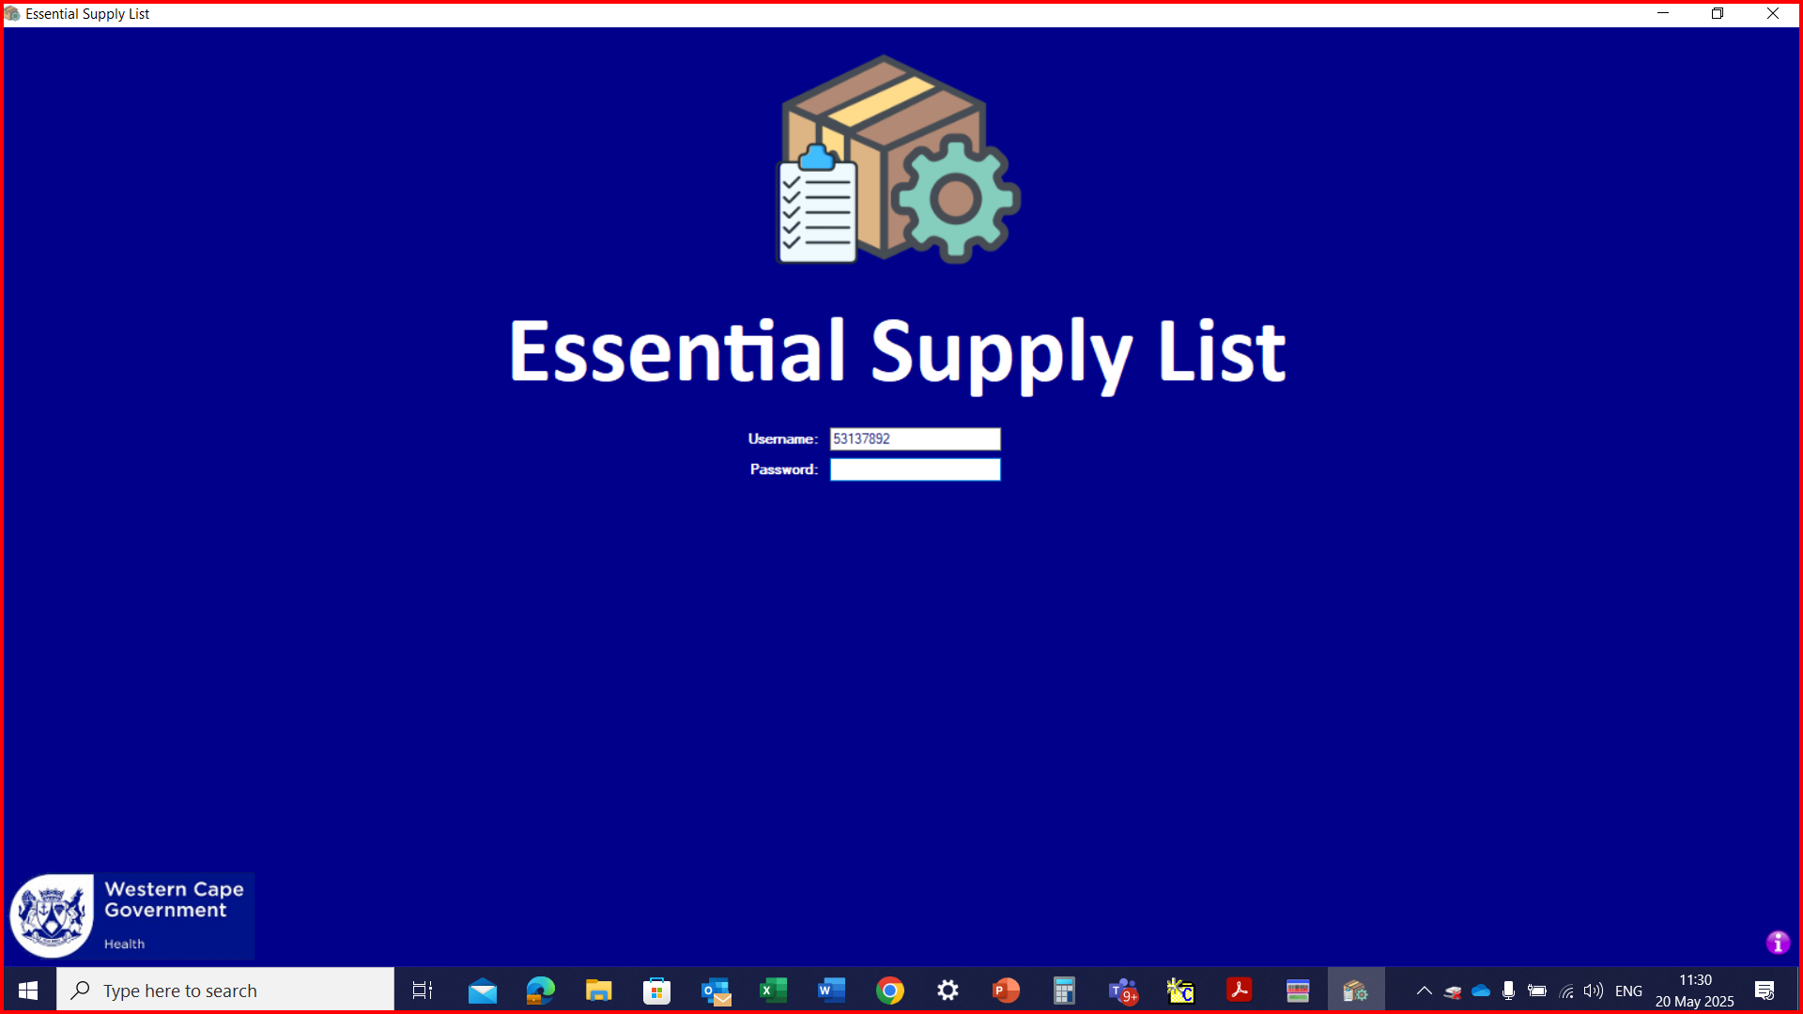
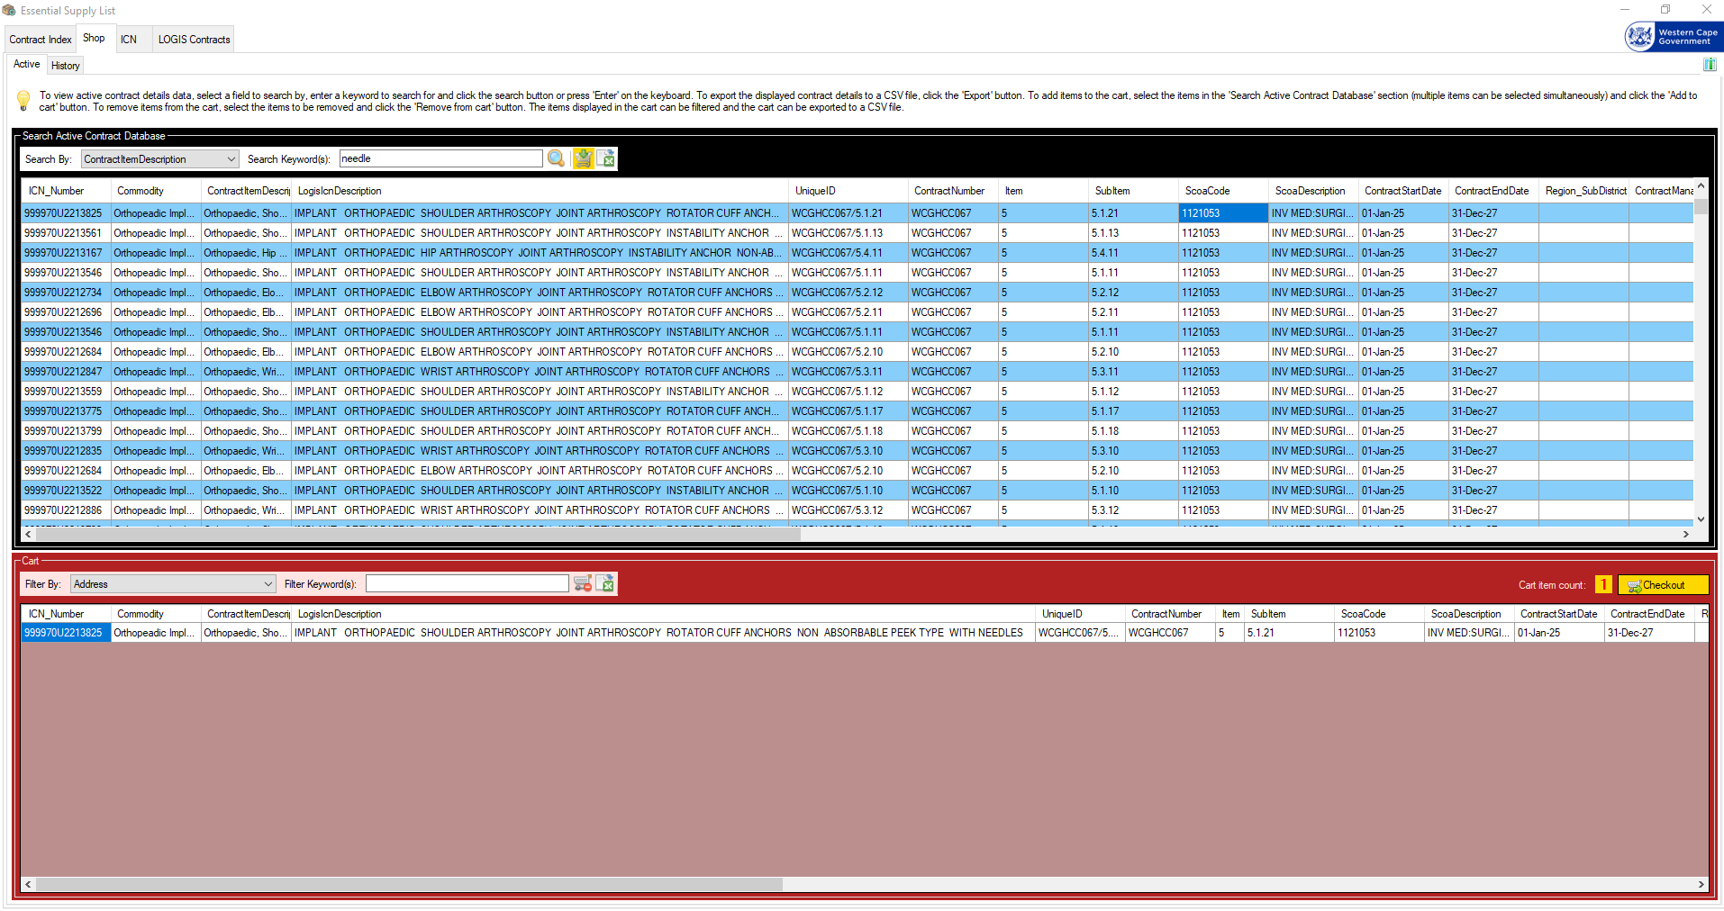
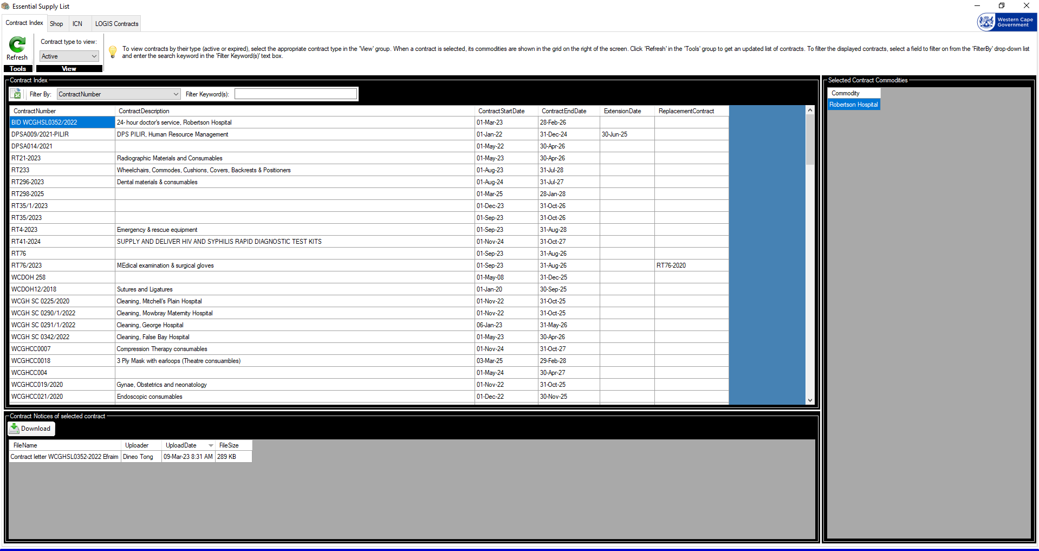
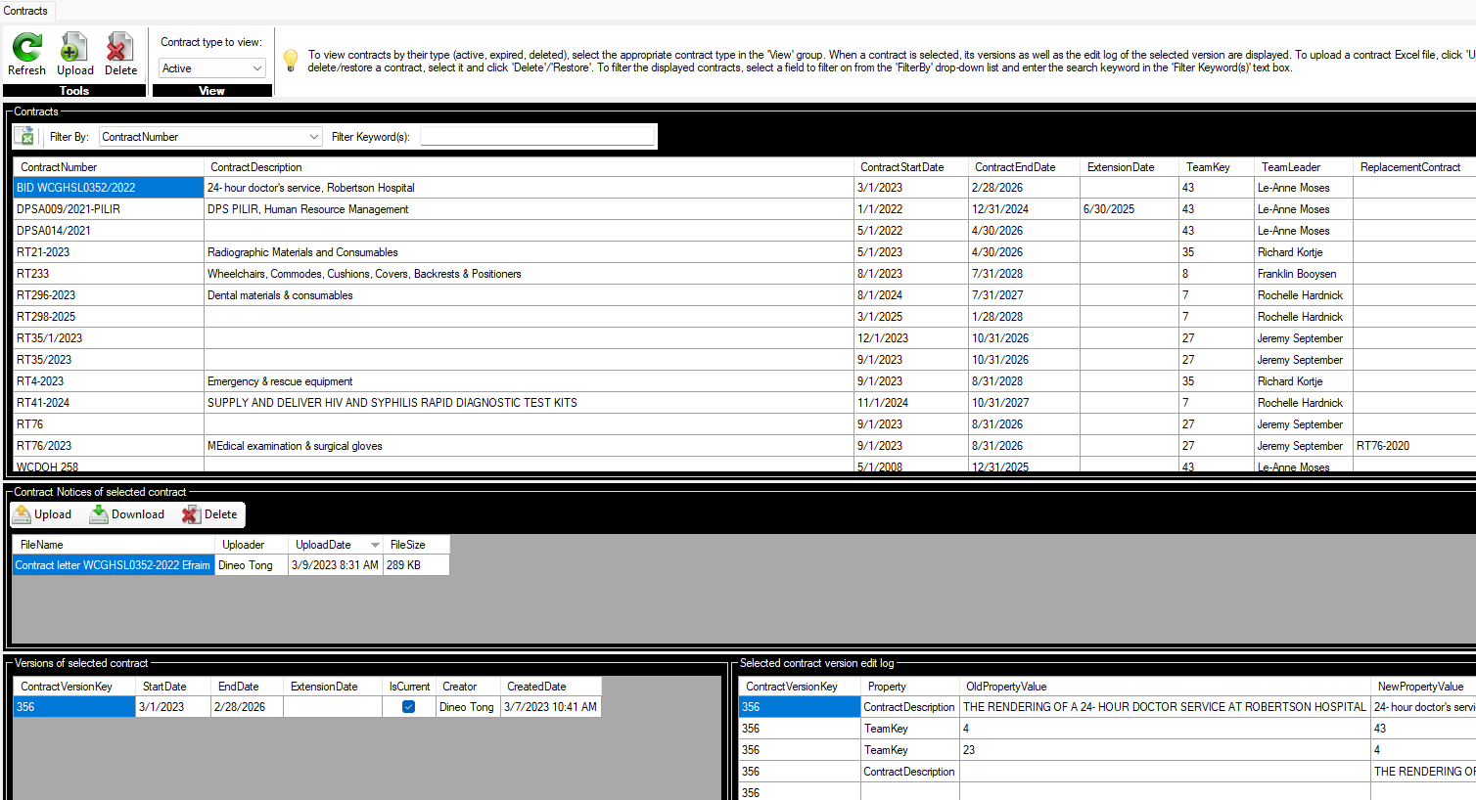

From Excel Chaos to Award-Winning Innovation
    2022: Desktop Application Rollout
    Transversal contract desktop application launched, managing 135 contracts and 11,000+ items
    Live access for 57 hospitals and nearly 1,000 trained users
    Commodity managers empowered to upload and maintain contracts
    Next-Level User Experience
    Shopping-style interface with “smart checkout” that auto-populates LOG 1 forms
    Dramatically reduced errors and manual effort
    Recognition & Impact
    Multiple awards, including the Premier’s Office Innovation Award
    Turned Excel nightmares into a scalable, self-service solution
    From formula-driven chaos to an award-winning, user-friendly system—what a journey!

Slide 8
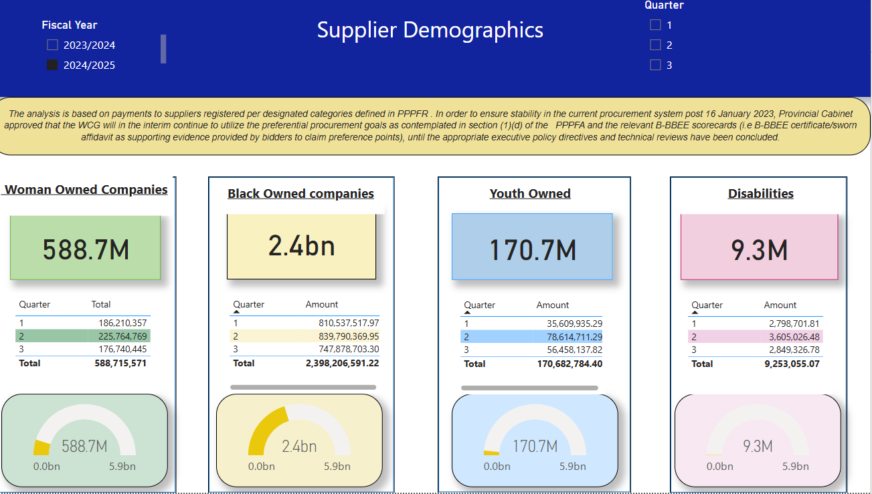
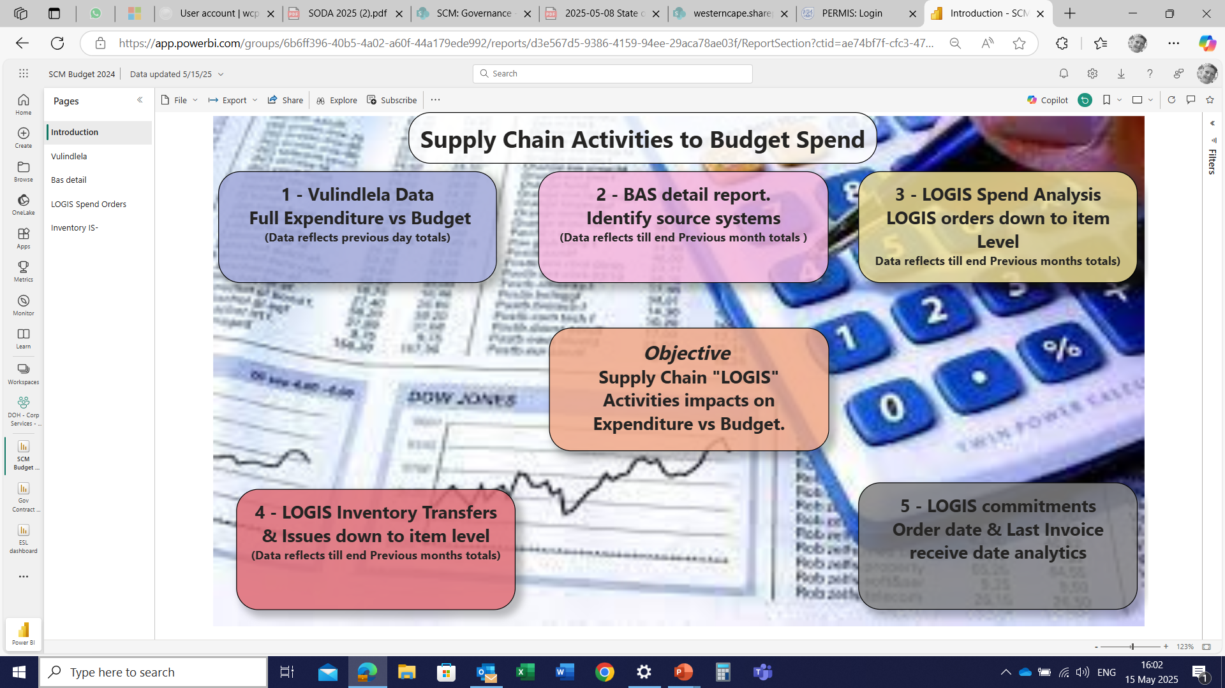
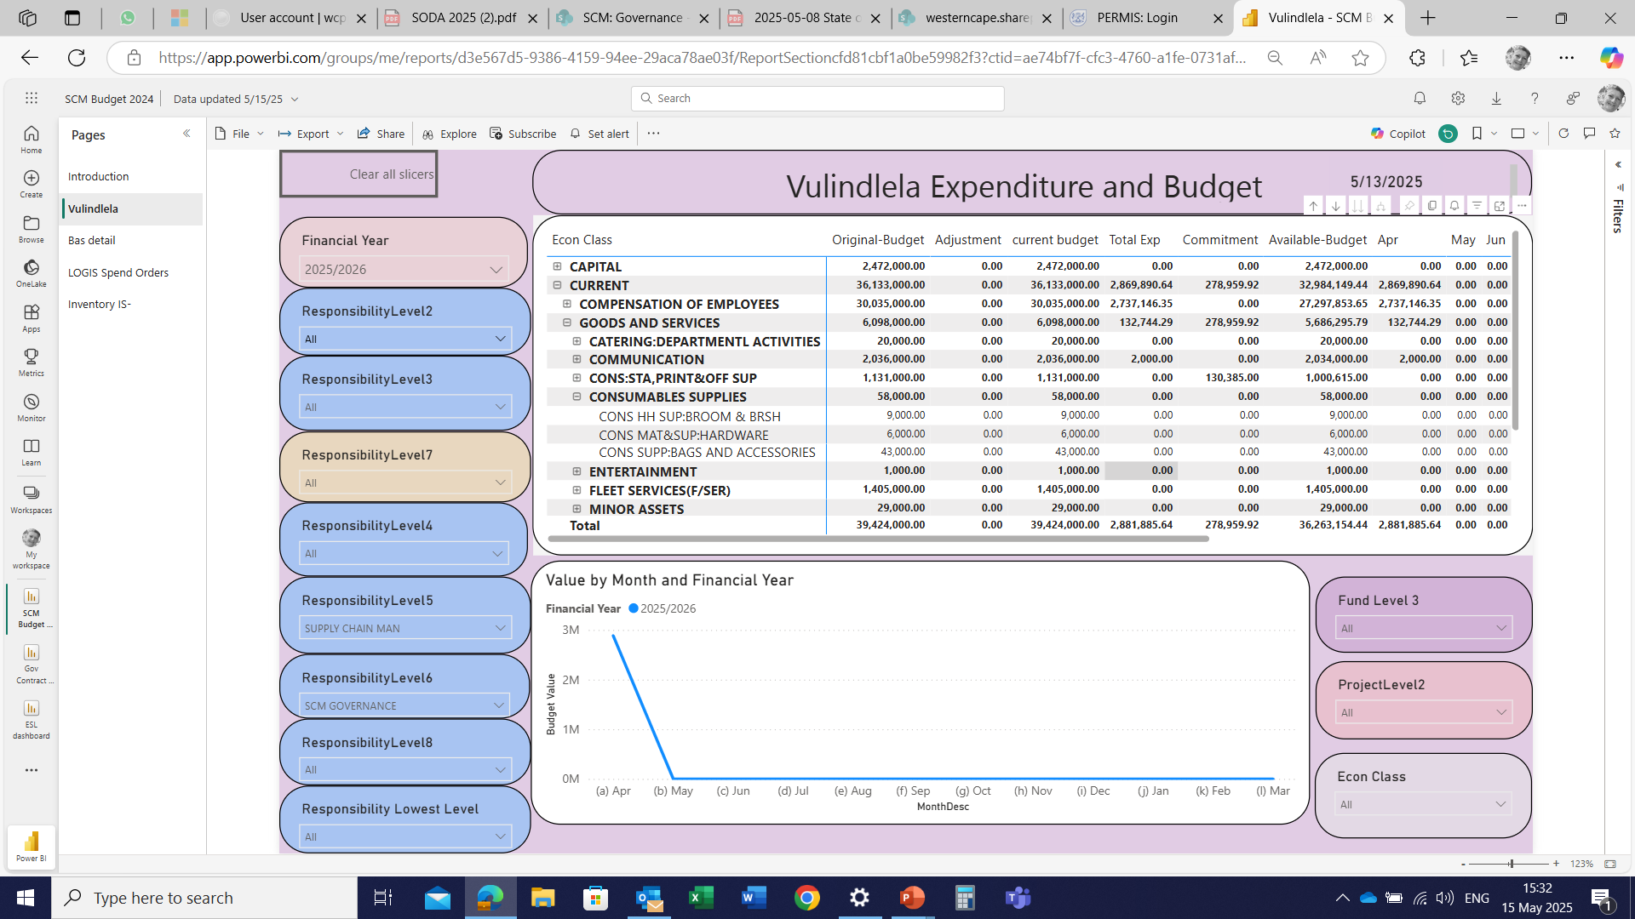
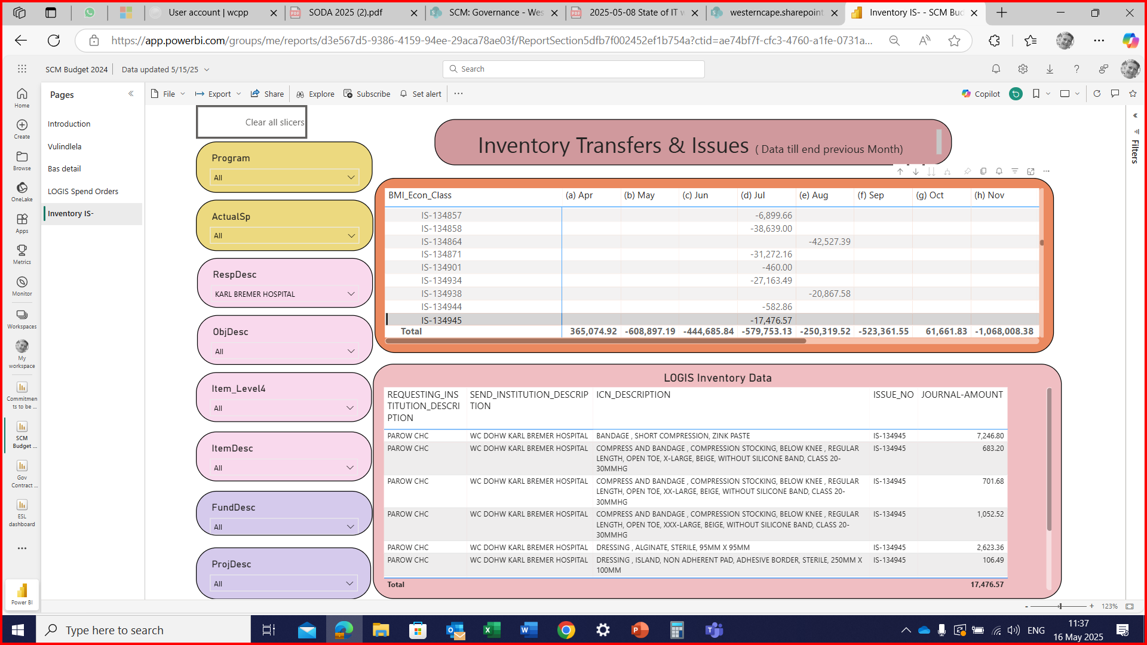
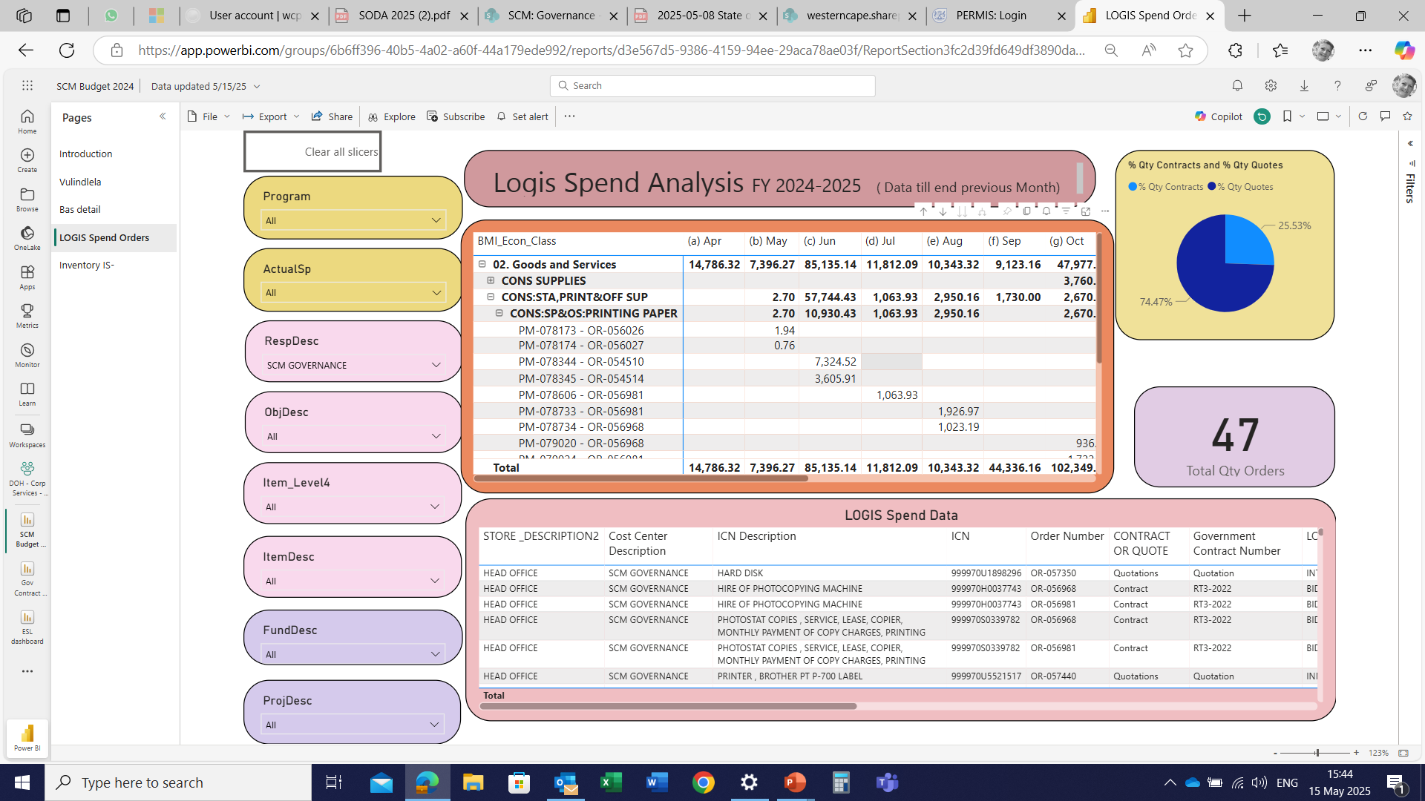
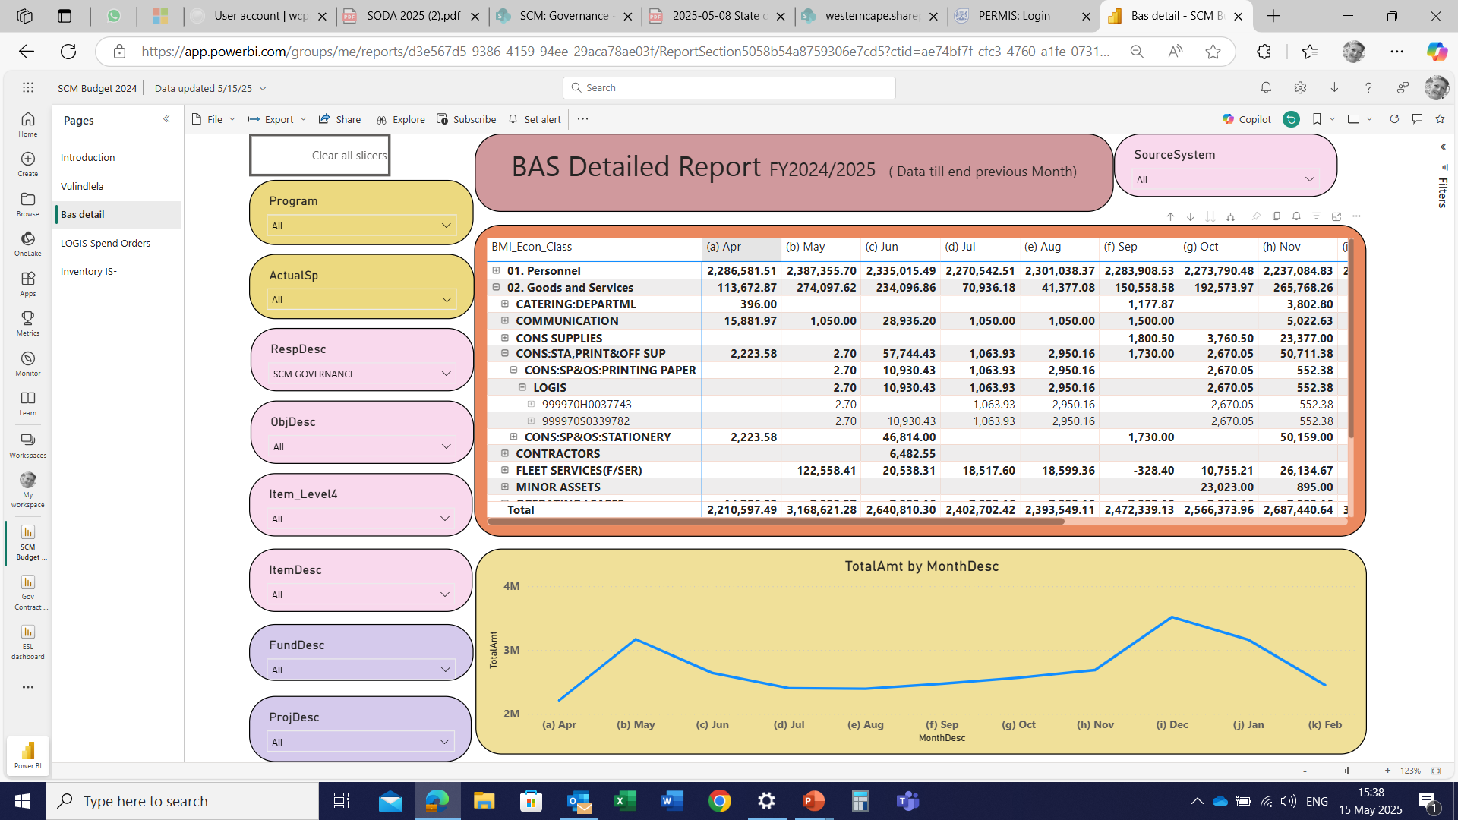
Centralized Data Cubes & On-Demand Reporting
Post-COVID Data Strategy
    Migrated disparate datasets into unified data cubes
    Defined relationships and DAX measures in Power BI for each cube
    Instant, Self-Service Analytics
On-demand reports:
    Annual performance on black-owned enterprise development
    Purchasing vs. procurement plan compliance
    And more, at the click of a button
Flagship Insight: Vulindlela Integration
    Direct linkage of SCM expenditure to the Vulindlela dataset
    Enabled deeper analysis of spending patterns and socio-economic impact
“From fragmented silos to centralized cubes—real-time insights are now just a dashboard away.”

Slide 9
Azure Optimization (September 2023 – January 2024)
    2023 Microsoft, Azure South Africa, Semantic Models
    Engaged Microsoft expertise to resolve performance and stability issues in our Azure cube environment
    Migrated Azure cloud storage from the Netherlands to a South African region for reduced latency
    Redesigned our data warehouse, transitioning from an OLAP cube model to a scalable semantic-model architecture
    Leveraged cloud-hosted semantic models for heavy data processing, using Power BI dashboards solely for visualization, significantly improving accessibility in rural sites with limited bandwidth

Slide 10
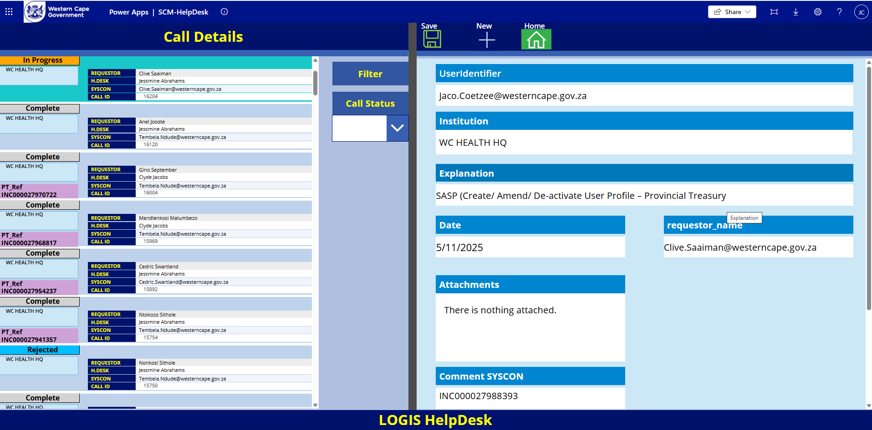
LOGIS Helpdesk Transformation
    December 2023 LOGIS Electronic Helpdesk
    Replaced chaotic email/Excel workflows with an in-house developed Power App based support platform
    Processes 1,000+ support calls monthly, complete with color-coded statuses and automated email notifications
    Delivers real-time dashboards for instant visibility into call volumes and resolution times
    The developer is nominated for a Smart Procurement Innovation Award
    Provincial Treasury has expressed interest in the application
    From fragmented chaos to a streamlined, digital helpdesk: a milestone in our innovation journey

Slide 11
Spend Analytics Rollout (March – April 2024)
    March 2024: Historical Spend Integration
    Imported spend data dating back to 2019
    Enabled staff and the Auditor-General to trace fund allocations over time
    Established a unified framework for cleaning and aligning spend categories across all facilities
    April 2024: Spend Dashboard & EPS Access
    Launched the Spend Dashboard on SharePoint, instant, self-service reporting for all users
    Eliminated ad-hoc phone requests and manual report distributions
    Secured access to the EPS container, unlocking new supplier insights (despite initial automation constraints)

Slide 12
Model Refinement & Dashboard Testing (May – June 2024)
    May 2024: EPS Model Stabilisation
    Diagnosed and repaired broken data relationships that surfaced “no-contract” supplier anomalies
    Retested end-to-end workflows, identified robust data keys, and formalised the semantic model structure
    Concurrent data-security consultations held with Provincial Treasury to safeguard sensitive information
    June 2024: Final Testing & Lessons Learned
    Completed final user acceptance testing on the SCM dashboard and semantic models
    Budget dashboard failure due to a .DAT upload instead of .CSV, resulting in data corruption and lost work
    Established strict pre-load validation and backup protocols to prevent future incidents

Slide 13
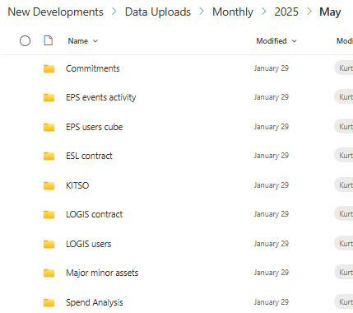

System Hardening & Automation (July – August 2024)
    July 2024: Damage Control & Secure Access
    Migrated dashboards into secured workspaces to prevent accidental deletions
    Re-submitted Sinjani geo-data request after initial submission went missing
    Expanded dashboard visibility, eliminated the need for Power BI Pro licenses
    August 2024: SharePoint-Driven Automation
    Designated a SharePoint upload folder as the LOGIS data “station”
    Automated server pickups, data delivery became as reliable as a Vespa courier
    Rebuilt the EPS model with robust backup protocols
    Enhanced inventory datasets with deeper semantic modeling
Key takeaway: Strengthening security and automating workflows paved the way for reliable, self-service analytics.

Slide 14
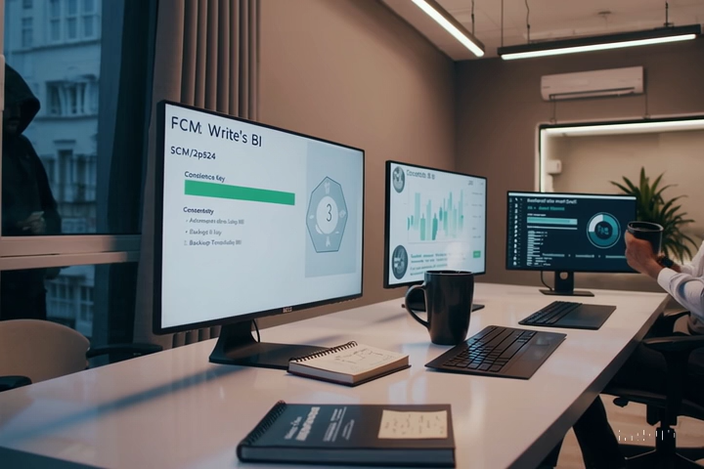
SQL Optimization & Resilience (Sep–Oct 2024)
    September 2024: “Let’s Do This Right”
    Abandoned slow PowerApps writebacks in favour of SQL-based solutions
    Asset-scan dashboards scheduled to refresh three times daily; attendance data four times
    Identified intermittent refresh failures, established consistency as the primary goal
    October 2024: Security Breach & Recovery
    Developer workspace was physically compromised, EPS model rebuild wiped out
    Rapid response: restored backups, reinforced access controls and backup protocols
    Launched Phase 3 enhancements: added disposals tracking and asset-transfer workflows
Key takeaway: Transitioning to SQL-driven processes improved performance—but true resilience combines rigorous testing with airtight security and backup discipline.

Slide 15
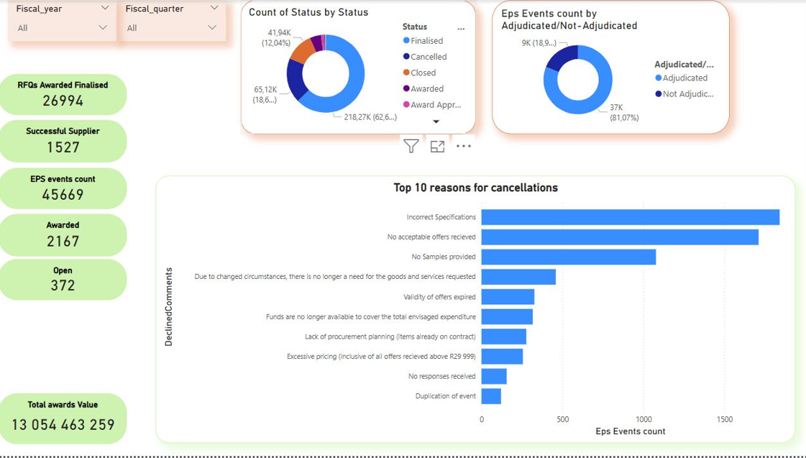
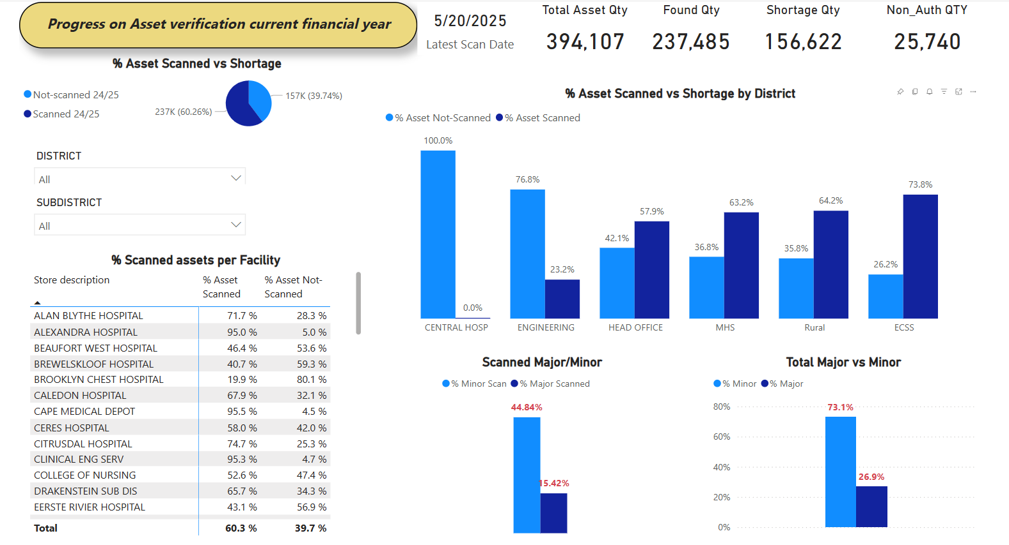
EPS Revitalisation & Asset-Scan Completion (Nov–Dec 2024)
    November 2024: EPS Model Rebuild & Validation
    Fully rebuilt the EPS semantic model with enhanced stability and performance
    Executed end-to-end testing across suppliers, EPS event workflows, and Sinjani geo-data feeds
    Introduced rural-tracking flags to capture remote asset movements
    December 2024: Asset-Scanning Model Finalisation
    Finalised the asset-scan solution, integrating scans, disposals tracking, and unauthorised-item alerts
    Deployed and began testing the EPS Helpdesk dashboard alongside the DOHW systems team
    Applied iterative “fine-tuning” to dashboard controls for precision issue-resolution
Key takeaway: A robust EPS foundation and fully featured asset-scan model now drive comprehensive, real-time asset visibility across the province.

Slide 16
SQL Transition & Dashboard Launches (Jan–Mar 2025)
    January 2025: Embracing SQL & BAS v6 Compliance
    Recognised Power BI writebacks were insufficient, adopted SQL as the primary writeback engine
    Refined dashboard fields and data mappings to align with BAS v6 requirements
    February 2025: Data Clean-Up & New Dashboard
    Resolved file-formatting issues: removed duplicated headers and filled blank rows
    Launched the Commodity Supplier Search dashboard, providing self-service supplier insights
    March 2025: Fully Automated Semantic Model & Dashboard Stability
    Completed and automated the EPS semantic model with live EPS, WCSEB, and Sinjani data feeds
    Published the Commodity Supplier Search and Asset Verification dashboards
    Achieved stable, real-time SCM dashboards, refreshing as reliably as Cape Town’s breeze
Key Takeaway:
A strategic shift to SQL and rigorous data governance enabled seamless, real-time analytics and empowered users with on-demand insights.

Slide 17
Data-Driven Transformation: Key Takeaways
    Better Data → Better Service
    Real-time visibility into spend, asset movements, and supplier performance
    Accelerates decision-making and enhances transparency
    Open, Scalable, Future-Proof Dashboards
    Built on open-source frameworks, easily extended for new requirements
    SharePoint “legendary” LOGIS uploads—warts and all—drove the need for stronger validation
    From Paint-Dry Writebacks to SQL Write Access
    PowerApps writebacks proved too slow—SQL became the efficient writeback engine
    Resilience & Innovation
    October’s EPS data loss sparked a rebuild that delivered a more robust model
    Continuous learning led to backup protocols, tighter QA, and rapid recovery
    The Big Picture
    The WC Department of Health & Wellness turned a fragmented, manual SCM process
    …into a unified, digital-first powerhouse powered by real-time dashboards
Thank you for joining the Western Cape Procurement Conference: Innovations Journey.
Now go forth—and always back up your dashboards!

Slide 18
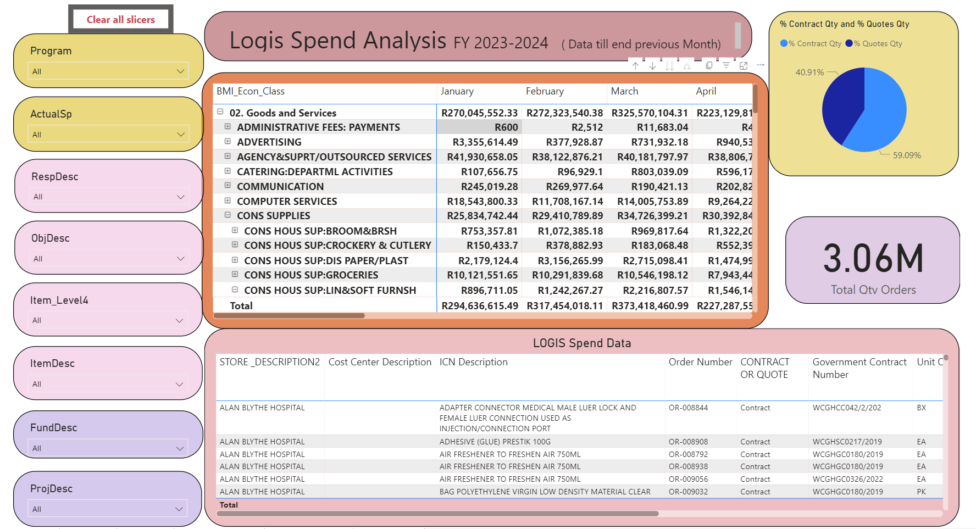
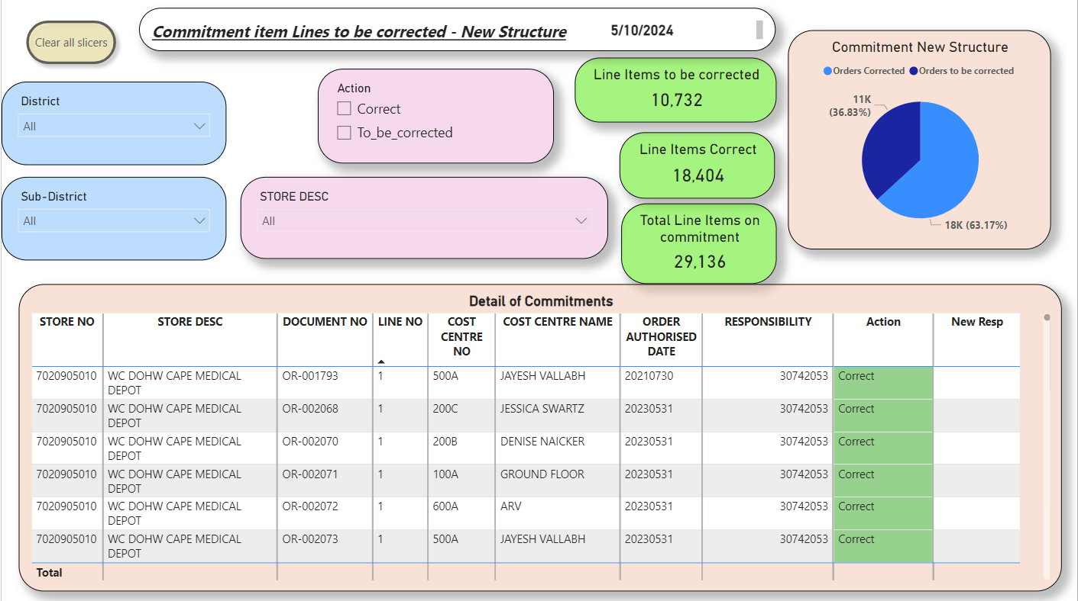
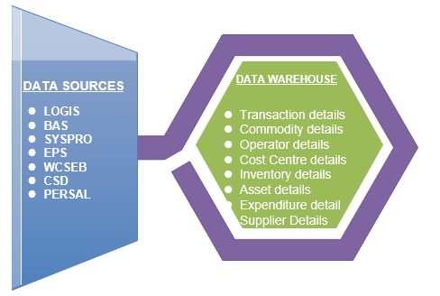
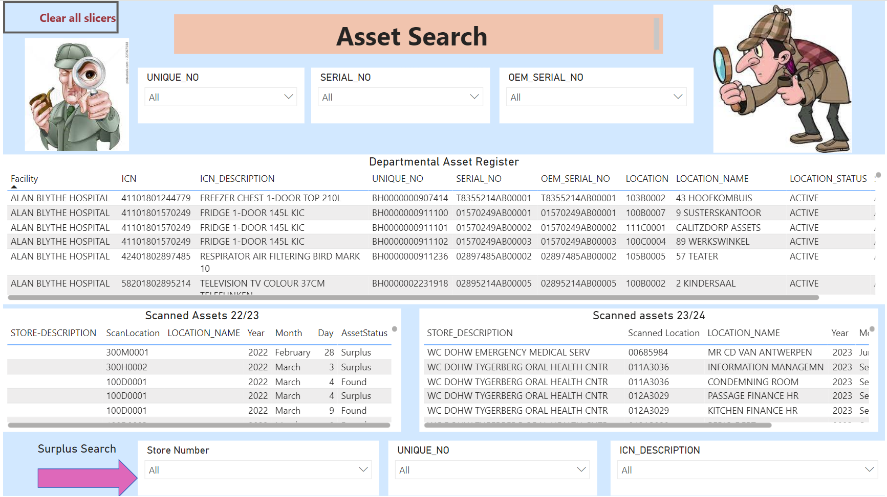
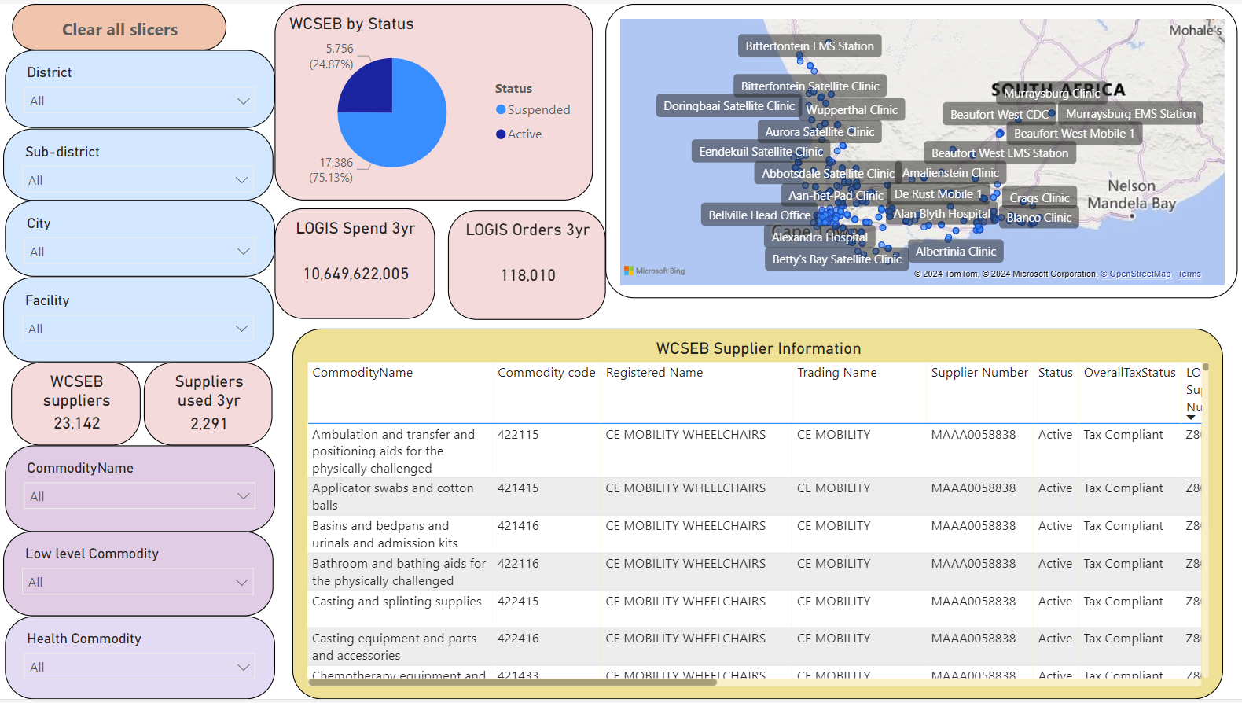
SCM Data Warehousing Project
Link to SCM Dashboard page - https://westerncape.sharepoint.com/sites/dohscm/governance/SitePages/Dashboards.aspx
SCM impact on Budget activities
What is DATA warehousing -
Commitments and Accruals
https://www.youtube.com/watch?v=AHR_7jFCMeY
Update daily Budget vs expenditure linked to item detail from LOGIS spend analysis
Asset verification
Supplier Search per commodity
Monitor Asset verification process at your facility and search DOHW scanned asset database for assets identified as shortage
Supplier search per item description for geographical area, with reference to correct commodity code to be used in EPS event

