Slide 1

From Confusion to Clarity:
Making Procurement AI Ready,
One Step at a Time
Caroline Lacocque, RVP Africa, Benelux & Nordics
28.05.2024

Slide 2

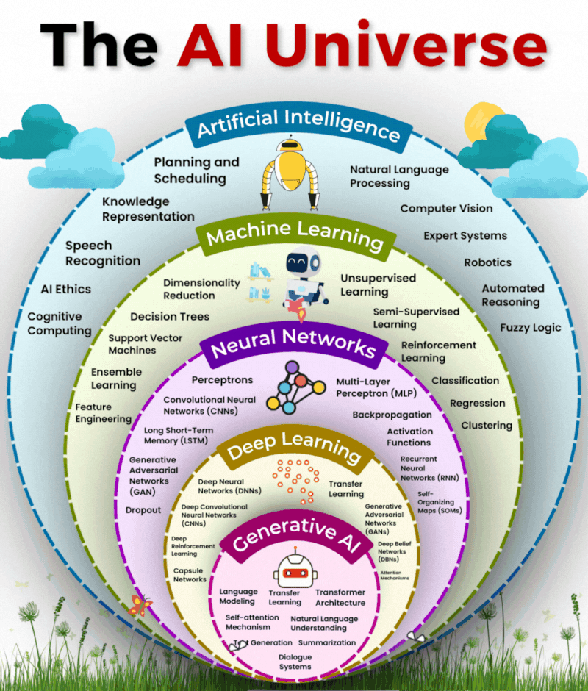

Notes:
Good morning/afternoon everyone, and welcome! We stand at the precipice of a new evolution – Generative AI. At Zycus, for many years we have strived to push boundaries and lead innovation.
Today, I want to introduce you to a technology that aligns perfectly with that vision: Generative AI.
According to analysts’ procurement is not untouched by the magic of Gen AI. While Gartner says that 80% of new enterprises procurement apps with use AI by 2025. Mckinsey confirms on the potential of unlocking trillions of dollars in savings with use of AI.
Early adopters are definitely going to gain an edge.

Slide 3
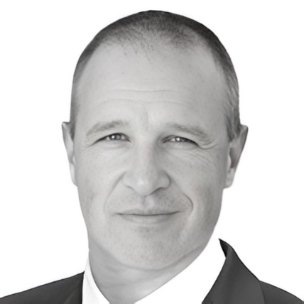

GENERATIVE AI IS A BIG DISRUPTER IN S2P
"Generative AI is poised to be the next game-changer in procurement, transforming the entire source-to-pay (S2P) process to unlock significant efficiency gains and cost savings for organizations."
Source: Alexander Linden, Research VP, Gartner
80%
$1 Tn
Of new enterprise procurement apps will use AI by 2025.
Worth of procurement savings can be unlocked with AI by 2025.
Notes:
Good morning/afternoon everyone, and welcome! We stand at the precipice of a new evolution – Generative AI. At Zycus, for many years we have strived to push boundaries and lead innovation.
Today, I want to introduce you to a technology that aligns perfectly with that vision: Generative AI.
According to analysts’ procurement is not untouched by the magic of Gen AI. While Gartner says that 80% of new enterprises procurement apps with use AI by 2025. Mckinsey confirms on the potential of unlocking trillions of dollars in savings with use of AI.
Early adopters are definitely going to gain an edge.

Slide 4


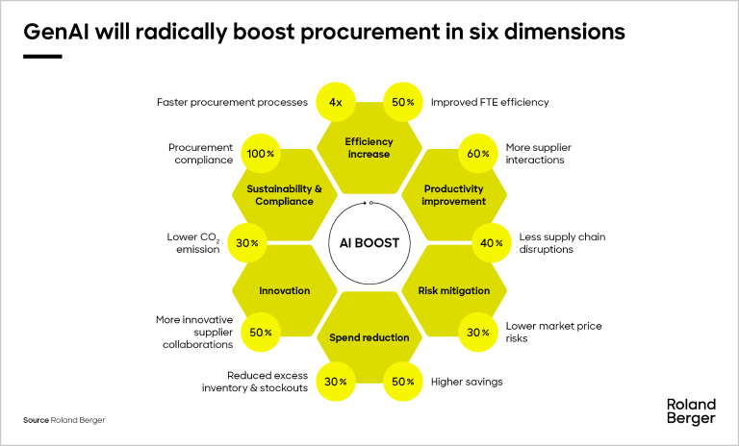


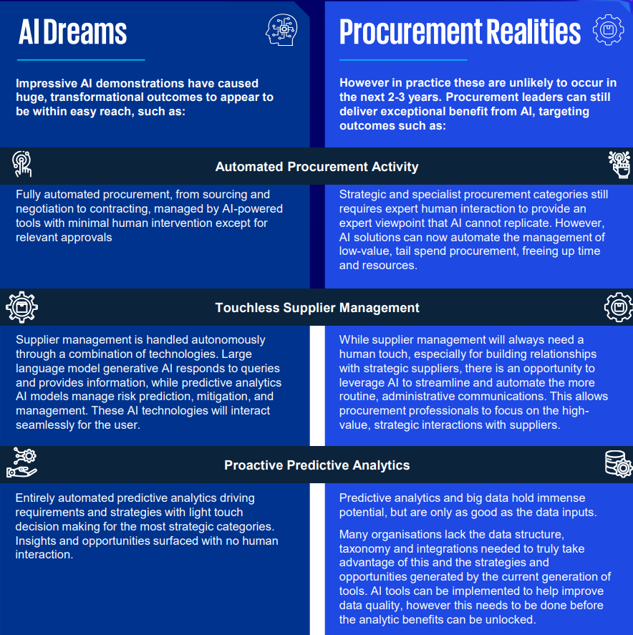
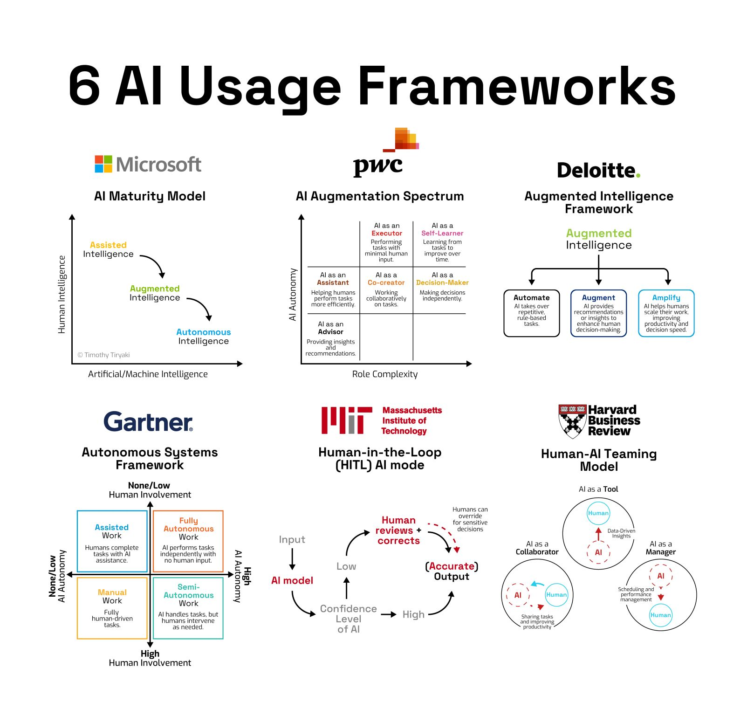
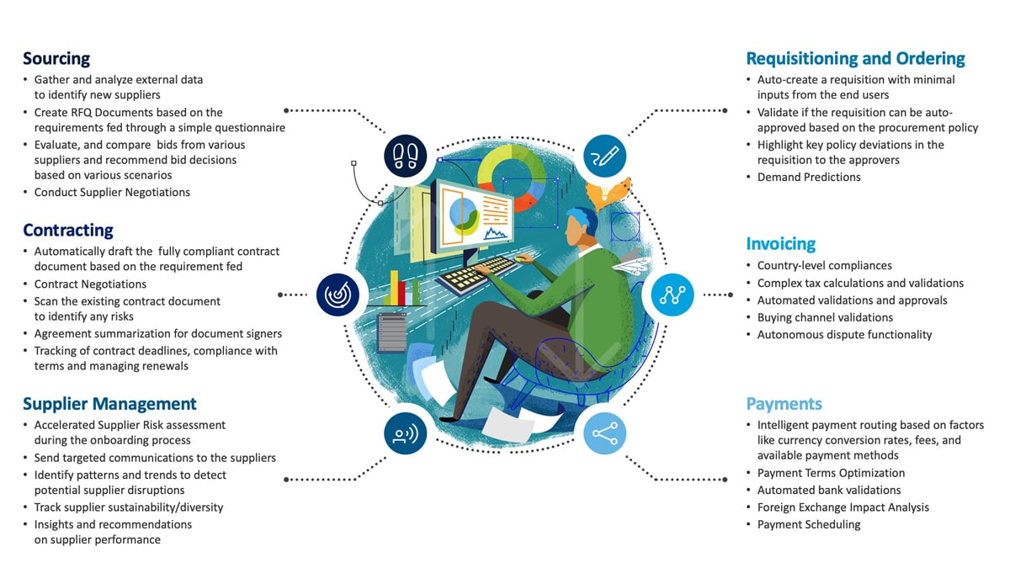
WHAT CAN GEN AI DO FOR PROCUREMENT?
Notes:
Good morning/afternoon everyone, and welcome! We stand at the precipice of a new evolution – Generative AI. At Zycus, for many years we have strived to push boundaries and lead innovation.
Today, I want to introduce you to a technology that aligns perfectly with that vision: Generative AI.
According to analysts’ procurement is not untouched by the magic of Gen AI. While Gartner says that 80% of new enterprises procurement apps with use AI by 2025. Mckinsey confirms on the potential of unlocking trillions of dollars in savings with use of AI.
Early adopters are definitely going to gain an edge.

Slide 5
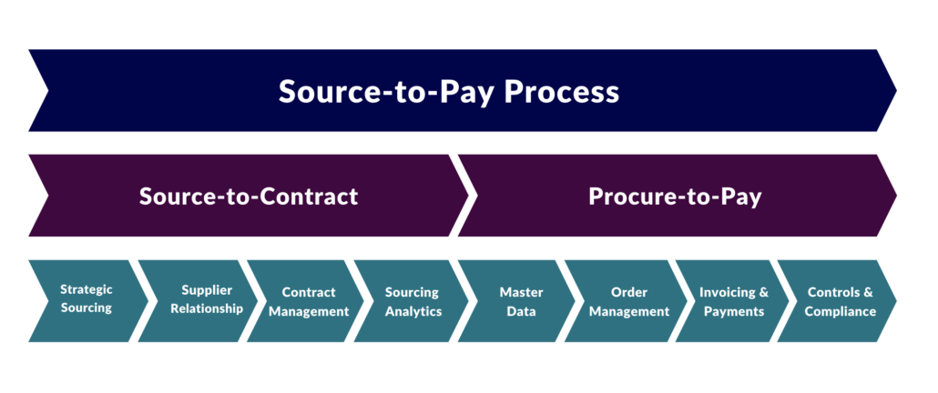

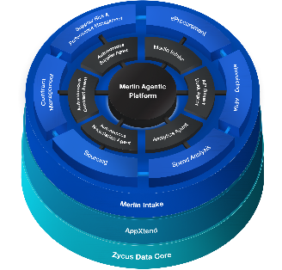
Prerequisite no.1 | your procurement processes!
1. Get on top of your procurement processes!
AI will
not fix
your processes!
2. Select an (AI supported) technology supporting these processes!
AI will
Support
Your processes!

Slide 6
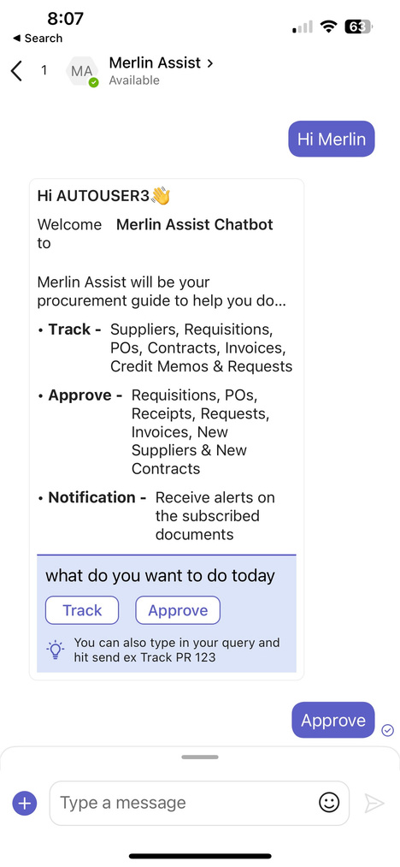
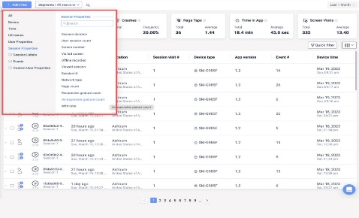
WHAT CAN GEN AI DO FOR PROCUREMENT?
1
ADOPTION
(Easy to Use)
Enhanced User Experience
For Everyone
Notes:
Why should procurement leaders pay attention to it?
GenAI is not just about automation; it's about creating a smarter, more efficient, and user-friendly procurement experience.
By leveraging GenAI, organizations can unlock significant benefits, improve productivity and compliance and giving organizations who make the shift a clear competitive leverage

Slide 7
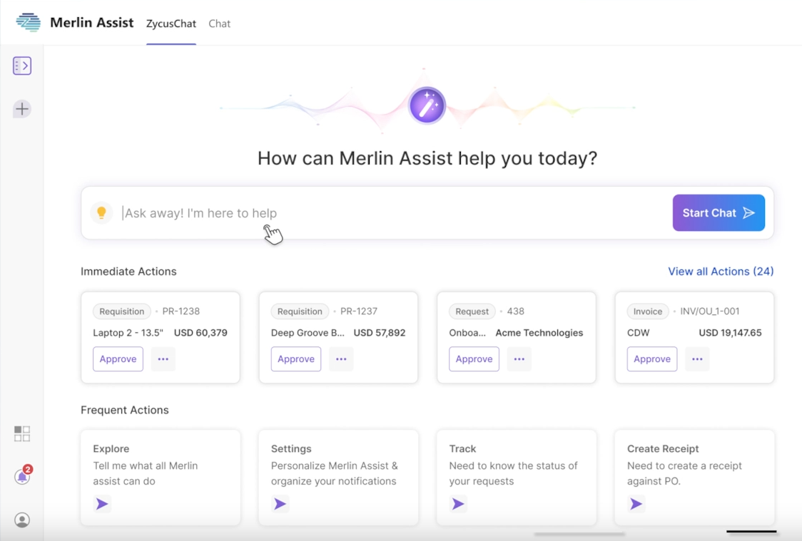
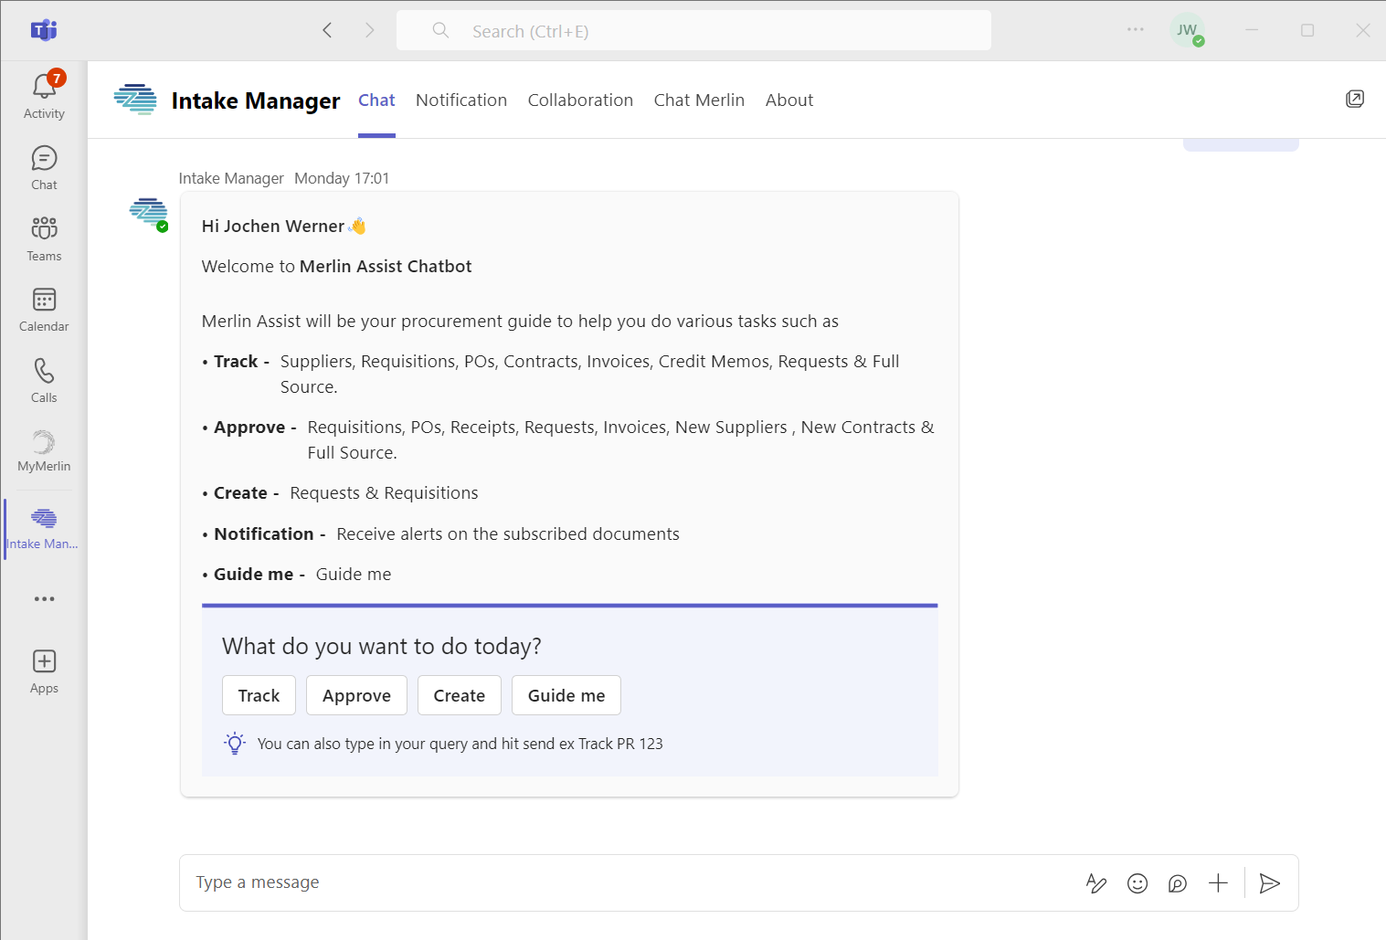
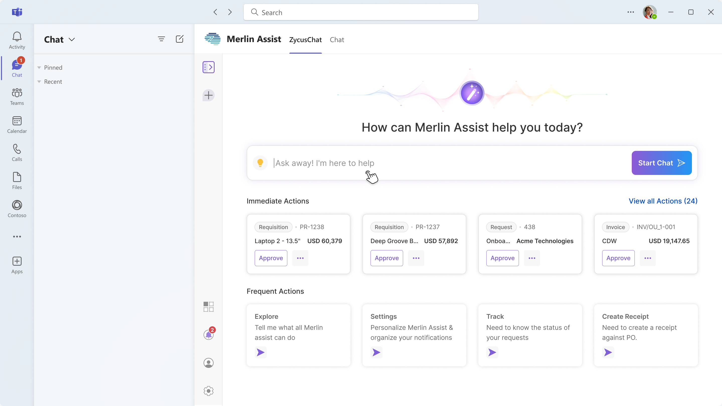
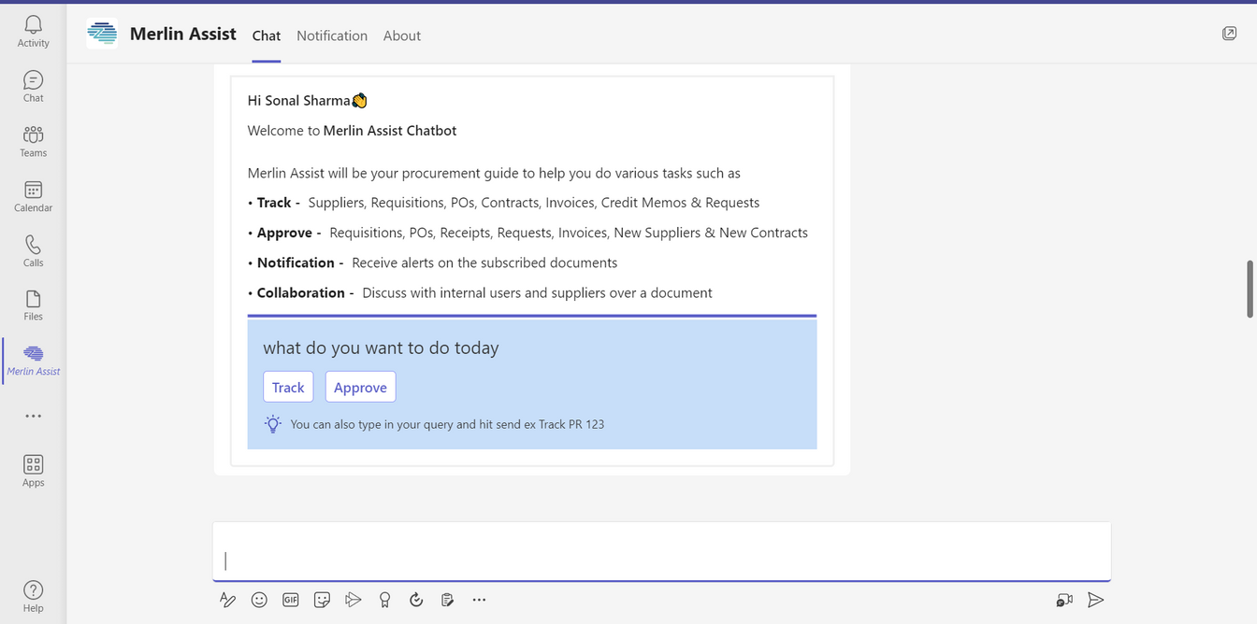
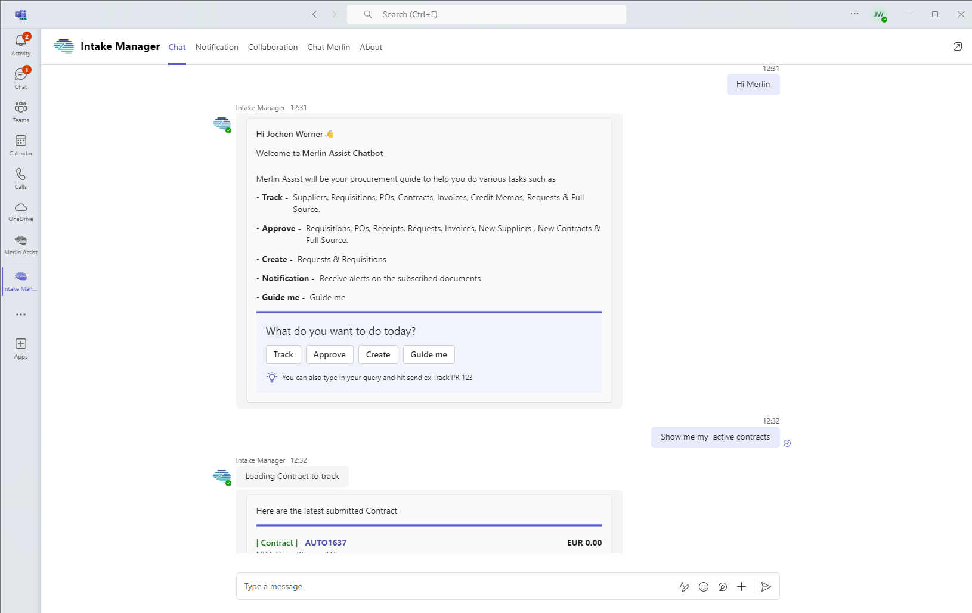
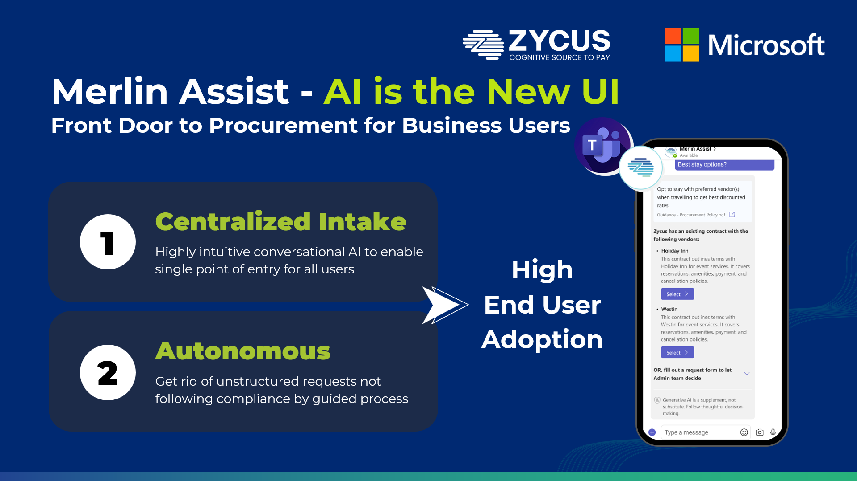


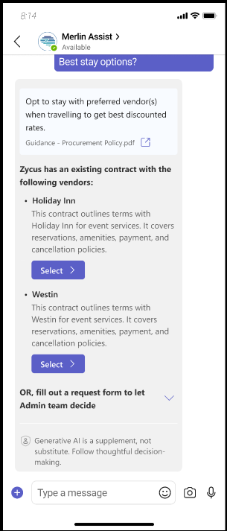



Merlin Intake - AI is the New UI
Front Door to Procurement for Business Users

Slide 8

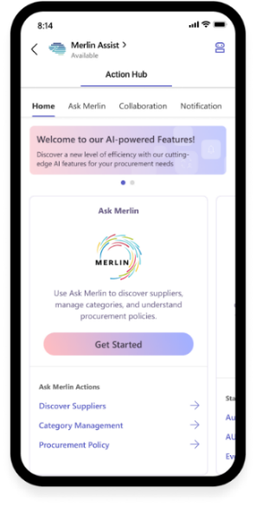



Merlin Intake within MS Teams, Slack or Webportal
Highly Configurable
Integrated into Source to Pay
S2P with Flow of Work
Platform allows you to create your tailored setup by enforcing policies that are important to your organization
Singular data lake to access information for each process of Source to Pay
No need to juggle between multiple applications, simply ask a query and get response
Request, Track and Approve Requisitions in Just Few Steps
Merlin Intake
Merlin Intake
Purchase Items in just a few Commands. Find contracts, events or suppliers easily by just asking.
How can Merlin Intake help you today?
Maintain compliance and provide guided intake
High adoption with proactive alerts, approvals, collaboration
Notes:
Let me show you how we make procurement truly effortless within your Microsoft Teams environment. Everything your teams need is right where they already work.
Look at the power this gives you - complete configurability to match your organization's unique needs. Your policies, your workflows, your way. But what makes this revolutionary is our singular data lake connecting every piece of your source-to-pay process. No more switching between applications - just ask and get what you need.
Want to track a requisition? Just a few clicks. Need to purchase items? Simple commands get it done. Everything maintains compliance automatically while guiding users through the process. And with proactive alerts and seamless collaboration, your teams will actually want to use the system.
The best part? Everything you're about to see in our demo is available on both desktop and mobile. Whether you're at your desk or on the go, you have the full power of intelligent procurement at your fingertips.

Slide 9




1
ADOPTION
(Easy to Use)
Business User
Non frequent user and user who are engaged in simple activities like requests and approvals
Conversational
Chat-Like Interface for all Users
Suite of Intelligent Functionalities within Zycus S2P Modules
Power User
Procurement professionals managing complex activities and processes

Slide 10



WHY SHOULD PROCUREMENT LEADERS SIT UP AND TAKE NOTICE?
1
ADOPTION
(Easy to Use)
2
RISK & COMPLIANCE
- Missed supplier
updates
- Human errors
- Unstructured requests
- Proactive risk alerts
- Risk with precision
missed details
- Low maverick
spends
Enhanced User Experience
For Everyone
AI support for Compliance and reduced Risk!
Notes:
Why should procurement leaders pay attention to it?
GenAI is not just about automation; it's about creating a smarter, more efficient, and user-friendly procurement experience.
By leveraging GenAI, organizations can unlock significant benefits, improve productivity and compliance and giving organizations who make the shift a clear competitive leverage

Slide 11
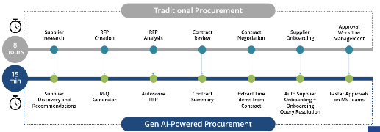
WHY SHOULD PROCUREMENT LEADERS SIT UP AND TAKE NOTICE?
ADOPTION
(Easy to Use)
RISK & COMPLIANCE
DRIVE EFFICIENCY
1
2
3
- Missed supplier
updates
- Human errors
- Unstructured requests
- Proactive risk alerts
- Risk with precision
missed details
- Low maverick
spends
Enhanced User Experience
For Everyone
AI support for Compliance and reduced Risk!
Reduce manual efforts and focus on high-value tasks!
Notes:
Why should procurement leaders pay attention to it?
GenAI is not just about automation; it's about creating a smarter, more efficient, and user-friendly procurement experience.
By leveraging GenAI, organizations can unlock significant benefits, improve productivity and compliance and giving organizations who make the shift a clear competitive leverage

Slide 12

INCREASED EFFICIENCY AND PRODUCTIVITY FOR ALL USERS
From days and hours to minutes and seconds
Traditional Procurement
Approval Workflow Management
Supplier research
RFP Creation
RFP Analysis
Contract Review
Contract Negotiation
Supplier Onboarding
8
hours
?
Auto Supplier Onboarding + Onboarding Query Resolution
Supplier Discovery and Recommendations
RFQ Generator
Autoscore RFP
Contract Summary
Extract Line items from Contract
Faster Approvals on MS Teams
Gen AI-Powered Procurement

Slide 13
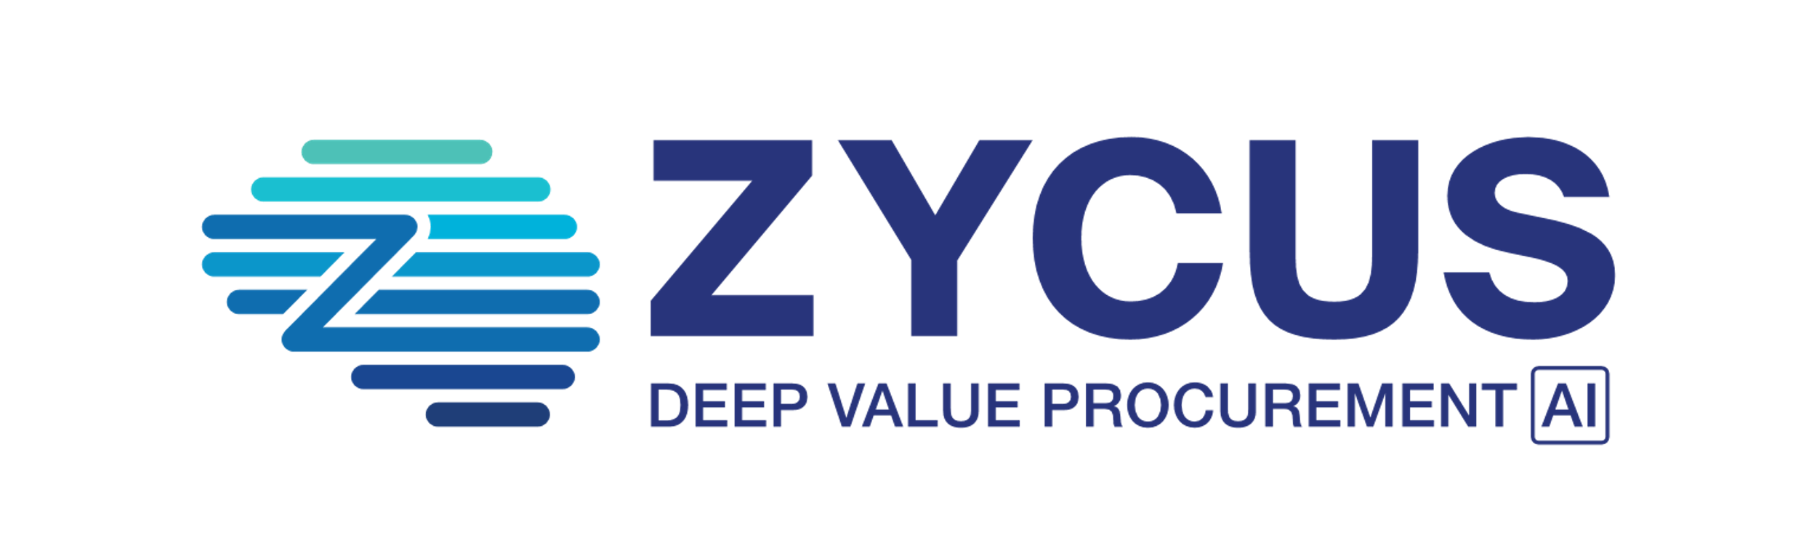
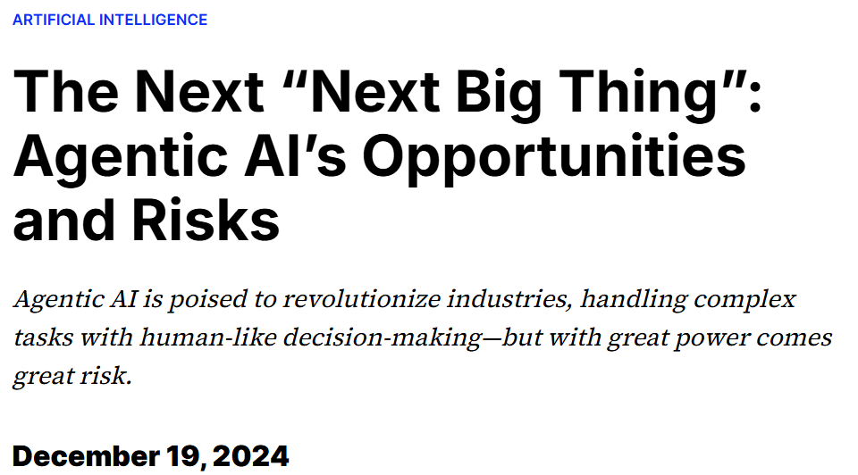

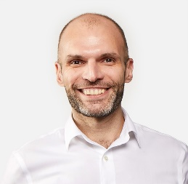
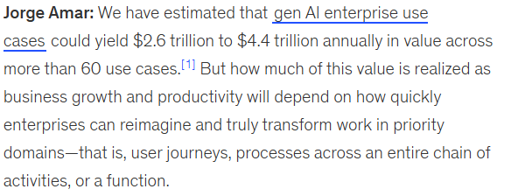




AGENTIC AI
THE NEXT FRONTIER OF GENAI
Notes:
Good morning/afternoon everyone, and welcome! We stand at the precipice of a new evolution – Generative AI. At Zycus, for many years we have strived to push boundaries and lead innovation.
Today, I want to introduce you to a technology that aligns perfectly with that vision: Generative AI.
According to analysts’ procurement is not untouched by the magic of Gen AI. While Gartner says that 80% of new enterprises procurement apps with use AI by 2025. Mckinsey confirms on the potential of unlocking trillions of dollars in savings with use of AI.
Early adopters are definitely going to gain an edge.

Slide 14








INCREASED EFFICIENCY AND PRODUCTIVITY FOR ALL USERS
AGENTIC AI – THE EVOLUTION OF GENAI
From days and hours to minutes and seconds
Traditional Procurement
Approval Workflow Management
Supplier research
RFP Creation
RFP Analysis
Contract Review
Contract Negotiation
Supplier Onboarding
8
hours
?
Auto Supplier Onboarding + Onboarding Query Resolution
S2P Agents
Supplier Discovery and Recommendations
RFQ Generator
Autoscore RFP
Contract Summary
Extract Line items from Contract
Faster Approvals on MS Teams
Gen AI-Powered Procurement

Slide 15




















AI AGENTS AS INDEPENDENT COMPOSABLE PROCUREMENT BUDDY’S
Agent Library
Autonomous Negotiation Flow
Create Event
Contract Review
Amend Contract
Create Event
Suppliers
Bid Collection
Negotiations
Creates an Event
Find Suppliers
Set no. of Bids
Negotiate with Suppliers
Suppliers
Award
Renewal Negotiation
Suppliers
Contract Renewal
Bid Collection
Bid Collection
Negotiate
Contract Review
Expiring Contract
Contract Review
Renewal Negotiation
Amend Contract
Miner
Redlining
Assistance
Autonomous
Negotiations
Collect Bids
Expiring Contract

Slide 16
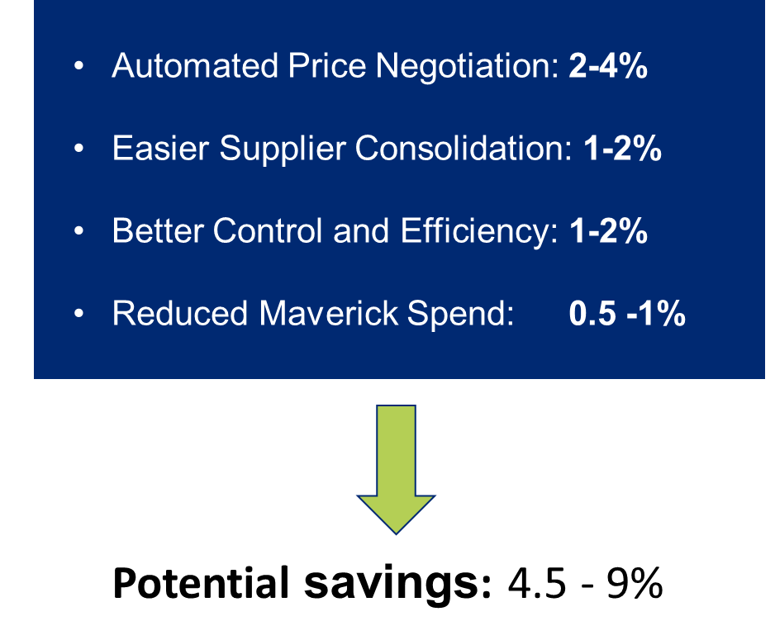
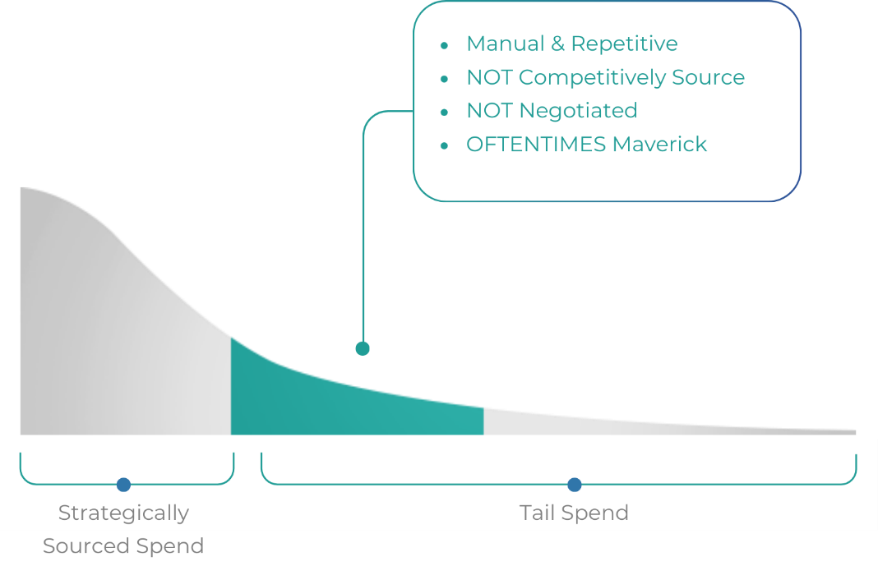
Tail Spend | Autonomous Agents, tackling the Missing Middle in CPO’s quest for Cost Savings, Compliance and Efficiency Wins!
Often Ignored or unmanaged costs Due to low value / high volume
Problems with Tail Spend
Fragmented and Decentralized Spending
Lack of Tools for Comprehensive Visibility
Inconsistent Procurement Practices
Limited Resources to Manage Tail Spend
Missed Saving Opportunities
Increased Compliance Issues
Maverick Spending
Notes:
A critical gap in the procurement landscape is what we call 'the missing middle.' These are costs that, due to their low value but high volume, often go unmanaged or ignored. Yet, they represent a significant savings opportunity that has remained largely untapped. ANA targets this specific area, ensuring that no savings opportunity slips through the cracks.

Slide 17
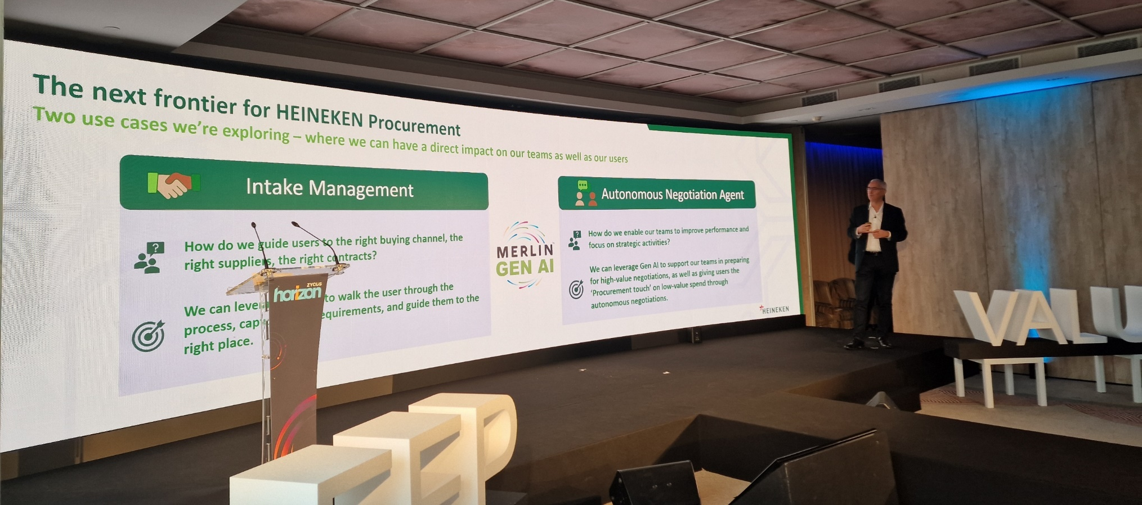
HEINEKEN AT ZYCUS’ HORIZON CONFERENCE

Slide 18

Zycus is the chosen Procurement Partner for Top South African brands

Slide 19

South Africa's Largest Manufacturer of FMCG products ​ partners with Zycus for s2p Transformation​

Slide 20
South Africa's Largest Manufacturer of FMCG products to take a leap of procurement transformation with Zycus’ Source-to-Pay Suite powered by Merlin AI technology
About the Company
The organization is founded in 1921 and headquartered in Johannesburg, employing over 11,000 employees. It operations in South Africa and Cameroon and exports to over 33 markets in Africa. The company’s core business is the manufacture, marketing and distribution of everyday branded food and beverages. Its products that cater for every meal and occasion.
11K+ Employees
25 Countries
5 Priority African Markets
Business Objectives
Digital Transformation and Modernization
Operational
Efficiency
Data-driven
Decision Making
Why Zycus was chosen?
Ease of use
Best-in-class solutions
Futuristic Technology: AI Innovation
Premium support and services
Key Challenges
Legacy systems
Limited visibility & usability
Transparency and compliance issues
Manual processes
Maverick spending
Increasing costs due to inefficiencies
“Our collaboration with Zycus will help us optimise our procurement operations, enabling us to streamline processes, enhance productivity and improve overall supplier management. With their cutting-edge technologies, we are confident in delivering exceptional value to our stakeholders as part of our efforts to optimise our supply chain.” – Procurement Transformation Lead
Solutions Opted from Zycus
Full end-to-end Source to Pay suite solutions with Merlin for eProcurement, AP, CLM, Merlin Assist

Slide 21

One of the Largest Healthcare provider in south Africa transforms its s2c function with zycus

Slide 22
One of the Largest Healthcare Providers in South Africa selects Zycus to strengthen its source-to-contract processes
About the Company
The organization is South Africa’s largest private healthcare provider. In addition to its world-class private hospital service, the organization provides primary healthcare, emergency medical services and mental health & psychiatric services. The organization's service offering includes cancer care and occupational health. The organization also has the distinction of being a leading private trainer of emergency medical and nursing personnel in the country.
21K+ Employees
51 Hospitals
79 Sites & 77 Clinics
Why Zycus was chosen?
Business Objectives
Market leading Automation solution to reduce cycle times
Ease of Use
Strong product road map with AI innovation capabilities
Category Management through Sourcing
Improving Cycle Times
Increasing Spend Under Management
Key Challenges
Very high cycle times for sourcing and contracting
Lack of savings opportunities as no visibility into savings
Lack of on-boarding compliance
"We are focused on growing our investments in people, infrastructure, and technology and developing lasting relationships with healthcare professionals. Technology being a key pillar of our growth story, we have partnered with Zycus as transforming our procurement processes will help us deliver value to our stakeholders
– General Manager, Group Procurement
Solutions Opted from Zycus
iSource
IContract
iSupplier
iRisk
iAnalyze
iConsole & SSO

Slide 23
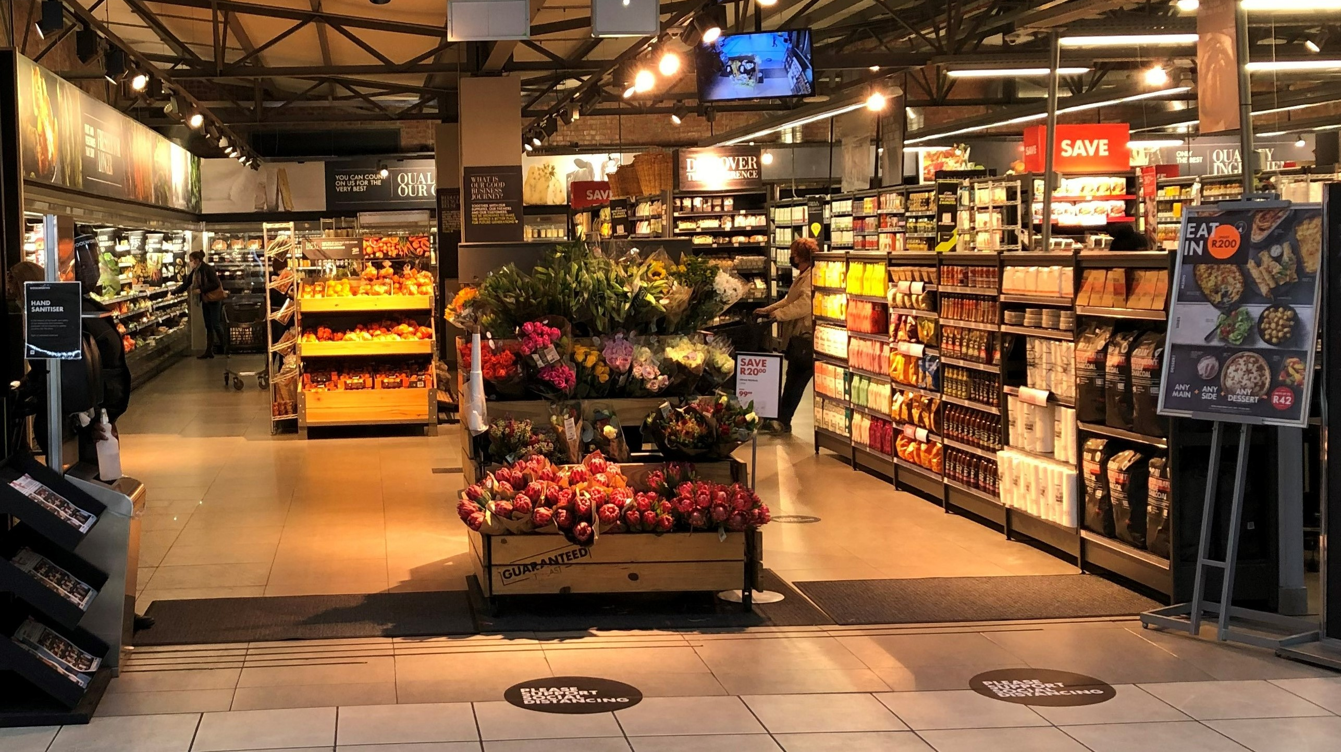
Retail giant in south africa improves its source to contract processes with Zycus

Slide 24
South Africa's retail giant improves their source-to-contract processes with Zycus AI powered Merlin CLM solutions
About the Company
With an annual revenue of $60+ billion, the organization is a leading African retailer offering a range of primarily private label products. It offers a wide range of quality clothing, general merchandise and food products with a focus on innovation, value, and sustainability.
33K Employees
719 Stores globally
10 African Markets
Why Zycus was chosen?
Business Objectives
Ease of use
Highly configurable system
Well established in Australia
Competitive pricing
Complete S2P offering available for future expansion plans
Centralization of Purchasing
Operational
Efficiency
Single view into Spend
Key Challenges
Lack of a system and reporting across South Africa and Australia operations
No visibility for sourcing and buying from same vendors
No spend visibility across locations
“To live by our values of customer centricity, quality and collaboration, we embarked on this non-trade procurement transformation journey. Through our partnership with Zycus, we aim to achieve greater efficiencies and seamless data flow across source-to-contract processes, thus providing better visibility for decision making. Zycus is a key partner in this journey of achieving our corporate goals.” – Head of Non-Trade Procurement
Solutions Opted from Zycus
iSource
iContract
iManage
iSave
iAnalyze
Merlin for CLM

Slide 25

South Africa’s leading global transport and logistics company to boost procurement performance with Zycus’ Source-to-Pay Suite along with AI powered AP solutions

Slide 26
South Africa’s leading global transport and logistics to boost procurement performance with Zycus’ Source-to-Pay Suite along with AI powered AP solutions
About the Company
The logistics organization, was established in 1910, its’ end-to-end logistics offering includes air, sea and road transport, warehousing, and customs brokerage services in all major industries. The organization operates in all the major centers in South Africa and has access to an exclusive global agent network with a presence in 120 countries, and 250 offices around the globe.
1800 Employees
250 Offices Worldwide
120 Countries
Why Zycus was chosen?
Business Objectives
Digital Transformation and Modernization
Operational
Efficiency
Data-driven
Decision Making
Ease of use
Futuristic Technology: AI Innovation
Premium support and partner services
Key Challenges
Higher cycle times
Maverick spending
No visibility on Spend
No Supplier performance management
Manual process for sourcing contracting and P2P
Compliance to governance and policies
“We were looking for an agile partner to overhaul our procurement processes and enable scalability and flexibility within our operations. We are happy to have empowered our Procurement and AP teams with Zycus’ scalable and sustainable solutions. We look forward to achieving our objectives together.”
– Business Development Director
Solutions Opted from Zycus
eProcurement
eInvoicing
iSupplier
iContract
Merlin for Accounts Payalble
iConsole

Slide 27

THANK YOU

