Slide 1
Potential Water Security Projects In The
Overberg District / Western Cape
Western Cape
Procurement Conference
28 MAY 2025

Slide 2
PURPOSE OF PRESENTATION
Secure in principle approval for funding for a
feasibility study
- Construction of a Major Dam

Slide 3
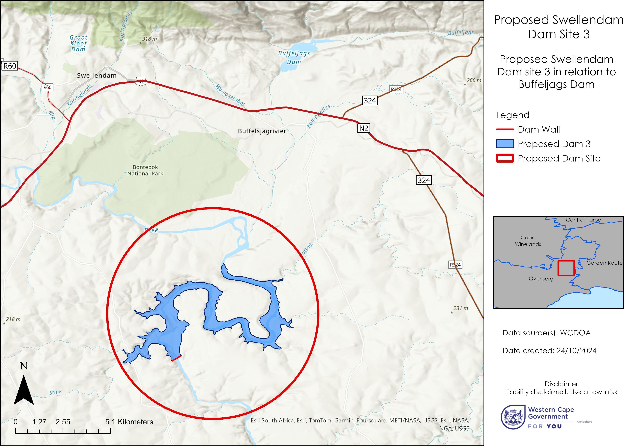
CONSTRUCTION OF A DAM IN THE BREEDE RIVER
123 million m³

Slide 4
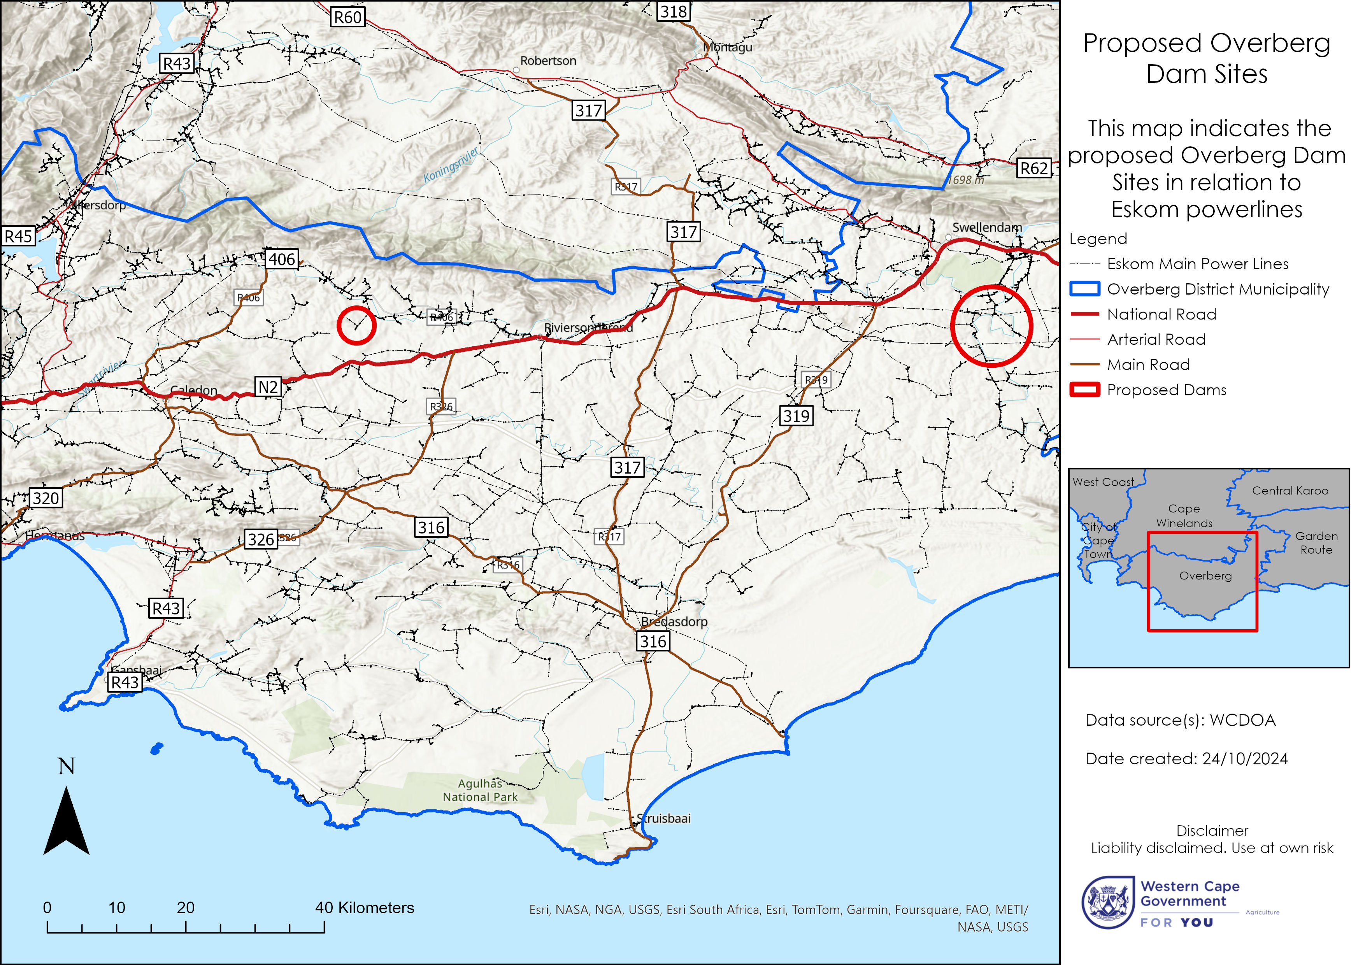
BROADER PROPOSAL FOR THREE DAMS
Focus however just on one initially – Breede River
– job creation potential 200 000 jobs

Slide 5
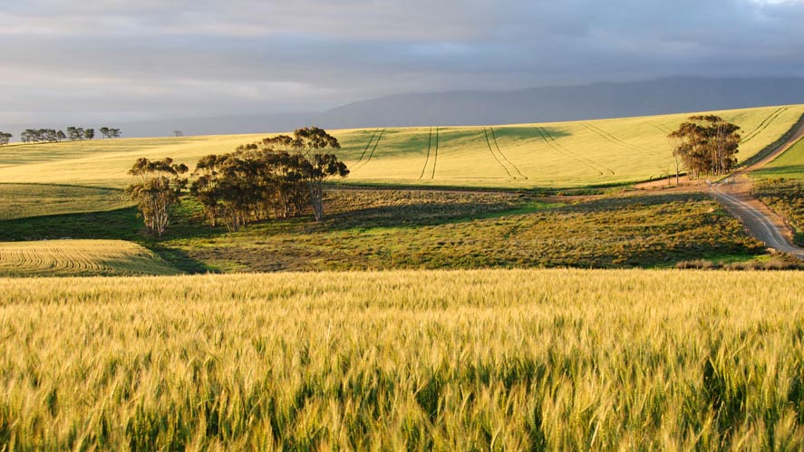
A CATALYTIC JDMA PROJECT FOR THE OVERBERG AND BROADER SOUTHERN CAPE REGION
Water security enabling infrastructure led investment growth

Slide 6





FOUR-FOLD BENEFITS
EXPANSION OF THE CURRENT AGRICULTURAL ACTIVITY IN AREA
JOB CREATION PER HECTARE UNDER IRRIGATION
ECONOMIC GROWTH & TOURISM & EXPORTS
WATER SECURITY – REGIONAL / PROVINCIAL

Slide 7






SECONDARY ECONOMIC ACTIVITY TO SUPPORT THIS GROWTH
TOURISM
TRANSPORT & LOGISTICS (N2)
AGRI PROCESSING
GROWTH OF SERVICE INDUSTRY
SMALL BUSINESS OPPORTUNITIES
GROWTH IN FOREIGN EXCHANGE
(EXPORTS) - GDP

Slide 8
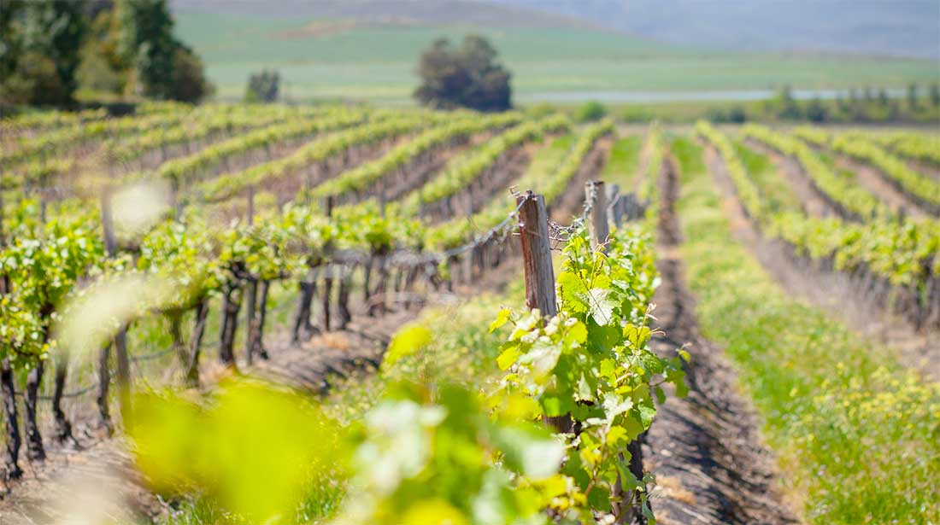
GREATER WATER SECURITY FOR THE WESTERN CAPE AS A WHOLE
Population Increase
Pressure On Potable Water Sources
Growth Will Outstrip Supply
Water Security Enabling Economic Growth
Mitigate The Effects Of Climate Change
Management Tool For Drought And Water Shortages
Water Transfer
Hydro-Electricity / Green Energy

Slide 9
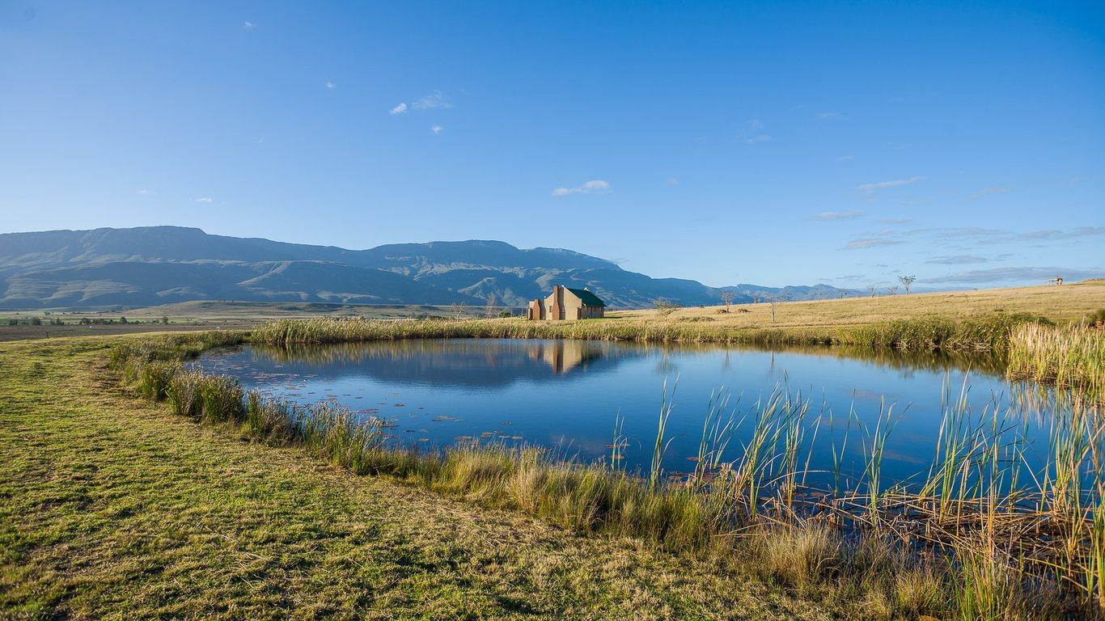
NO MAJOR DAMS TO BE CONSTRUCTED BY DWAF IN THE WC IN THE NEXT DECADE
– DEMAND WILL OUTSTRIP SUPPLY
NO MAJOR DAM IN THE SOUTHERN REGION OF THE WESTERN CAPE – BERGRIVER DAM
CAN SUPPORT THE ENTIRE EASTERN PART OF THE WESTERN CAPE
GROWTH CATALYST FOR A FUTURE METRO - SOUTHERN CAPE REGION

Slide 10
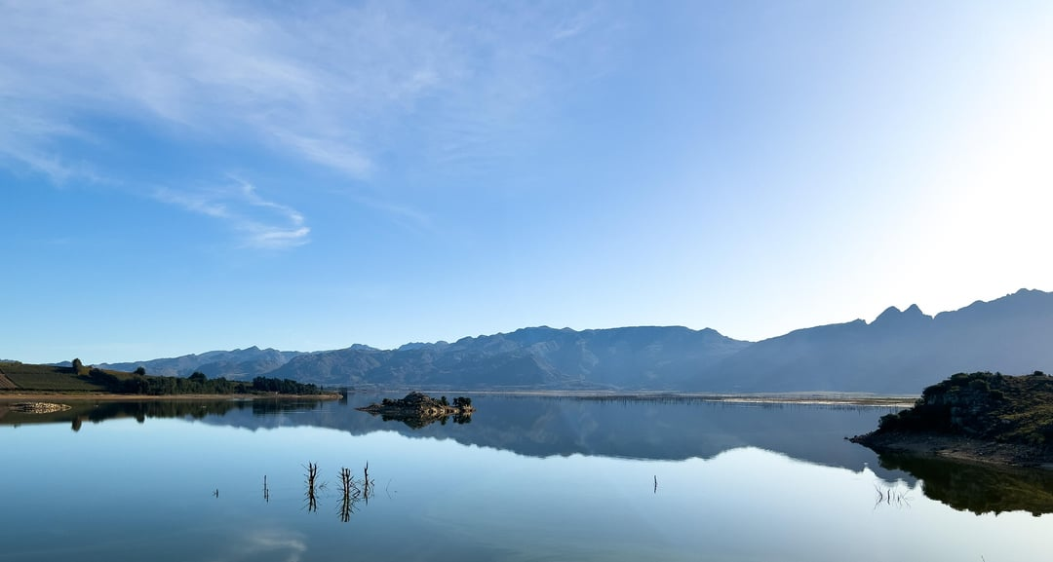
LINKAGES / COHERENCE OF THIS PROPOSAL
GNU PRIORITIES
PROVINCIAL PRIORITIES
JDMA PRIORITIES – OVERBERG CATALYTIC PROJECTS
ALIGNS WITH MTBPS SPEECH – 30 OCTOBER 2024
CLIMATE CHANGE MANAGEMENT TOOL
AGRI WESTERN CAPE
PROVINCIAL WATER SUMMIT – WCG
MERO & PERO

Slide 11
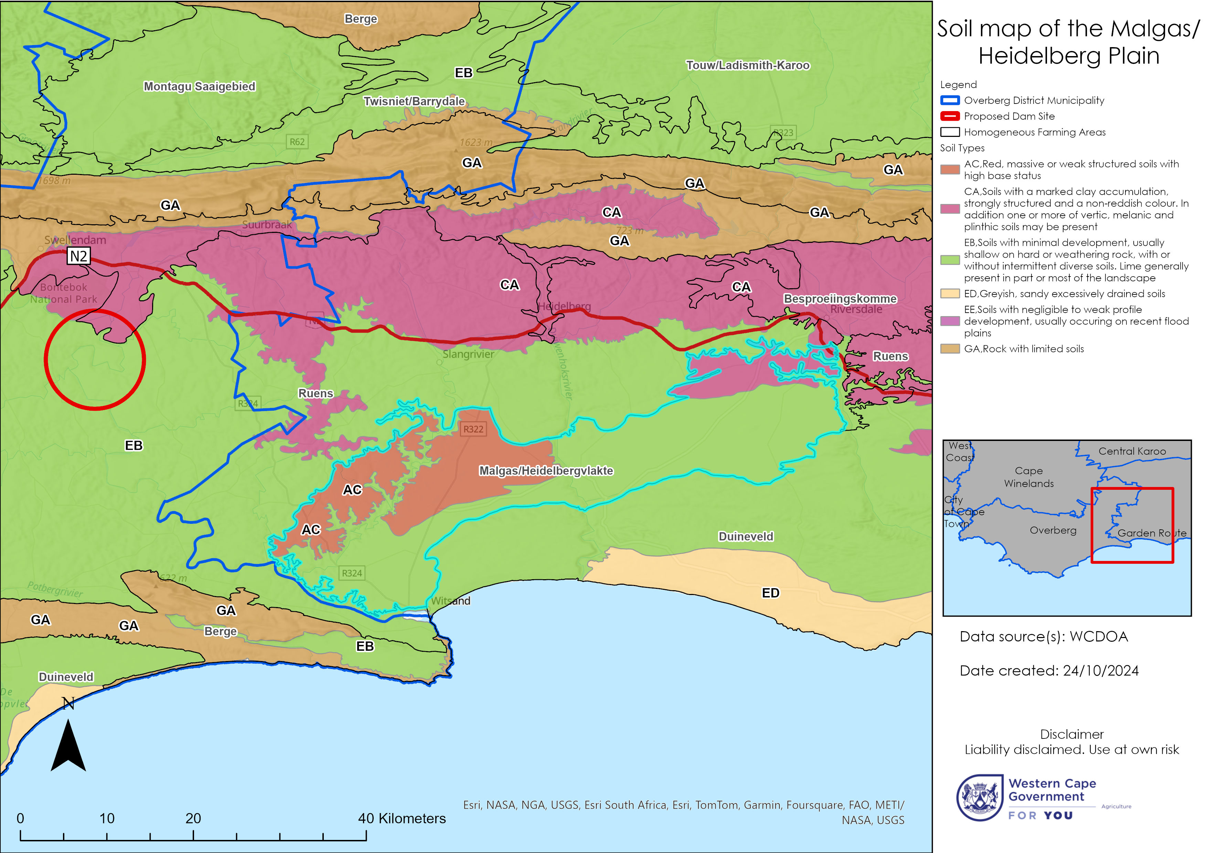
CONCLUSION
REQUEST IS TO SUPPORT AND FUND A PRE-FEASIBILITY STUDY
TERM OF OFFICE INTERVENTION
CAN WE AFFORD NOT TO DO THIS
ACKNOWLEDGEMENTS
ANDRE ROUX, PR Eng – Water & Drought
DEPARTMENT AGRICULTURE – Western Cape
QUESTIONS / COMMENTS

Slide 12

Thank You
Ald Andries Franken
EXECUTIVE MAYOR
afranken@odm.org.za
Tel.: 028 425 1157
Cell: 082 927 4989
Richard Bosman
MUNICIPAL MANAGER
rbosman@odm.org.za
Tel.: 028 425 1157
Cell: 079 269 2239

