Slide 1


Affordable Housing
Gavin Wiseman
Human Settlements

Slide 2

“BUILDING DREAMS”
#Providing Diverse Housing Options to Meet Diverse Needs
#Mind the Gap...

Slide 3

Setting the Context

Slide 4

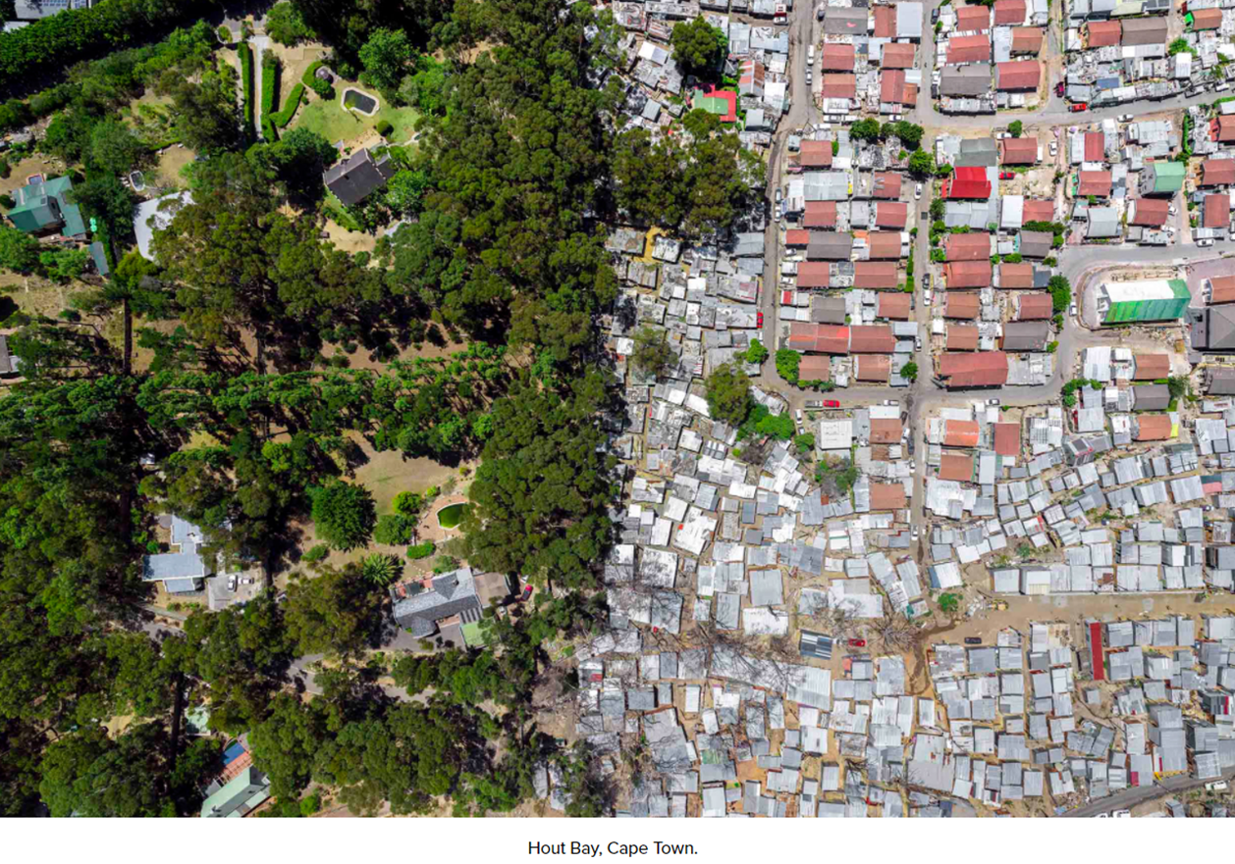
Spatial Exclusion : The Case of Cape Town
By Jonny Miller

Slide 5
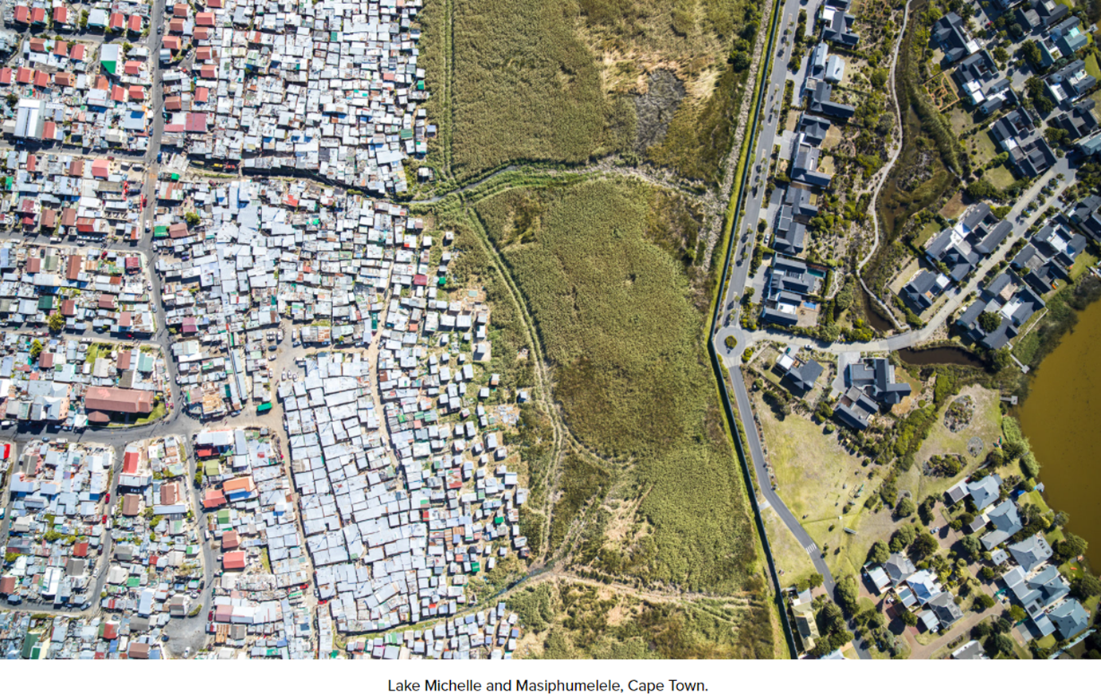
Spatial Exclusion : The Case of Cape Town
By Jonny Miller

Slide 6

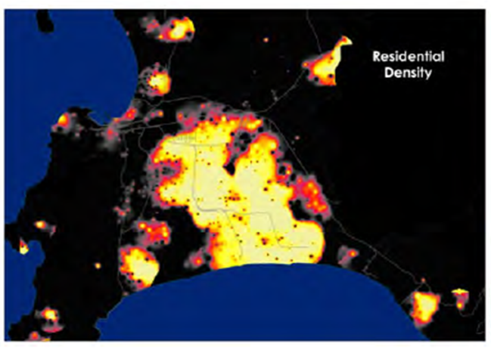
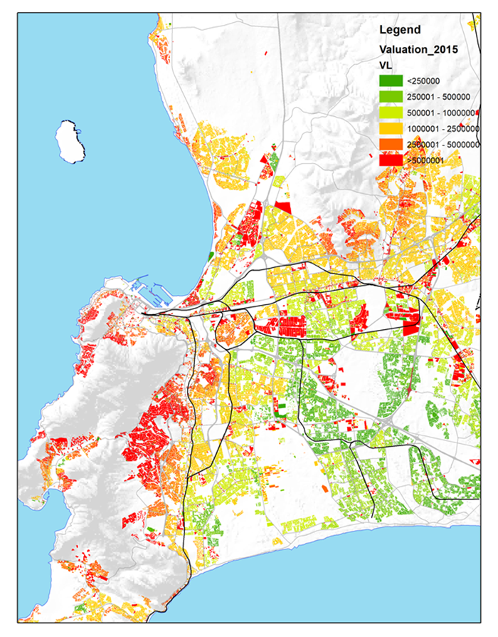
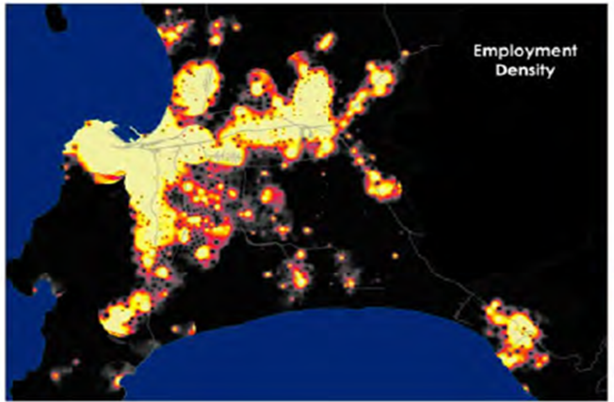
Spatial Exclusion : The Case of Cape Town

Slide 7

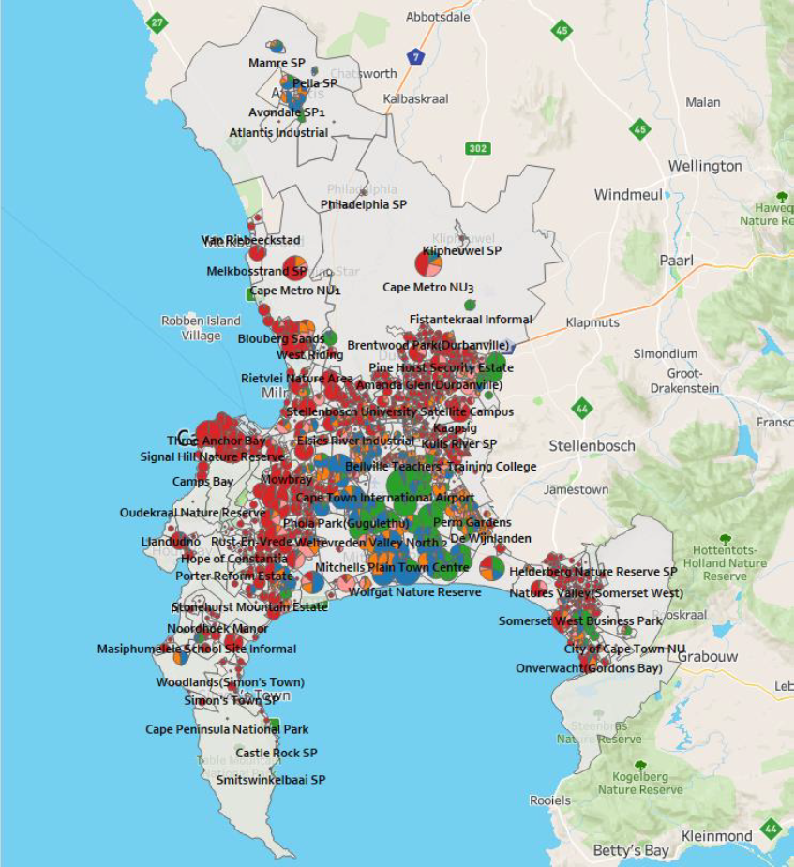
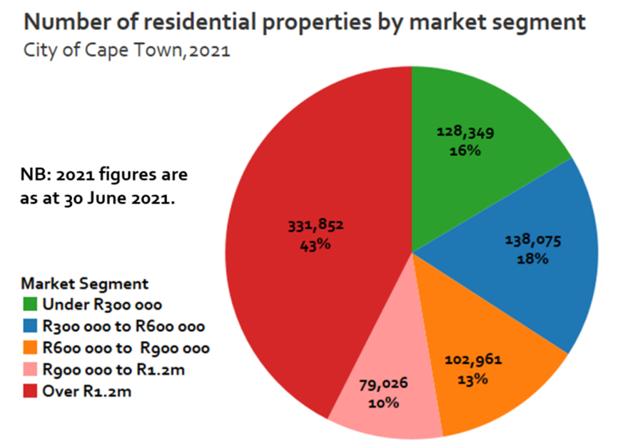
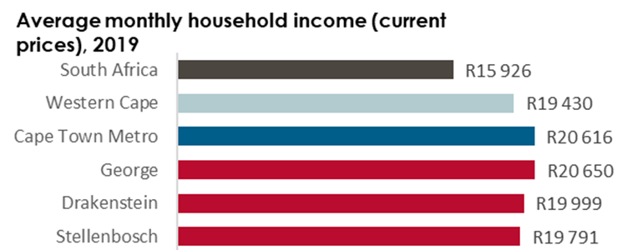
Existing Residential Markets

Slide 8

Provincial Affordable Housing Demand and Context
The Western Cape Growth Diagnostic report (2022) notes that:
“a large gap between demand and supply has led to rising prices across the whole housing market from top to bottom. On the one hand, this raises the household wealth of homeowners. On the other, it raises the cost of accommodation resulting in lower real ex-accommodation household incomes. It also results in upward wage pressure on local firms. Higher prices ripple across the housing market, making even the most affordable formal housing stock more expensive, with huge implications for living standards and inclusion” (Intellidex, 2022)

Slide 9

Provincial Affordable Housing Demand and Context
WCG commissioned Housing Market Studies for four intermediate cities/ larger towns -George, Mossel Bay, Stellenbosch and Paarl/Wellington area
Building on the success of the first round of studies, the WCG has funded a further round of studies for larger towns and their surrounds in seven (7) more municipalities in the Western Cape, outside of the Cape Town Metro. These municipalities are:- Saldanha Bay; Overstrand; Breede River; Bitou; Knysna; Swartland and Oudtshoorn Municipality

Slide 10
Provincial Affordable Housing Demand and Context
These studies profile housing demand and supply and identify the affordability gap in each of the urban centres. This built an evidence base to inform suitable responses to address the shortcomings in the housing market
Functional housing markets that respond to the diversity of residential accommodation needs of households across the spectrum of affordability and optimise the role of the private sector (from large-scale property developers to micro-landlords), are central to the economic and social well-being of our settlements, as well as for the financial sustainability of our towns and cities

Slide 11

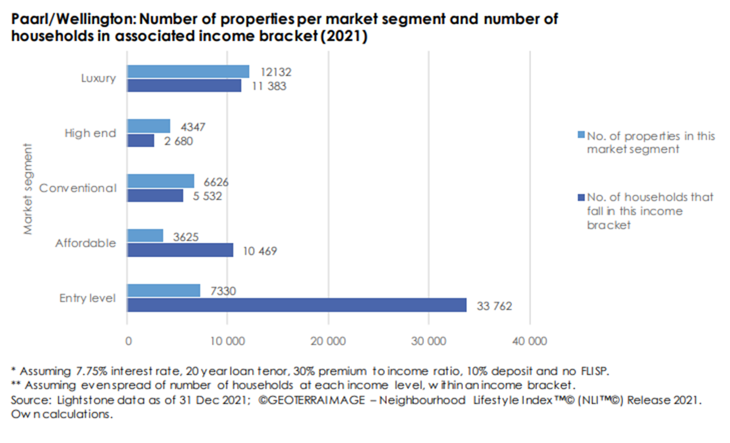
The Affordability Gap…
Paarl/Wellington:-

Slide 12
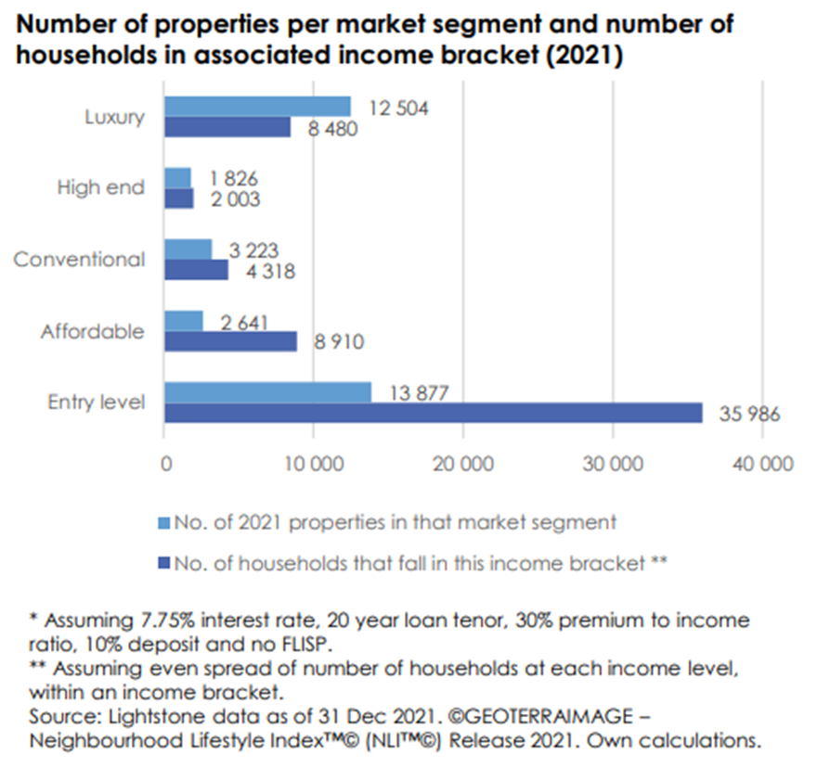
The Affordability Gap…
George :-

Slide 13
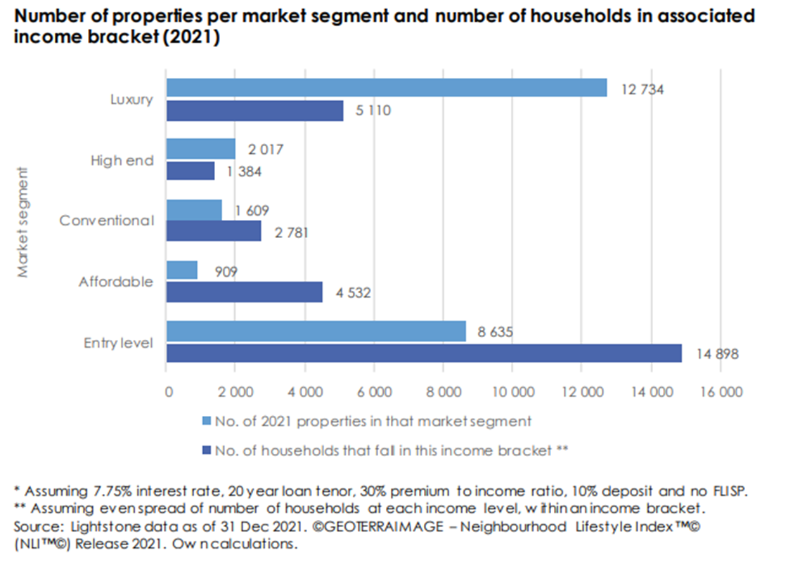
The Affordability Gap…
Mossel Bay:-

Slide 14
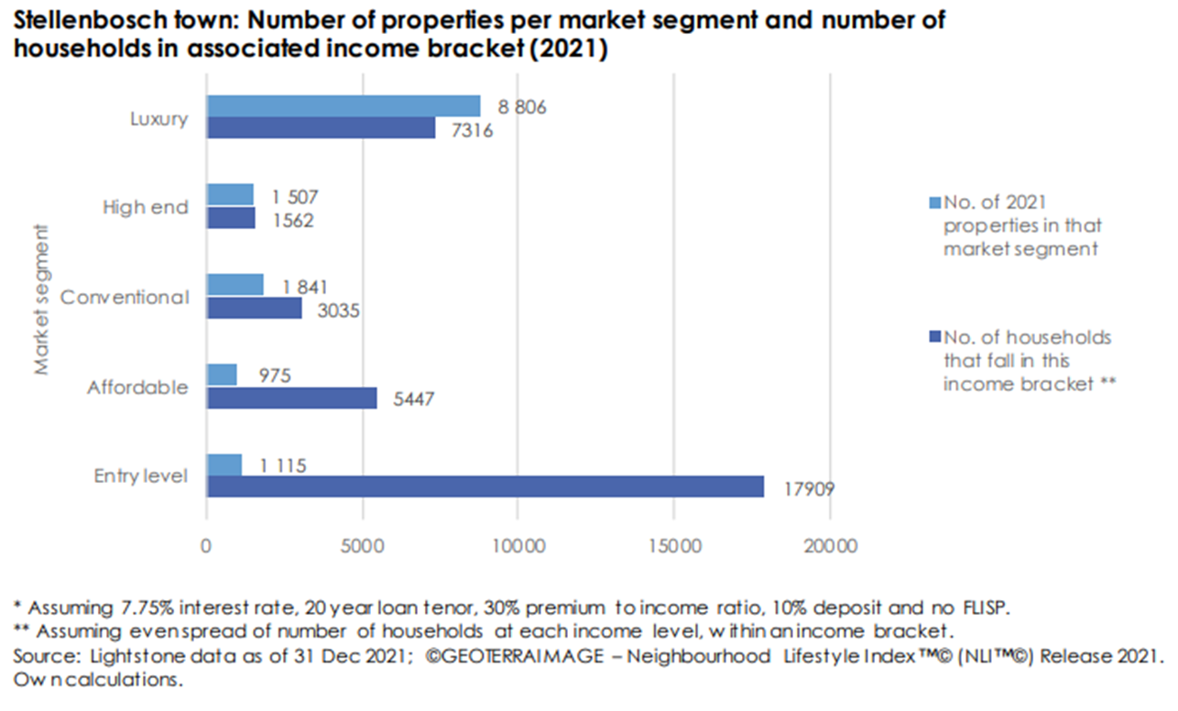
The Affordability Gap…
Stellenbosch:-

Slide 15
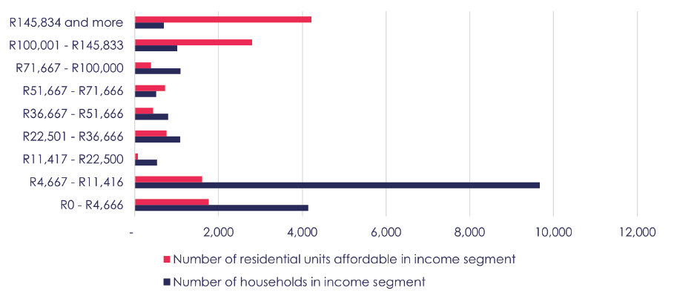
The Affordability Gap…
Knysna:-

Slide 16
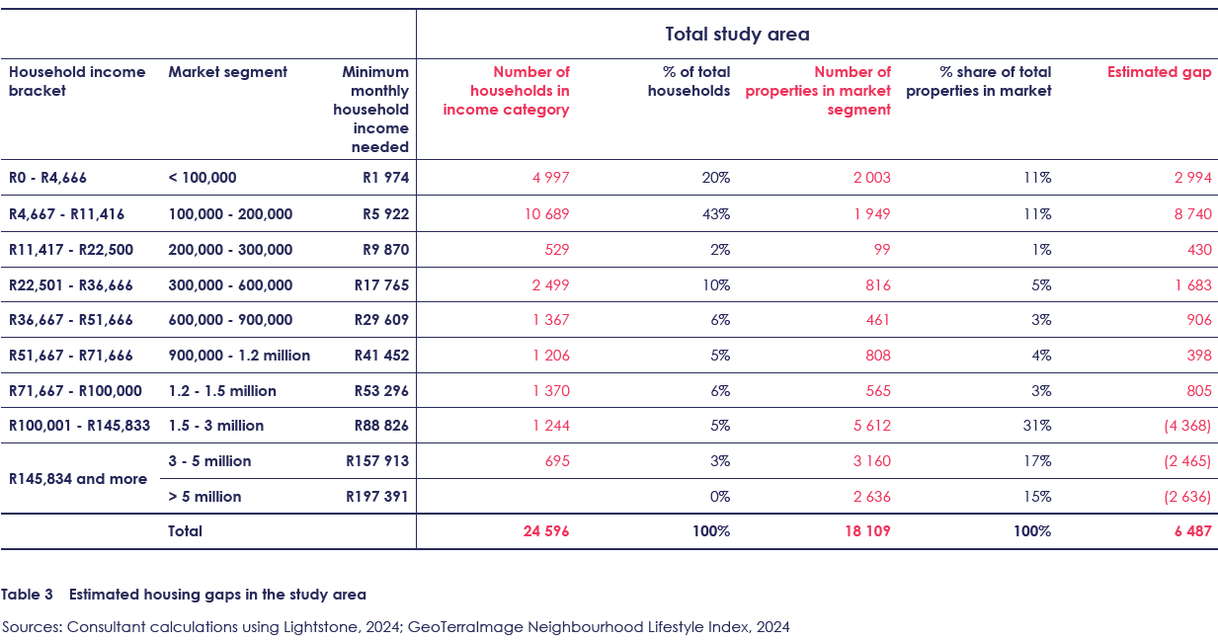
The Affordability Gap – Knysna Study Area

Slide 17
Provincial Affordable Housing Demand and Context
As a result, economic inequality persists, and the property market, as a means to support upward mobility, or to respond to changing accommodation requirements, is increasingly limited in the Western Cape
The studies confirm that the formal housing markets are not responding adequately to the needs of households who earn up to approximately R30,000 a month, perhaps even more
A functional housing market requires that the gaps in the housing ladder are addressed, particularly in the market for properties between R300,000 and R900,000, and especially in the affordable market between R300,000 and R600,000

Slide 18
Housing Programme vs Income Band

Slide 19
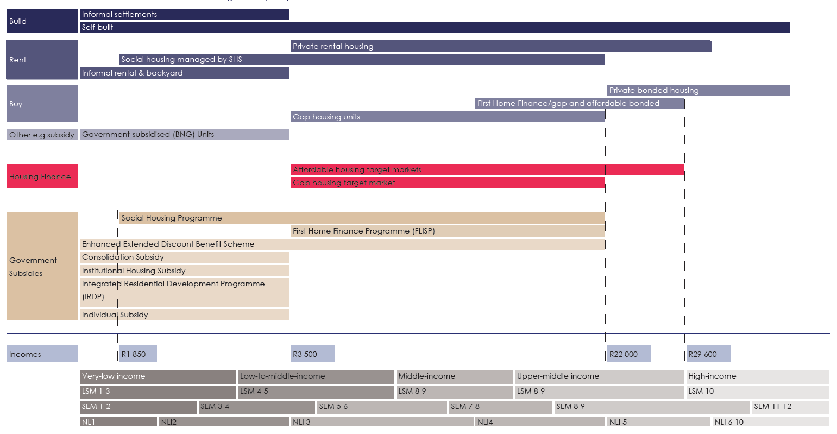
Housing Programme vs Income Category

Slide 20
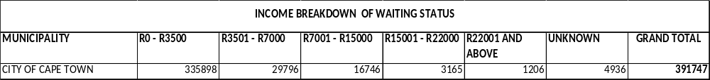
Current Database Information – City of Cape Town (Metro)
49 707

Slide 21
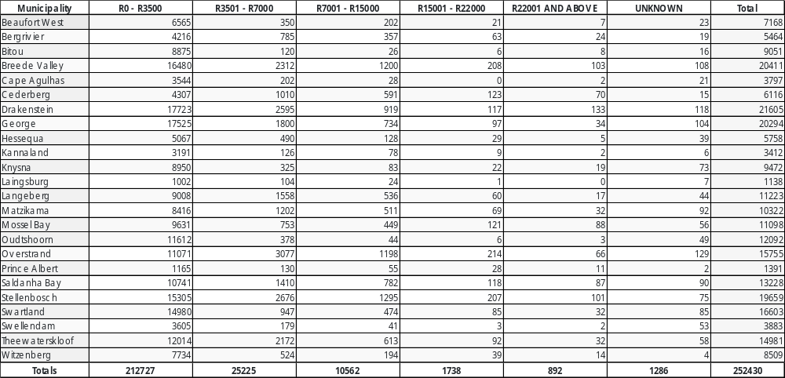
Current Database Information – WC Municipalities
37 525

Slide 22
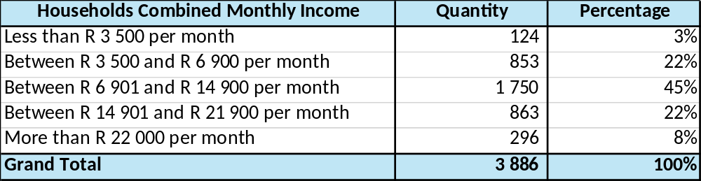
Database Information from FLISP.CO.ZA – Western Cape

Slide 23

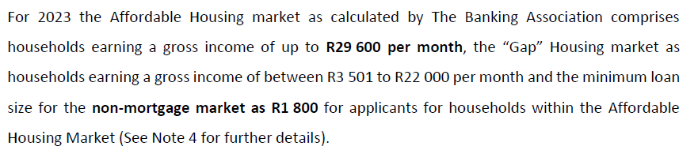
The Growing Gap….

Slide 24
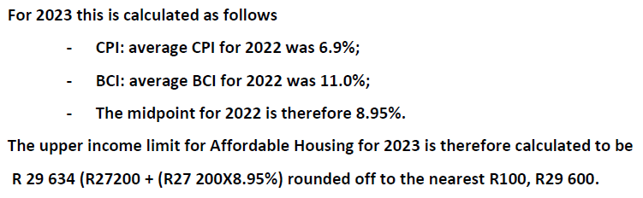
The Growing Gap….
2017: - R 22 100
2018: - R 23 300 (FLISP subsidy increased from R15 000 to R22 000)
2024:- Apply 9% escalation to R 29 600 = R 32 300 vs FLISP/FHF subsidy– still R 22 000

Slide 25

The Growing Gap….

Slide 26
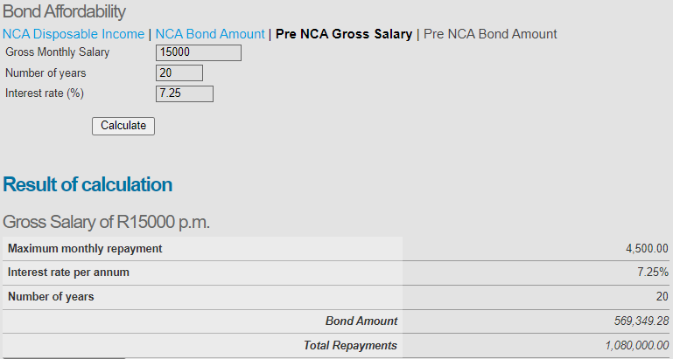
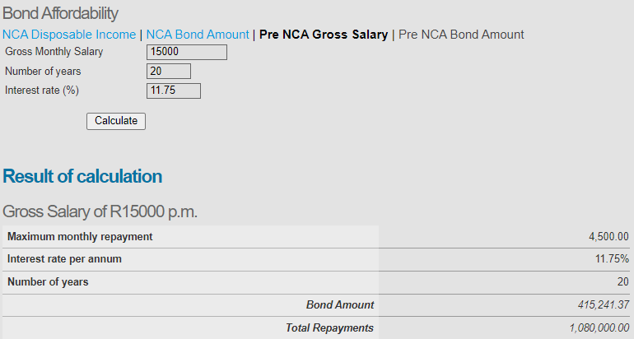
The Growing Gap….
Impact of increasing interest rate from Nov 2021 to July 2024
R 15 000 per month gross salary
Could previously afford a home of R 569 350 (Interest Rate at 7.25%)
Now can only afford a home of R 415 250 (Interest Rate at 11.75%)
27 % reduction

Slide 27
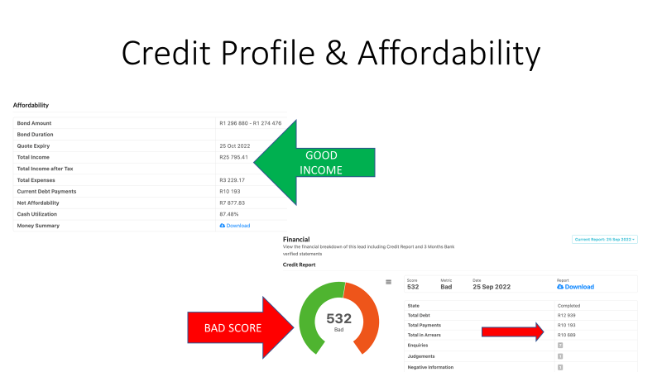
The Growing Gap….
Good score: above 630

Slide 28
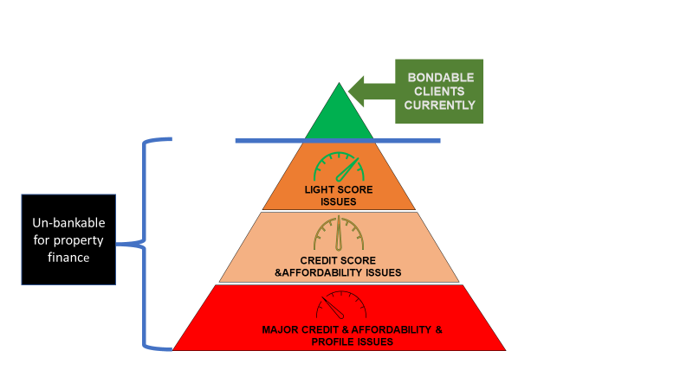
The Growing Gap….

Slide 29
The Growing Gap….
Current statistics show that over 50% of bond applications get declined
Customer Financial Wellness at the core
Requires financial education to help manage resources and commitments effectively
To provide interactive programmes to prospective buyers through budgeting, avoiding costly microloans, understanding hidden costs and navigating financial risks
Holistic approach ensures homeownership remains a joyful
milestone, rather than a source of financial distress

Slide 30
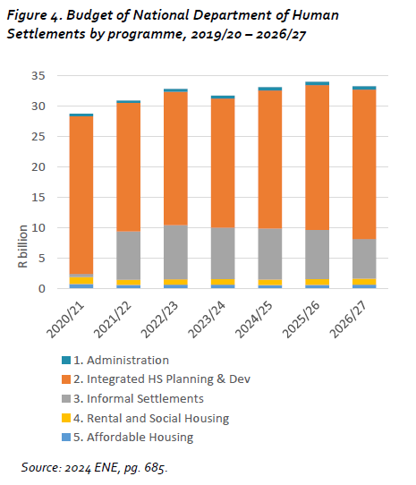
National Funding Allocation by Programme…
Human Settlements in the 2023/24 Budget, Centre for Affordable Housing Finance in Africa, 2023

Slide 31
Responding to the Affordability Gap

Slide 32
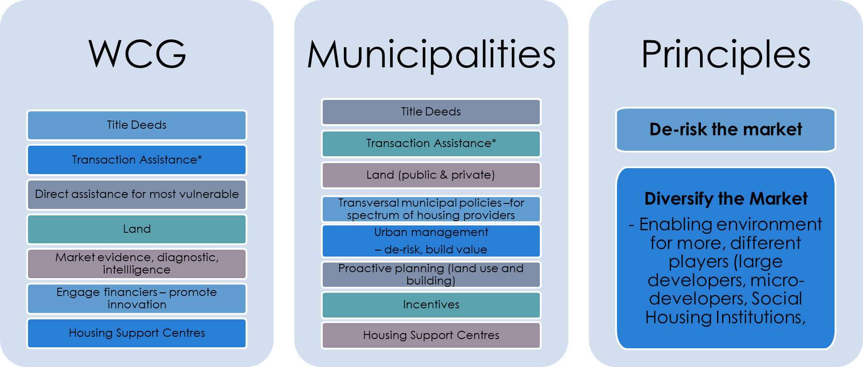
Responding to the Affordability Gap

Slide 33
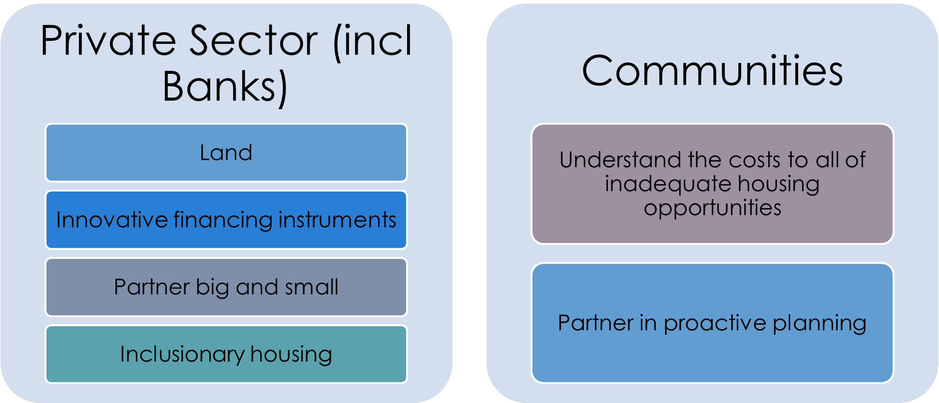
Responding to the Affordability Gap (work in progress…)

Slide 34
Affordable Housing Initiatives

Slide 35
Addressing the Gap….
The Department previously implemented a ‘credit readiness programme’ to assist with first-time home buyers improve their credit score and affordability. This formed part of the prioritization and enablement of affordable housing
The programme highlighted the need to assist aspirant first-time home buyers, many of whom have poor and/or impaired credit scores, and hence not able to gain access to end user finance e.g. a mortgage bond. Many first-time buyers on lower income are being excluded from entering the affordable housing market
A previous Consumer Credit Market Report from the National Credit
Regulator tells the story….

Slide 36
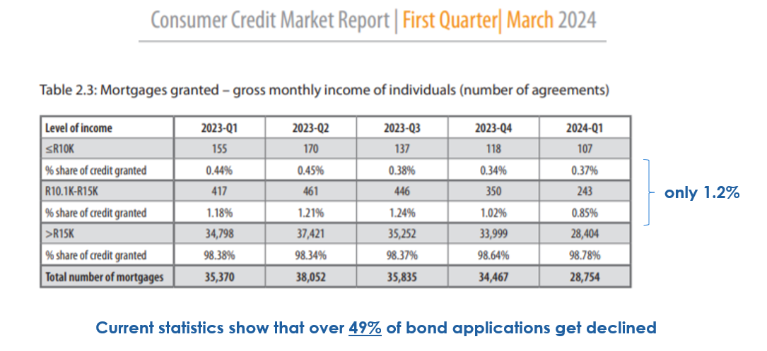
Addressing the Gap….

Slide 37

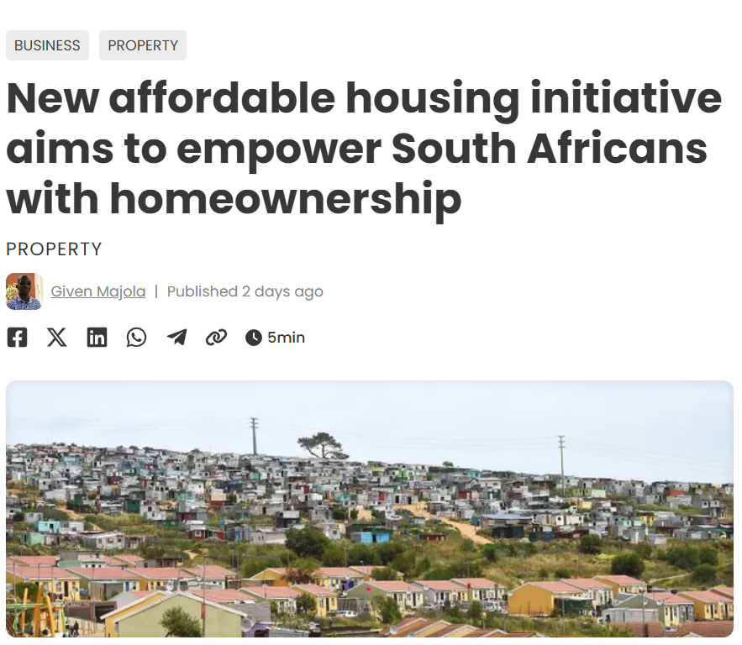
Addressing the Gap….
‘# through collaboration…’

Slide 38
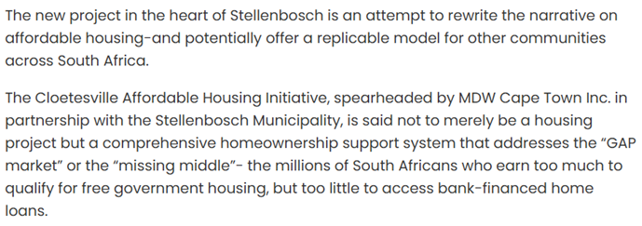
Addressing the Gap….

Slide 39
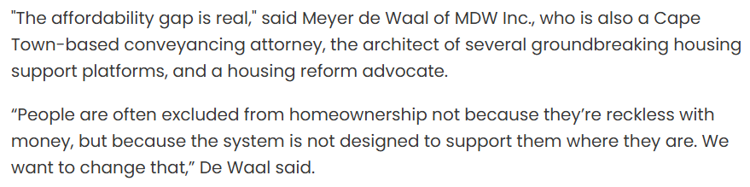
Addressing the Gap….

Slide 40
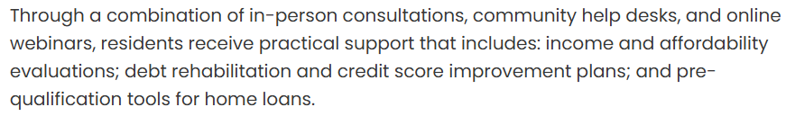
Addressing the Gap….

Slide 41
Addressing the Gap…
  In October 2021, after much advocacy, the National Department of Human Settlements amended the National Housing Code with the previous Finance Linked Individual Subsidy Programme (FLISP) now known as the First Home Finance (FHF) programme
  Previously, the FLISP subsidy was only available to beneficiaries who qualified for a mortgage bond from a financial institution, but now the FHF subsidy was extended to non-mortgage housing finance facilities

Slide 42
Addressing the Gap…
  The objectives of the revised FLISP interventions are:- to stimulate transactions in the affordable housing market and expand the affordable housing market; to promote vibrancy, progression and upward mobility; to broaden the options for accessing home-ownership

Slide 43
Addressing the Gap…
  The new non-mortgage housing finance facilities can include:-
  • A pension/provident fund loan
  • A cooperative or community-based savings scheme
  • The Government Employees Housing Scheme
  • Any other Employer-Assisted Housing Scheme
  • An unsecured loan
  • Own revenue
  • An instalment sale agreement or rent-to-own agreement

Slide 44
Rent-to-Own (Deferred Ownership)
  The implementation of a deferred ownership, or Rent-to-Own model, within the Province, was conceptualised around the need for the ‘rehabilitation’ of aspirant first-time buyers and to create the means by which their credit score, and affordability, can be improved, resulting in their access to an affordable housing opportunity
  Province provided an initial R10m, plus a further R15m, from the AFR Fund, to Cape Agulhas Municipality, for the piloting of the Deferred Ownership, or Rent-to-Own initiative – as catalyst

Slide 45
Rent-to-Own (Deferred Ownership)
The Rent-to-Own concept is concluded in terms of a Rent to Own Sale Agreement which includes an Agreement of Sale, an Option Agreement and a Lease Agreement.
The house is made available to rent for a period up to 36 months by means of the Lease Agreement. During this period, the buyer has the right to exercise their Option over the property to purchase it at the determined value at the start of the agreement. This selling price remains fixed for the 36-month period (as per the Option Agreement)

Slide 46
Rent-to-Own (Deferred Ownership)
The monthly rental amount is modelled on what an equivalent home loan payment would be for the buyer, at the time of purchase. The detailed affordability check undertaken is based on this proposed rental. The buyer is ‘stress tested’ to ensure they will be able to pay the monthly rental. This is an essential component of the risk mitigation for the concept
The regular payment of the monthly rental then forms part of assisting the prospective buyer improve their credit score and rehabilitate it, where necessary. The buyer is assigned a financial coach, who helps the buyer through the MyBudget Fitness Programme with regular training sessions. Buyers are also taken through a Housing Consumer Education Programme

Slide 47
Rent-to-Own (Deferred Ownership)
Almost 50% of the monthly rental is invested in a savings account on behalf of the beneficiary. This grows into a substantial deposit that the buyer can then use to help secure a home loan at the end of the 36-month lease period. Banks are far more willing to provide an 80% loan-to-value and would give preferential rates. This greatly increases the probability of a buyer securing a home loan, along with an improved credit score

Slide 48

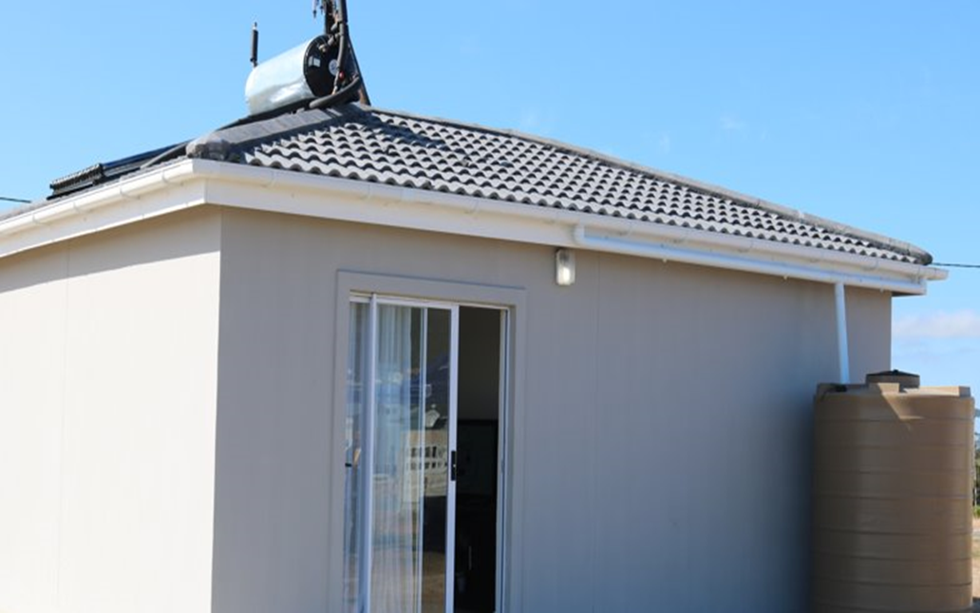
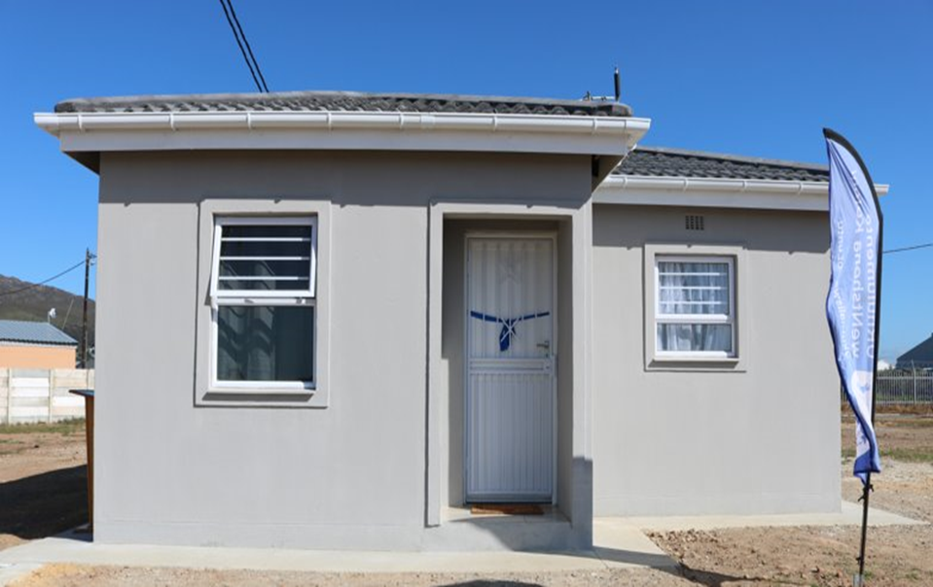
Rent-to-Own (Deferred Ownership)

Slide 49
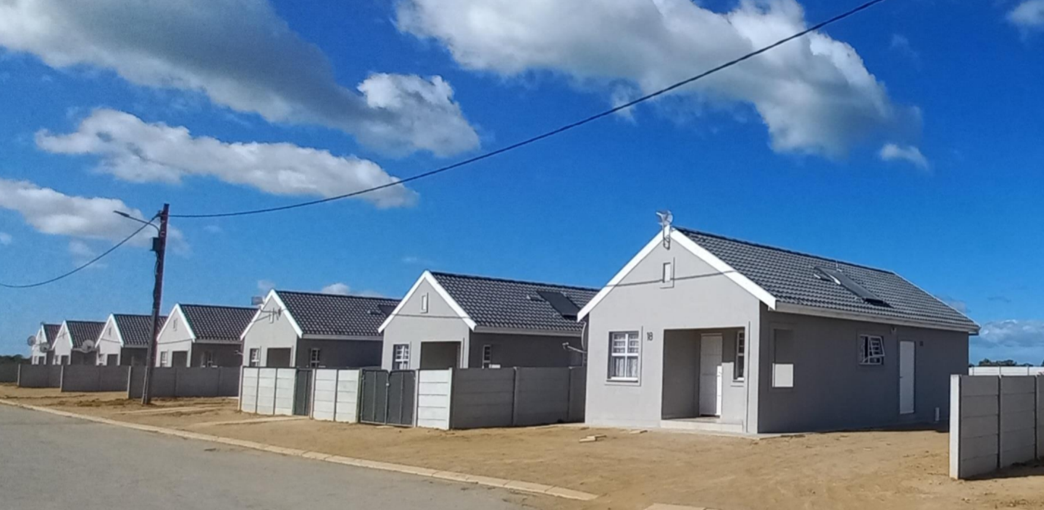
Rent-to-Own (Deferred Ownership)

Slide 50
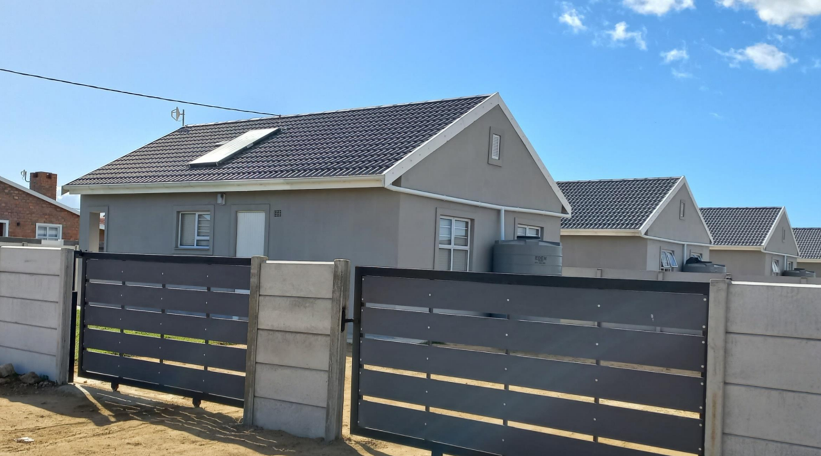
Rent-to-Own (Deferred Ownership)

Slide 51
Private Sector Opportunities…

Slide 52
Rent-to-Own (Deferred Ownership)…Private Sector…?
Can the private sector take on the developer role…?
Can private sector provide catalytic funding to replenish/replace
AFR funding…?
What would create an enabling environment…?
Are there other innovative funding mechanisms e.g. Instalment Sale…?
Alternative and blended finance options…?
A possible instrument within inclusionary housing…?

Slide 53
Incremental Development Options

Slide 54
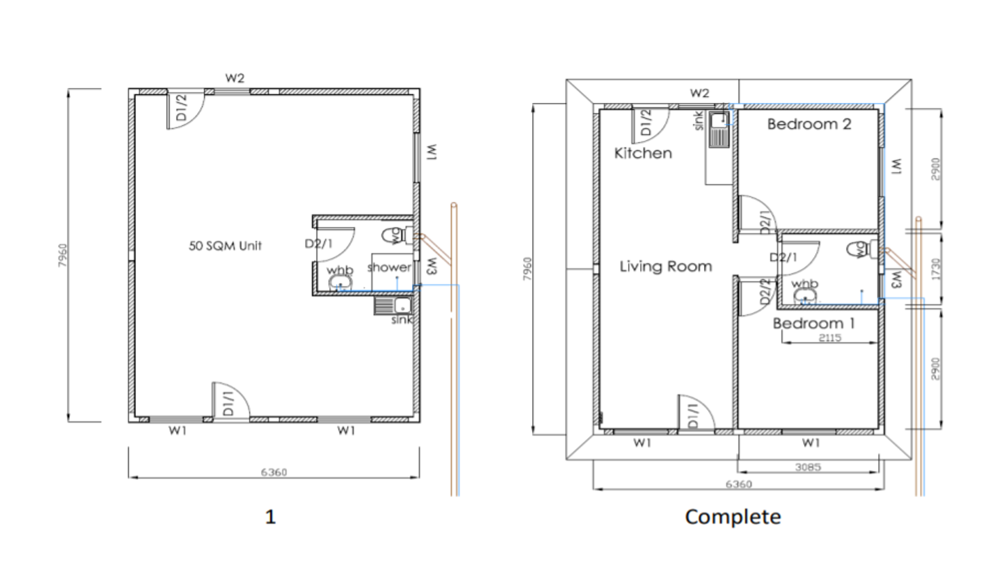
Adaptive/Enabling Housing Model

Slide 55
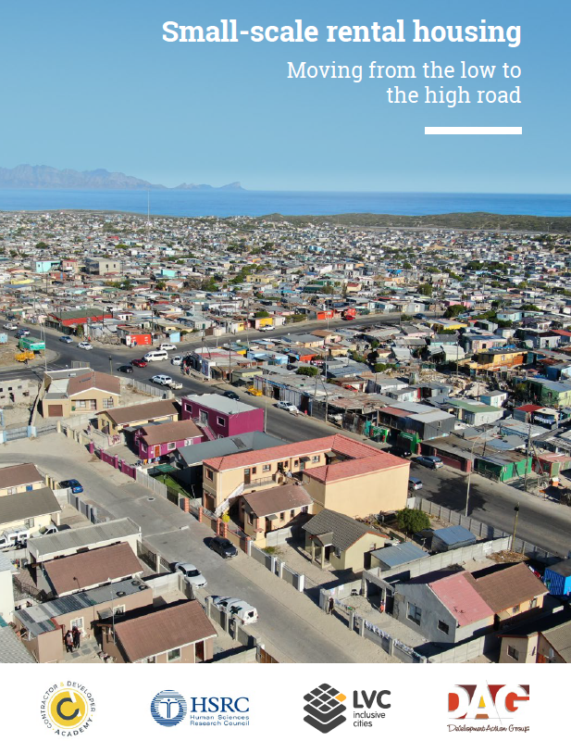

Collaboration across the sector…

Slide 56
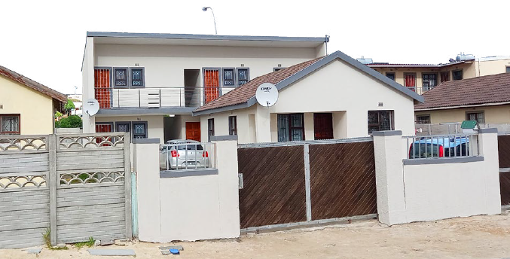
Enabling small-scale rental housing

Slide 57
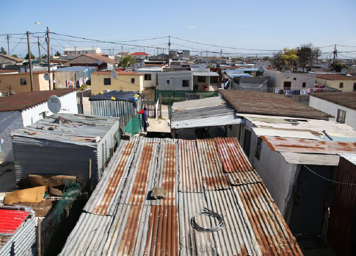
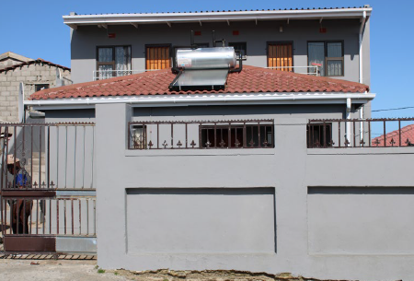
Backyard vs Small Scale Rental Sector

Slide 58
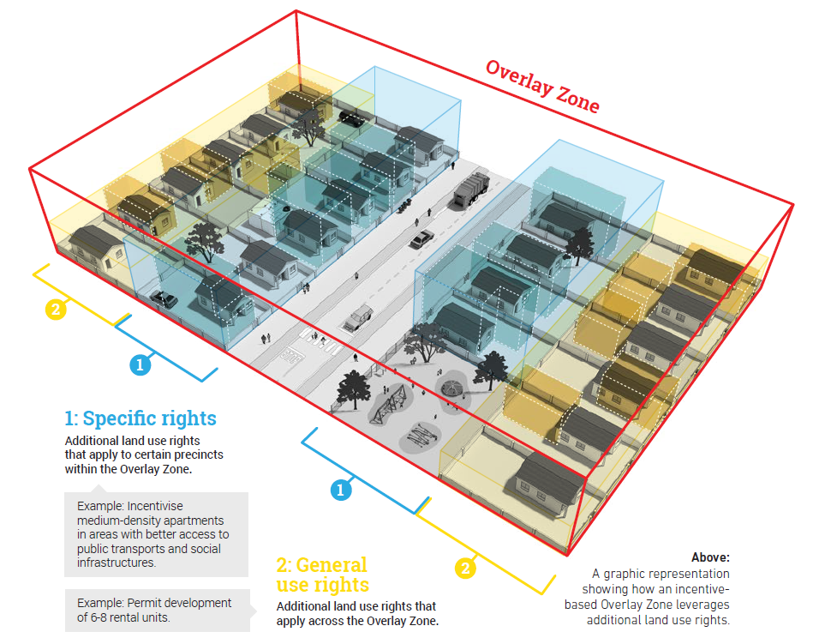
Enabling small-scale rental housing

Slide 59
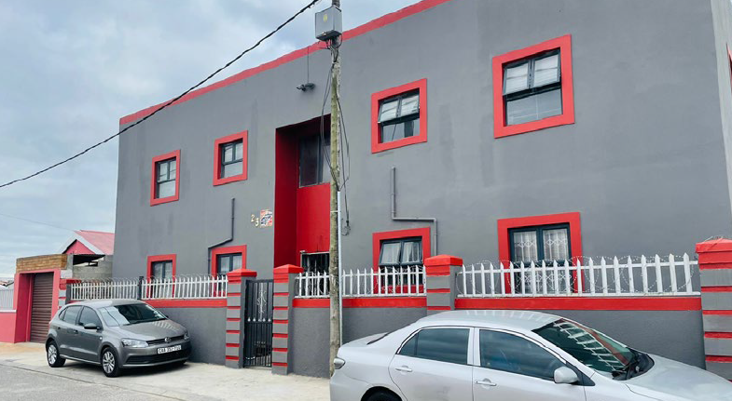

Enabling small-scale rental housing

Slide 60
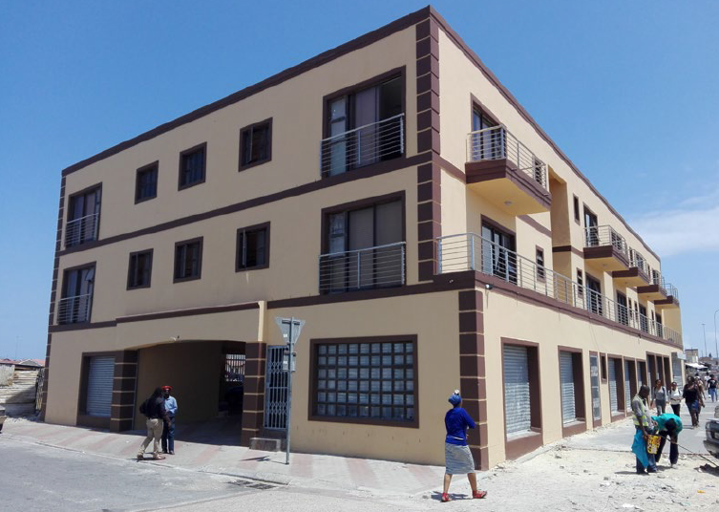

Enabling small-scale rental housing

Slide 61
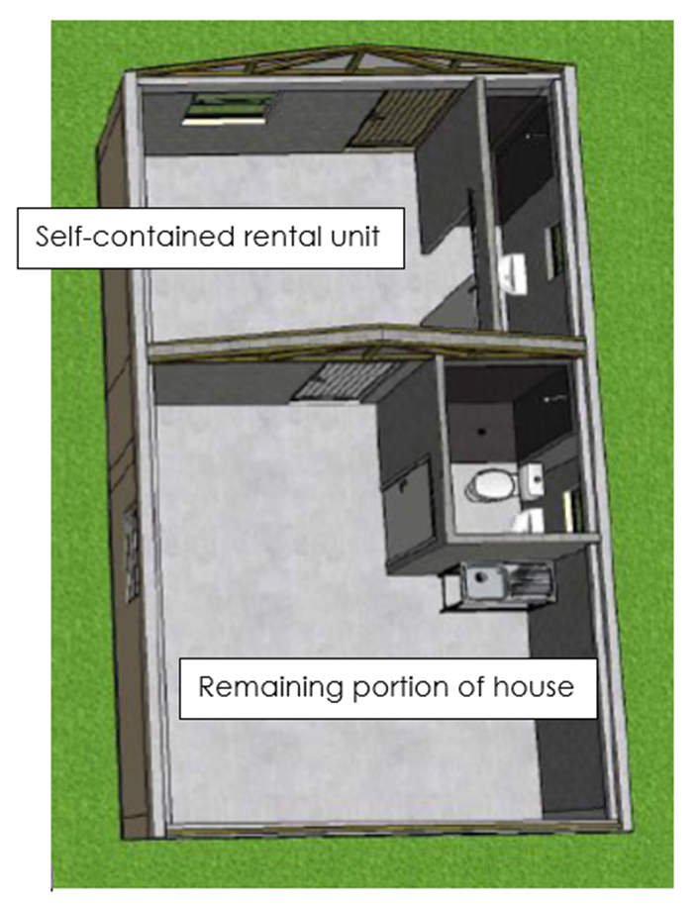
Adaptive/Enabling Housing Model – Micro Rental Option

Slide 62
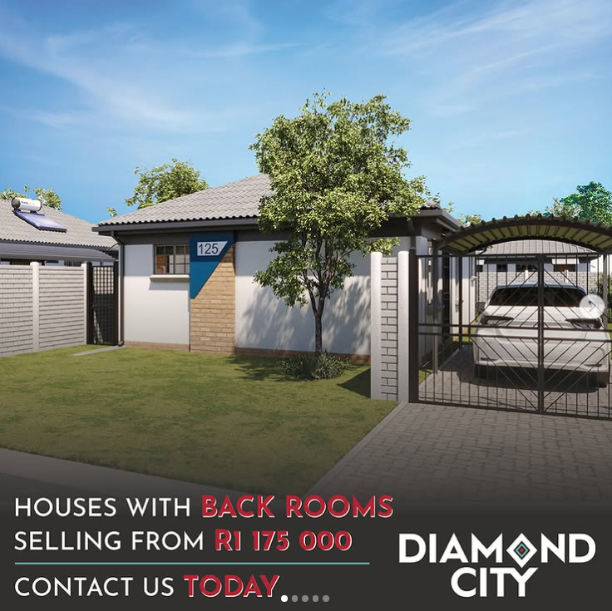
Adaptive/Enabling Housing Model – Micro Rental Option

Slide 63
Private Sector Opportunities…

Slide 64
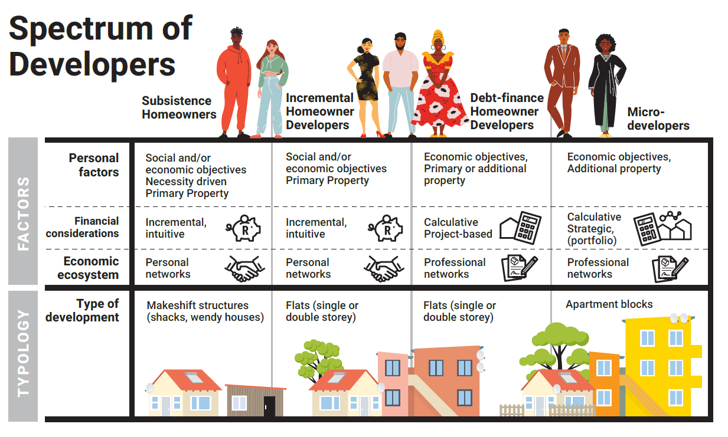
Adaptive/Enabling Housing Model

Slide 65
Adaptive/Enabling Housing Model… Private Sector…?
Can the private sector take on the developer role…?
Can private sector provide catalytic funding to provide home improvement micro loans…?
The provision of materials and technical assistance, and support…?
What would create an enabling environment…?
Small SMME businesses can be developed and supported…?
Alternative and blended finance options…?
‘Massive small…’

Slide 66
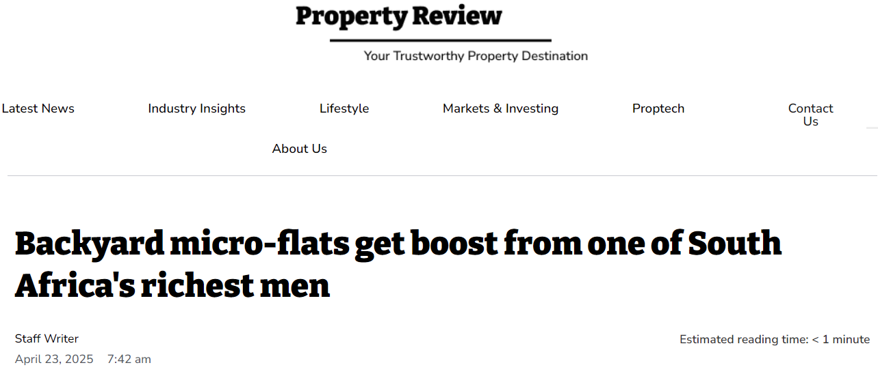
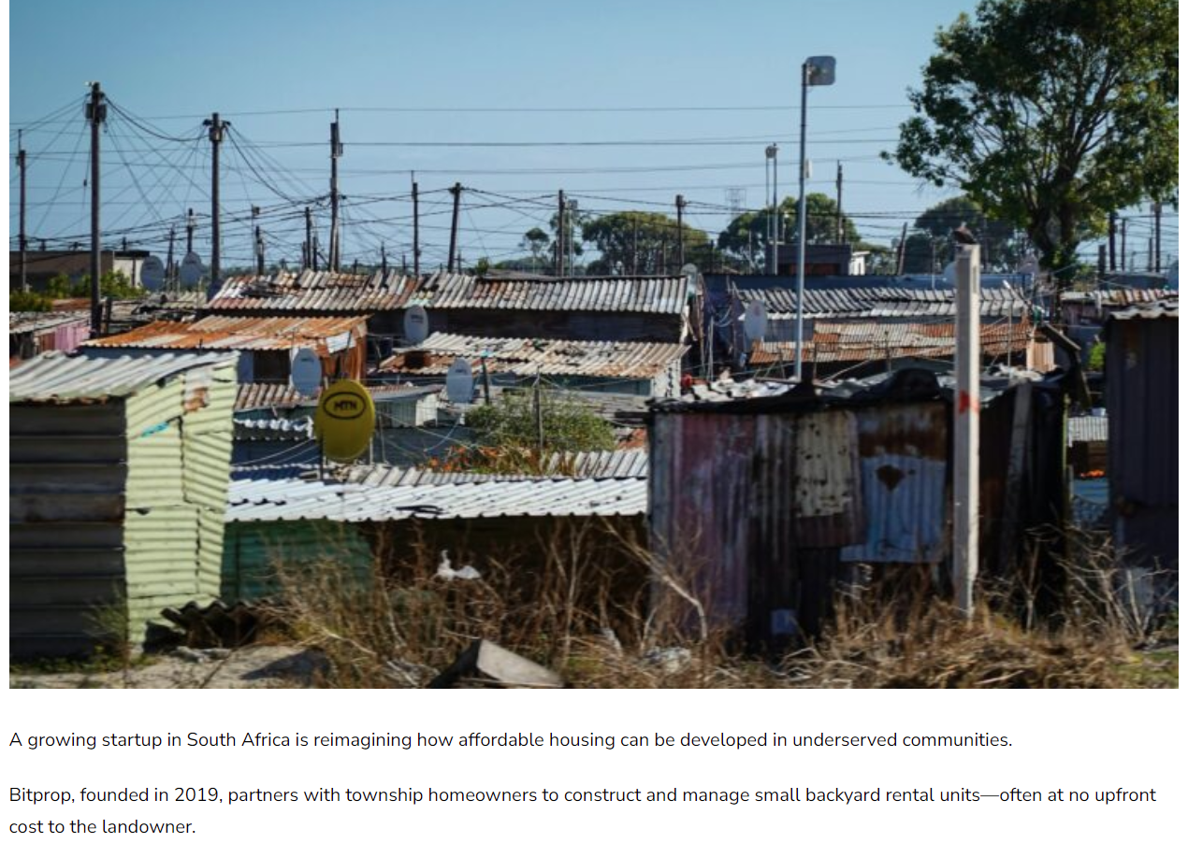
Adaptive/Enabling Housing Model… Private Sector…?

Slide 67
Adaptive/Enabling Housing Model… Private Sector…?

Slide 68
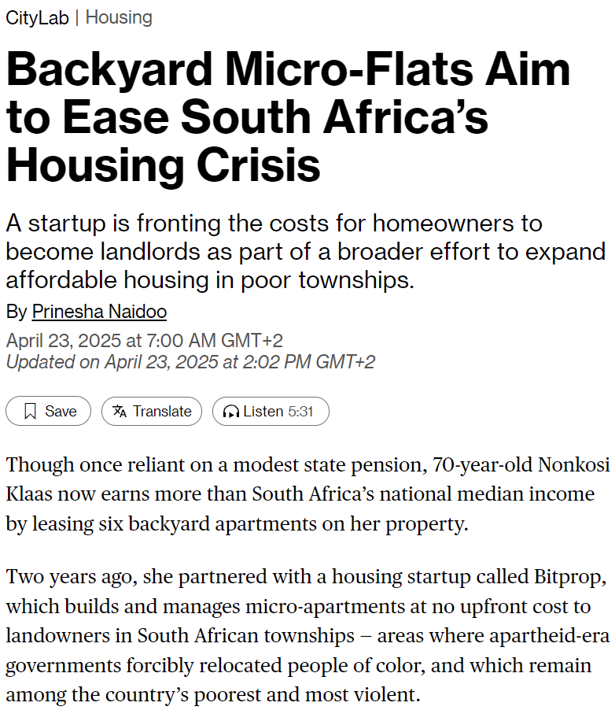
Adaptive/Enabling Housing Model… Private Sector…?

Slide 69
Multi-family Residential Market

Slide 70

Multi-family Residential Market

Slide 71

Collaboration – Mixed Income Rental Market

Slide 72

Multi-family Residential Market

Slide 73

Multi-family Residential Market

Slide 74

Multi-family Residential Market

Slide 75

Multi-family Residential Market

Slide 76

Multi-family Residential Market

Slide 77

Multi-family Residential Market

Slide 78

Collaboration : Mixed-Income Rental Market
Salt River Market Site

Slide 79

Collaboration: Mixed-Income Rental Market

Slide 80

Collaboration: Mixed-Income Rental Market

Slide 81

Collaboration: Mixed-Income Rental Market

Slide 82

Collaboration – Mixed Income Rental Market

Slide 83
Further Investment Opportunities

Slide 84
Social Housing Programme

Slide 85

Reflection on past achievements

Slide 86

Reflection on past achievements

Slide 87

Reflection on past achievements

Slide 88

Reflection on past achievements

Slide 89

Reflection on past achievements

Slide 90

Reflection on past achievements

Slide 91

Reflection on past achievements

Slide 92

Reflection on past achievements

Slide 93

Reflection on past achievements

Slide 94

Reflection on past achievements

Slide 95

Social Housing Pipeline – over next 3-year period

Slide 96

Projects awaiting SHRA final assessment and funding

Slide 97
Social Housing Programme… Private Sector…?
Shared development risk and (reward)…
Optimal land release mechanisms…?
Levels of land enablement through cross subsidisation and concessions…?
Mixed-use, mixed-income development…land release…?
Grant and development finance…?
Alternative and blended finance options…?

Slide 98
Social Housing Programme… Private Sector…?
Possible innovative funding mechanisms e.g. FSC & ESG Mandates…?
Possible instrument within the inclusionary housing framework…?
Appropriate ‘covenants’ and institutional mechanisms…?
Municipal incentives policy…?
What creates an enabling environment…?

Slide 99
Possible ‘bulk sale’ of housing units…

Slide 100

Marketing of FHF units

Slide 101

Marketing of FHF units

Slide 102

Possible Bulk Sale…
240 freehold units – 2 Bed 46m²

Slide 103

Possible Bulk Sale…
240 freehold units – 2 Bed 46m²

Slide 104

Possible Bulk Sale…
240 freehold units – 2 Bed 46m²

Slide 105
Possible Bulk Sale…
240 freehold units – 2 Bed 46m²
Terms and Conditions:-
Requisite approvals (Accounting Officers, Provincial Treasury, Municipality)
Requisite Supply Chain Management processes to be followed
To be utilised for affordable housing for at least 15-year period
Title Deed Restriction to ensure relevant covenants are upheld
Possible Rent-to-Own model or Instalment Sale option…?

Slide 106
#TOGETHER we CAN close the GAP….

Slide 107


