Slide 1
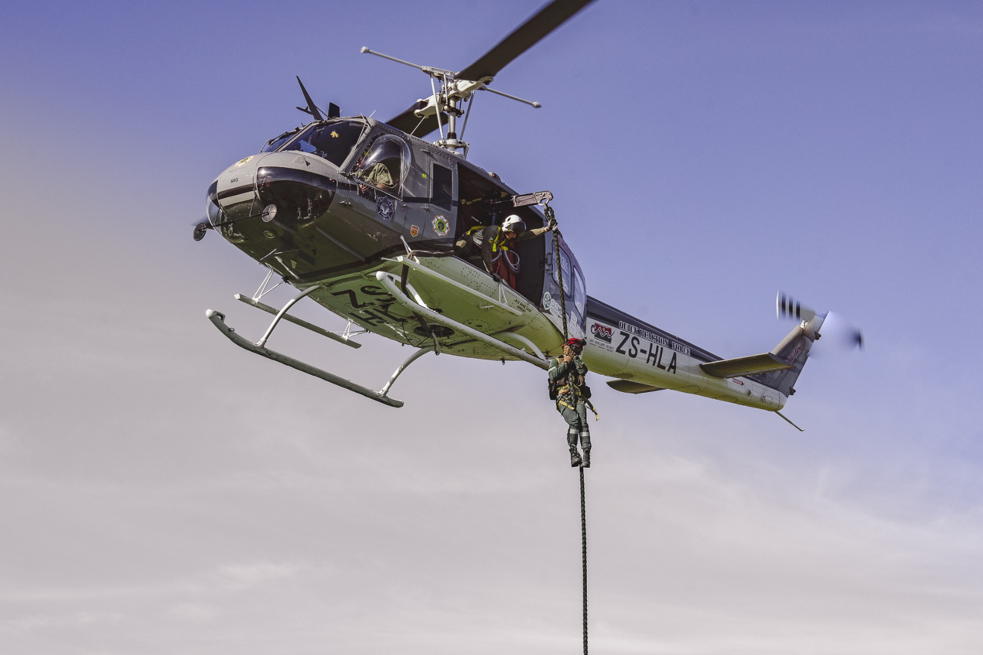
Department of Local Government
Disaster Procurement: Challenges and Pitfalls
WESTERN CAPE PROCUREMENT CONFERENCE 2025
C Deiner 28 May 2025

Slide 2
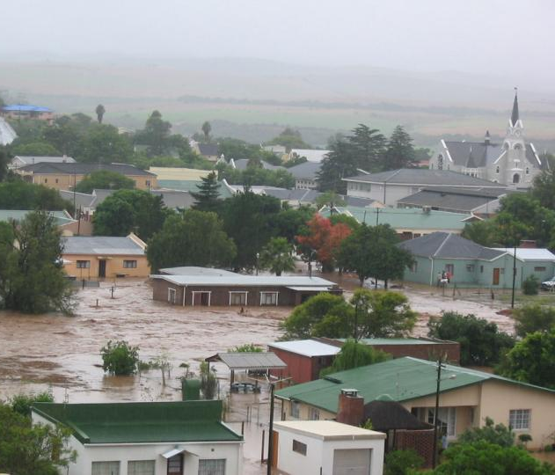
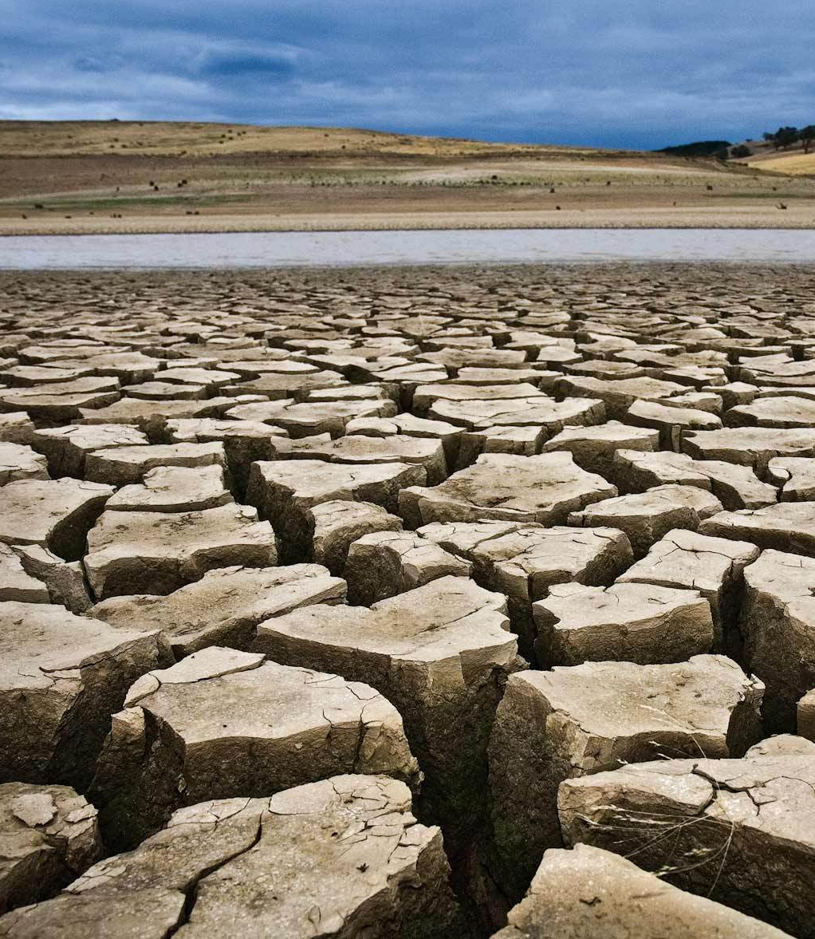
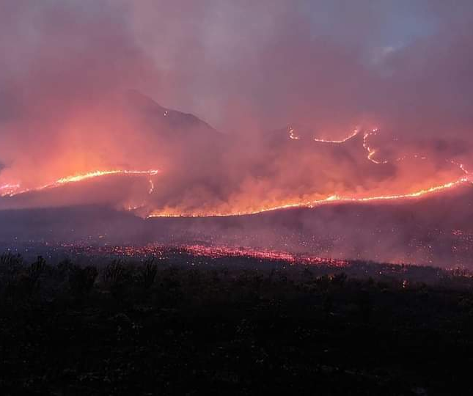
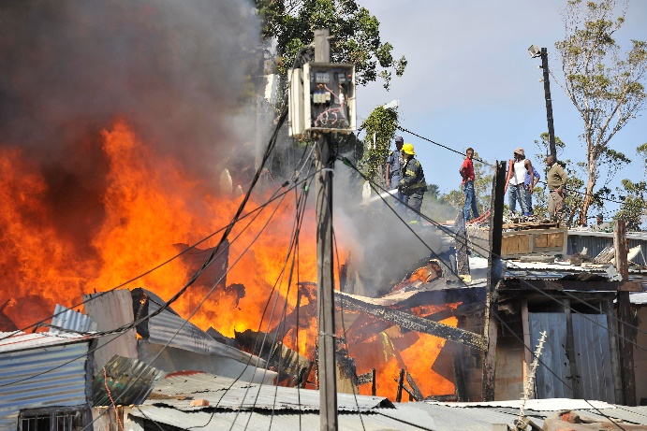
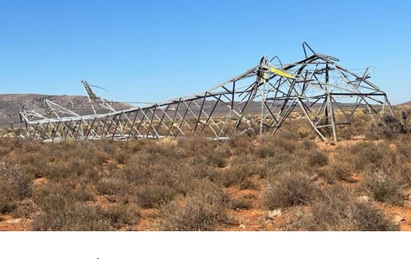

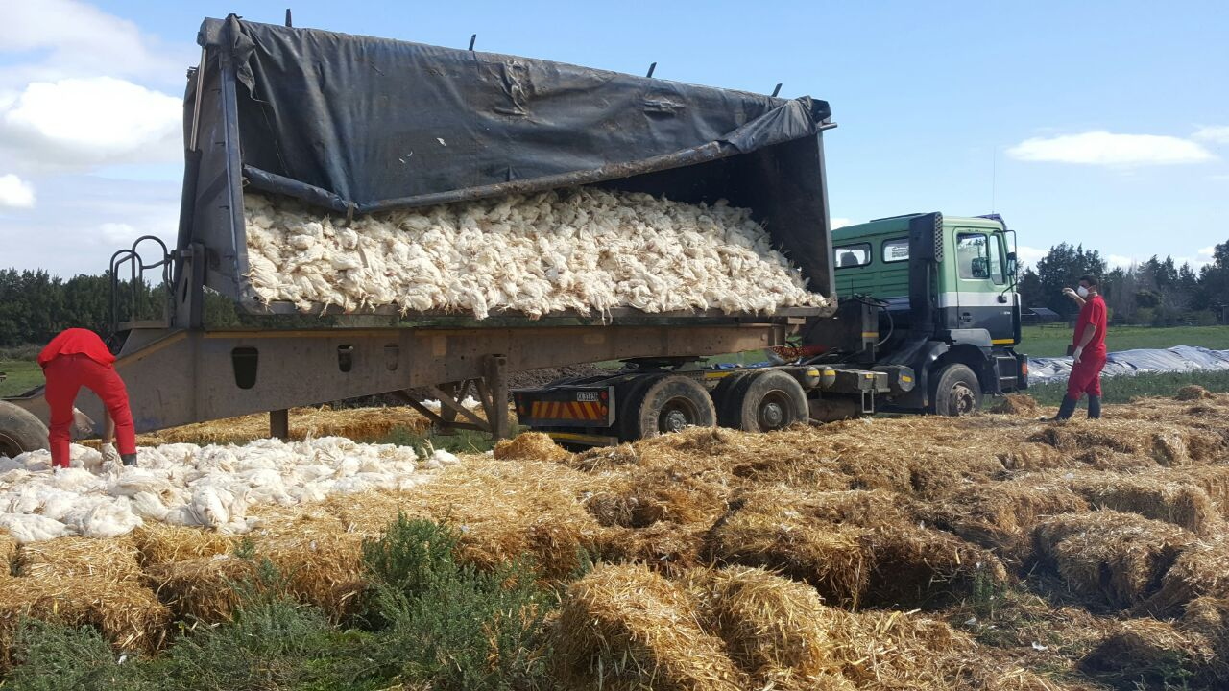
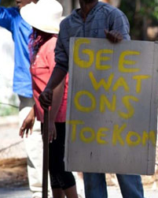
Current Disaster Landscape:
Major Disaster Incidents
Floods
Drought
Wildfires
Structural fires
Human Communicable Diseases
Animal Communicable Diseases
Infrastructure
failure
Civil Unrest

Slide 3
Major Disaster Incidents for the past year 2023 to current date to
14–19 June 2023
Severe Weather Event: Floods
24–26 Sept 2023
Severe Weather Event: Floods
5–16 Feb 2024
Regional Black-out: Central Karoo & Garden Route DM
Nov 2023 – April 2024
Multiple Wildland
& Informal
Settlement
Fires
7–10 April 2024
Severe Weather Event: Floods
6 May 2024
George Building Collapse
2-6 June 2024
Severe Weather Event: Floods
8-14 July 2024
Severe Weather Event: Floods
18-19 July 2024
Severe Weather Event: Floods
8 &17 August 2024
Riverlands flooding cause by dam bursts
Nov 2024 – Current
Multiple Wildland fires

Slide 4
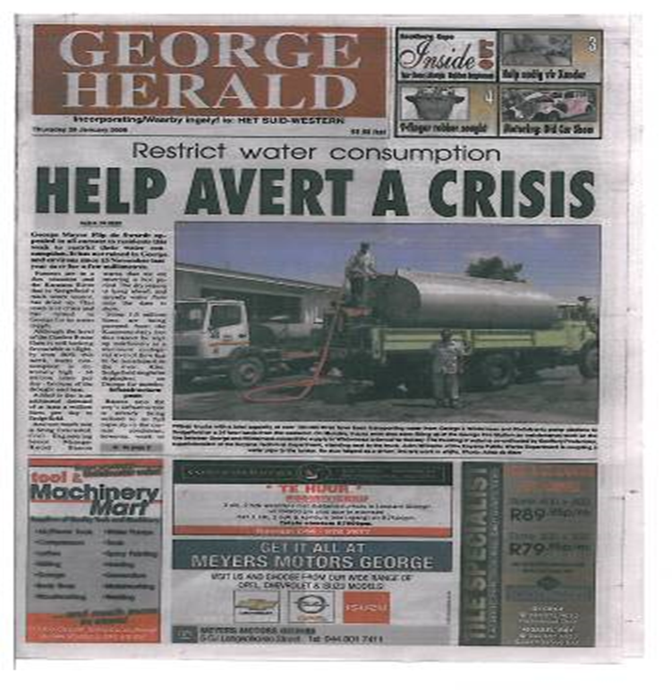
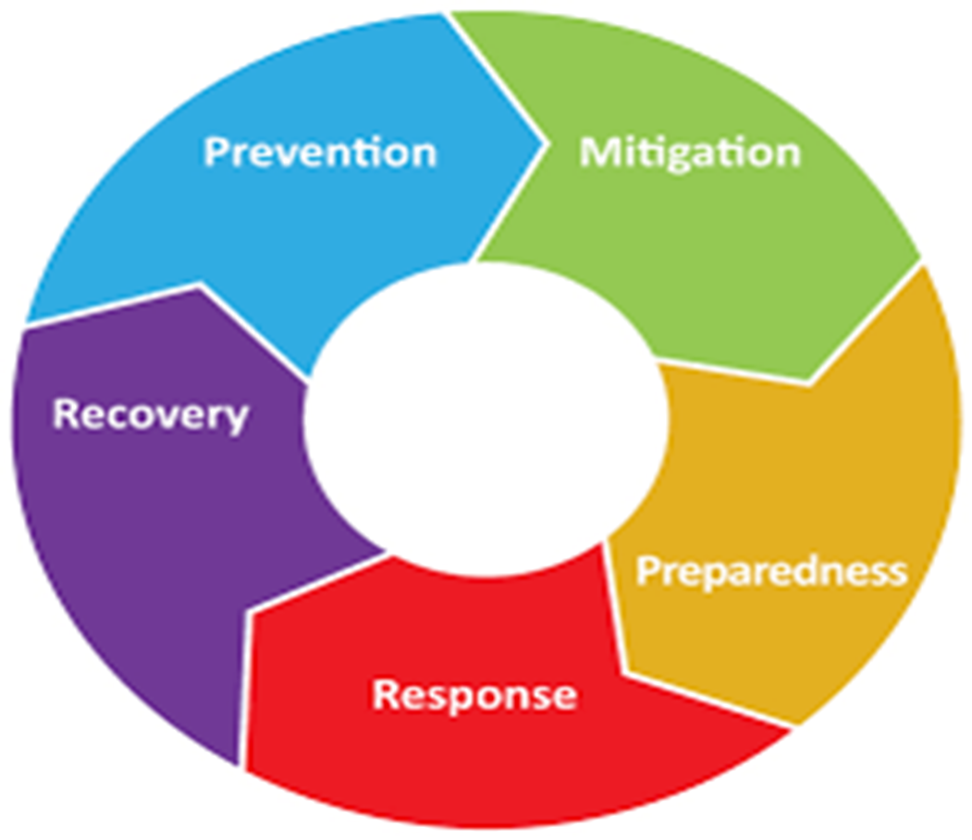
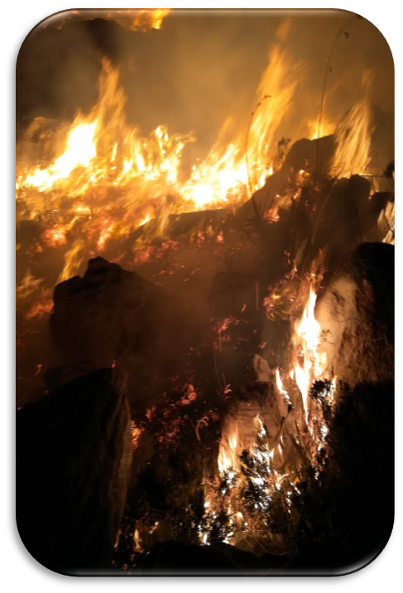
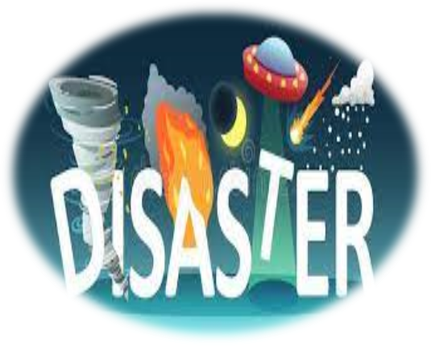
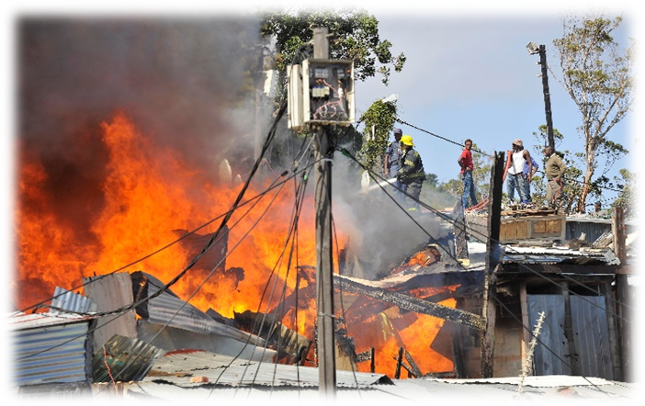
The Disaster Management Cycle (Continuum)

Slide 5

Unpacking the Disaster Management Cycle
Disaster
Impact
Reduction Phase
Recovery Phase
Early Warning
Command & Control
Risk Reduction
Response
Exercises & Simulation
Detection
Awareness
Mobilisation
Risk Management
Operations
Risk Profile
Resource Assignment
Community Based Risk Assesments
Relief
Humanitarian Aid
Data Collection & Management
Emergency Housing
Reconstruction & Rehabilitation
Rehabilitation
Risk Assessment
Risk Assessment

Slide 6
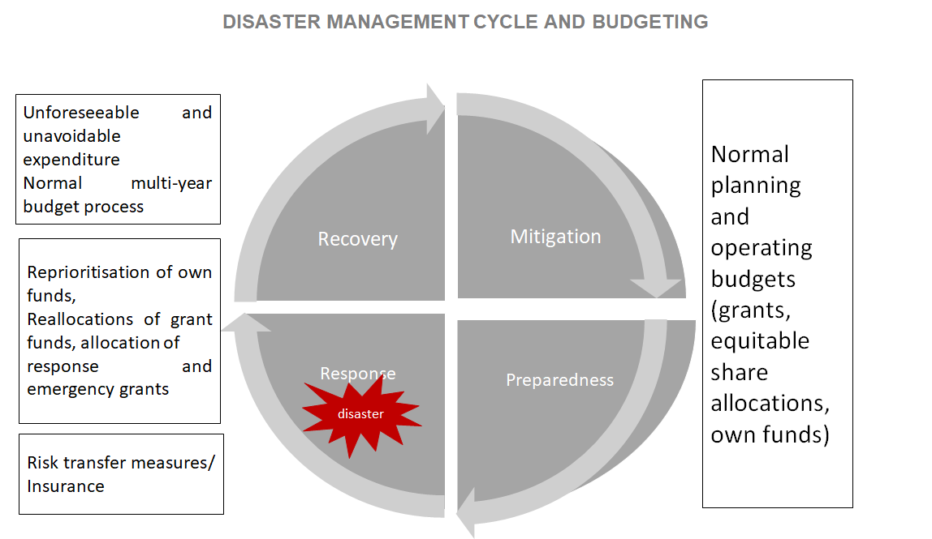
Disaster funding arrangements

Slide 7
The Disaster Management Act (DMA)
  The DMA envisages an integrated and coordinated disaster management system that is focused on:
    Preventing or reducing the risk of disasters
    Mitigating the severity of disasters
    Emergency preparedness
    Rapid and effective response to disasters
    Post-disaster recovery and rehabilitation
  A gateway to the DMA is the definition for a “disaster”.
  Section 1 of the DMA defines a “disaster” to mean the following:
  “… a progressive or sudden, widespread or localised, natural or human-caused occurrence which –
  (a) causes or threatens to cause -
  (i) death, injury or disease;
  (ii) damage to property, infrastructure or the environment; or
  (iii) significant disruption of the life of a community; and
  (b) is of a magnitude that exceeds the ability of those affected by the disaster to cope with its effects using only their resources”

Slide 8
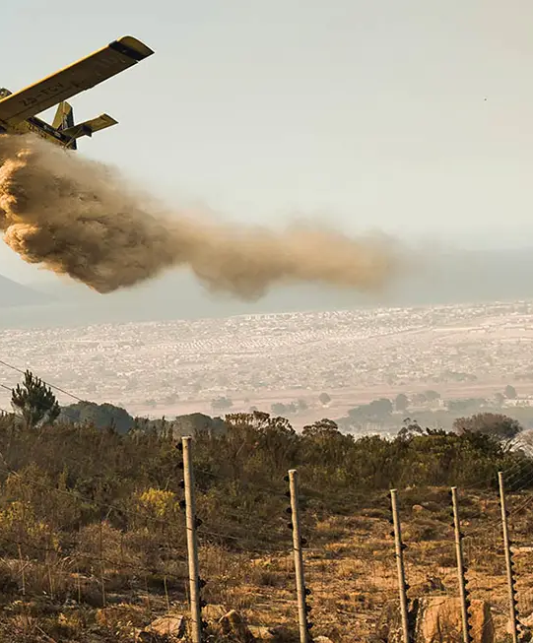
The National/Provincial Disaster Management Framework
DMA requires both National & Provincial Frameworks.
Framework Objectives:
    Provide a uniform approach to disaster risk management across all spheres of government in South Africa, ensuring consistency in planning, response, and recovery efforts.
    Guide the development and implementation of disaster risk reduction strategies to minimise vulnerabilities and build resilience in communities, infrastructure, and the environment.
    Facilitate coordination and cooperation among government institutions, private sector entities, NGOs, and communities for effective disaster preparedness, response, and recovery.

Slide 9
The National/Provincial Disaster Management Framework - KPAs
Disaster Risk Assessment
    Conducting comprehensive risk assessments.
    Identifying vulnerable communities and critical infrastructure.
Disaster Risk Reduction
    Implementing mitigation measures.
    Promoting resilient infrastructure and ecosystems.
Disaster Preparedness
    Developing and testing emergency response plans.
    Conducting training and awareness campaigns.
Disaster Response
    Coordinating emergency response operations.
    Providing humanitarian assistance and relief.
Disaster Recovery
    Facilitating post-disaster recovery and reconstruction.
    Supporting affected communities in rebuilding efforts

Slide 10
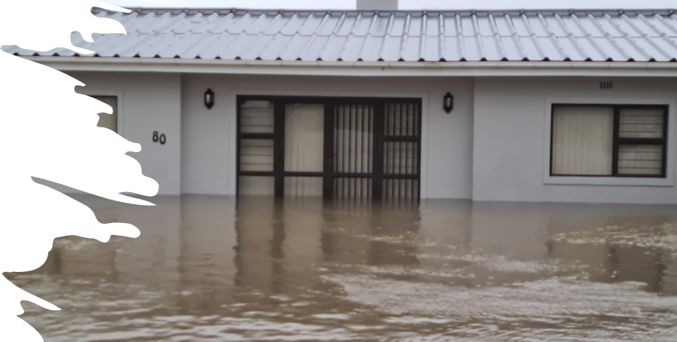
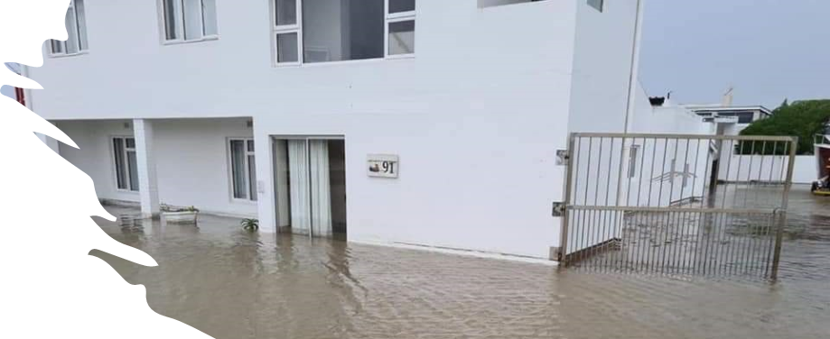
The National/Provincial Disaster Management Framework - Enablers
Enabler 1: Information Management and Communication
  Objective: To guide the development of a comprehensive information and communication system and establish integrated communication links with all disaster risk management role players.
Enabler 2: Education, Training, Public Awareness and Research
  Objective :To promote a culture of risk avoidance among stakeholders by capacitating role players through integrated education, training and public awareness programmes informed by scientific research.
Enabler 3: Funding
  Objective :To establish mechanisms for the funding of disaster risk management.

Slide 11
Disaster Risk Reduction – Funding Challenges

Slide 12
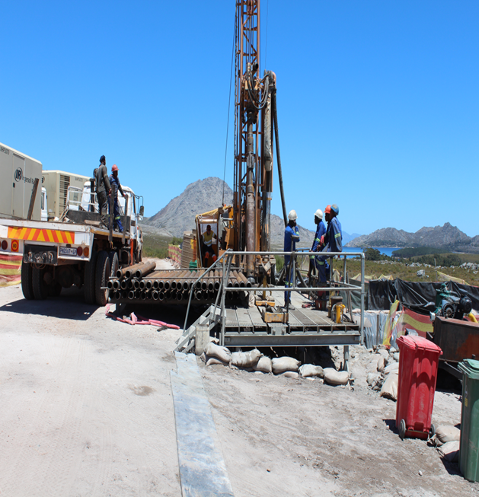
Disaster Risk Reduction Funding Challenges
No National funding for Disaster Risk Reduction (DRR).
Inadequate funding for Disaster Management activities in Municipal & Provincial sphere
Line functions are not budgeting for DRR
Risk reduction strategies and projects are presented to the IDP forums but are still not being prioritised as required.
Heavy reliance on Provincial funding.
Public/Private & International partnerships becoming more prominent.
Non- compliance to VFFA of landowners (e.g. Eskom, DAFF)

Slide 13
Funding for Disaster Risk Reduction: Western Cape Government
Capacity Building Project (R5m over three years)
    Disaster Management Learning Programme: Three-year project to capacitate municipal employees in Disaster Management through 16 short courses
Priority Hazard Model (R2.5m over two years)
    Development of a flood hazard model
Hazard Awareness Campaign (R405 000)
    Roll out of the Disaster Awareness Campaign in the form of an industrial theatre for primary school learners
    Development and distribution of awareness materials
    International Day for Disaster Risk Reduction Commemoration
Risk and Vulnerability Assessments (R60 000)
    In house support to municipalities for the review of disaster risk assessments
GIS (unfunded)
    Enhancements and maintenance of GIS systems and Decision Support Tool (DST)
Integration of Disaster Risk Reduction in Development Planning (unfunded)
    Support to municipalities for the development of Disaster Risk Reduction Plans and integration of Disaster Risk Reduction in IDPS
Early Warnings and Interventions (unfunded)
    Development and distribution of early warning systems and implementation of interventions when required

Slide 14
Funding for Disaster Risk Reduction received from Private Public Partnership
Partnership for Risk and Resilience (Santam)
  Disaster Risk Reduction Projects funded in 2024(R 978 813.00):
    Disaster Awareness Campaign: industrial theatre for 20 primary schools
    Hazard awareness: development of social media collateral and radio messages about floods, fires and wildfires
    Printing of awareness materials and procurement of promotional materials
    Community Resilience Building: fire and flood training for isolated communities
    Smoke alarms distributed to Wupperthal as part of International Day for Disaster Risk Reduction
  Budget allocated for Disaster Risk Reduction (including fire projects) in 2025: R850 000
    Projects focus on awareness and training

Slide 15
Disaster Preparedness & Response

Slide 16
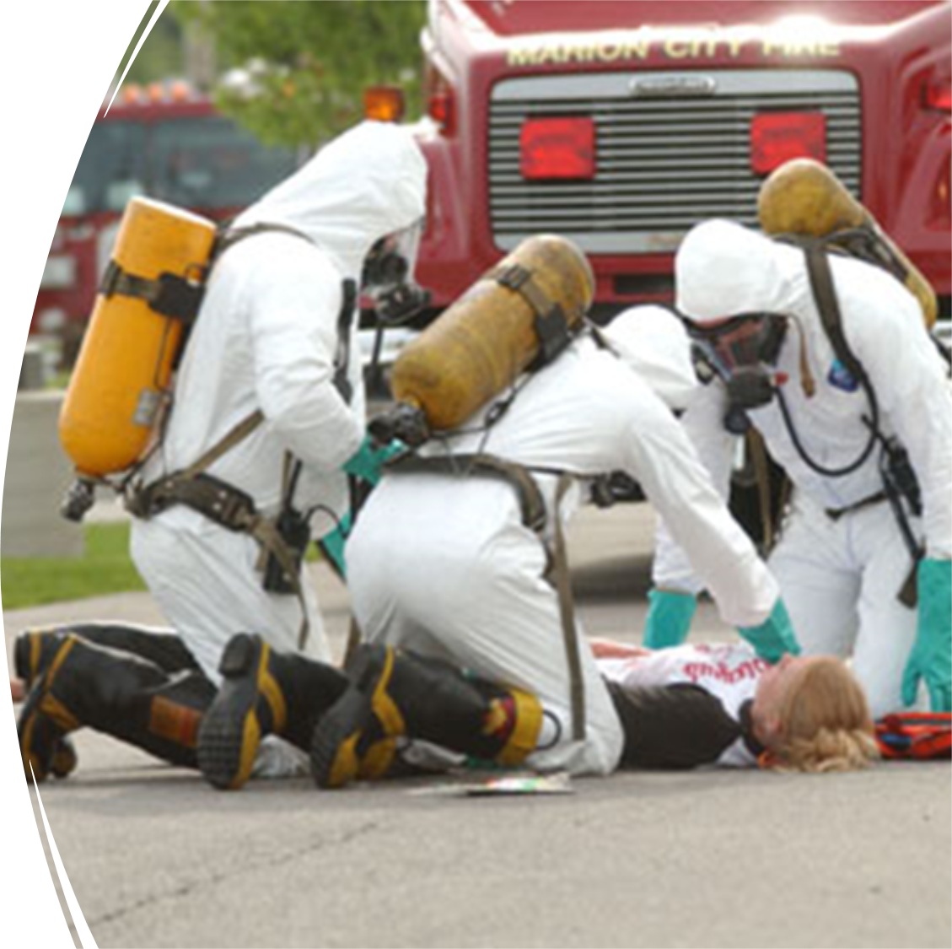
Disaster Preparedness & Response - Challenges
No National funding for preparedness & response.
Disaster Response Grant – Not immediately available.
Municipalities reluctance to approve emergency expenditure.
Critical lack of National Government Resources
  Military aircraft & engineering.
  Degrading of fire services nationwide.
Budget cuts on National Programmes: Working on Fire

Slide 17
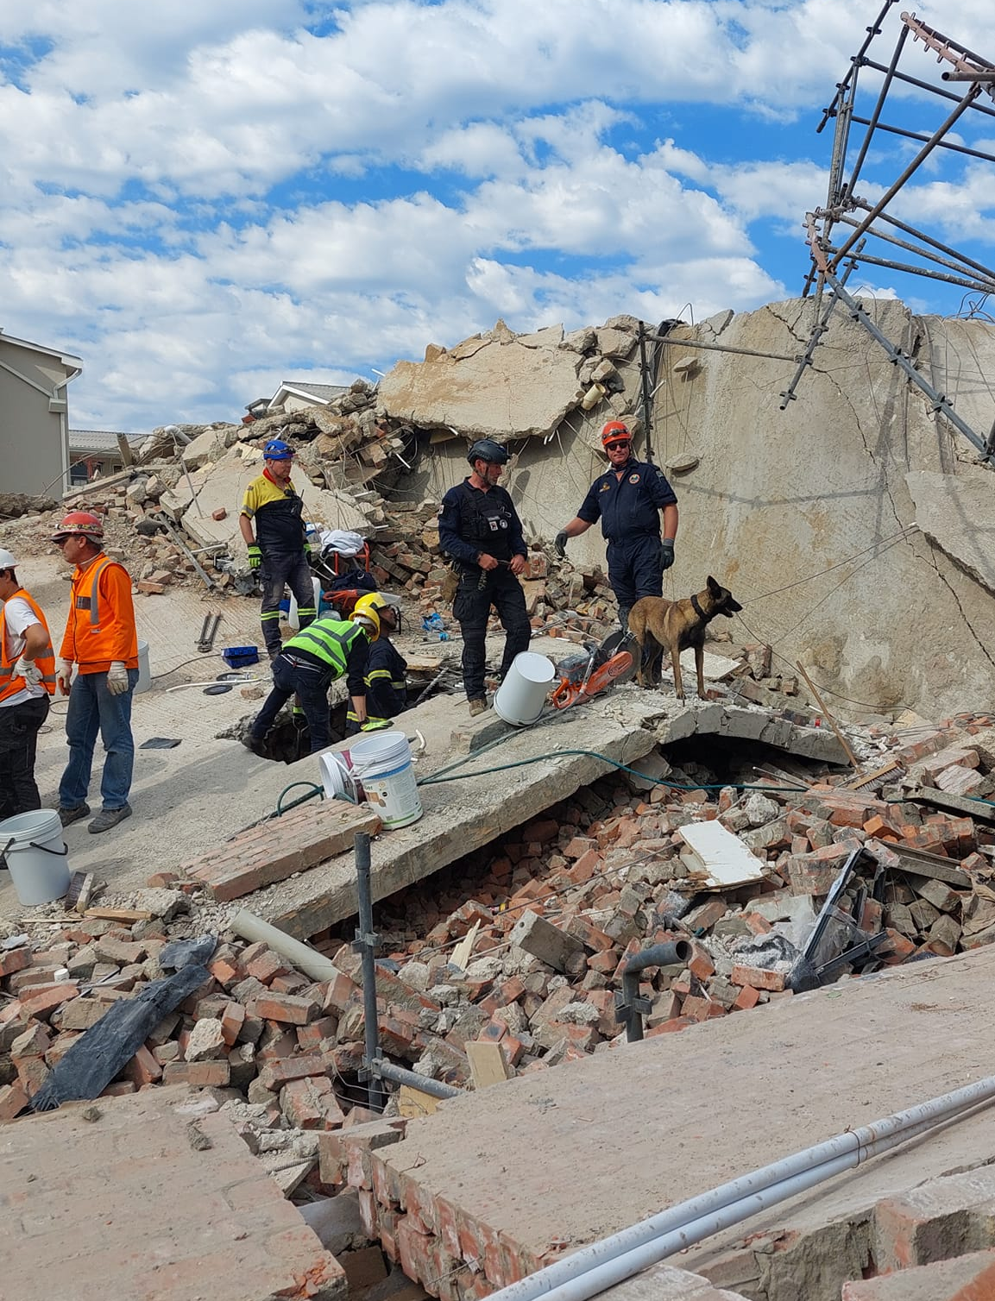
Funding for Preparedness & Response: Western Cape Government
Municipal Fire Services Grant for purchase of fire and rescue vehicles
  R106-million (11 Years/2014 – 2025) - > 100 units
Wildfire Support
  Aerial support for rapid fire attack programme
  Approx: R20-million p.y.
  Specialised ground teams
Grant Funding for new fire stations
  Garden Route District
Special Operations Capacity
  Prov. Urban Search & Rescue Unit (Breede Valley)
  Prov. Flood Response Unit (Garden Route)
Training & Capacity Building
Smoke Alarm project
Single DM Management System

Slide 18
Disaster Recovery

Slide 19
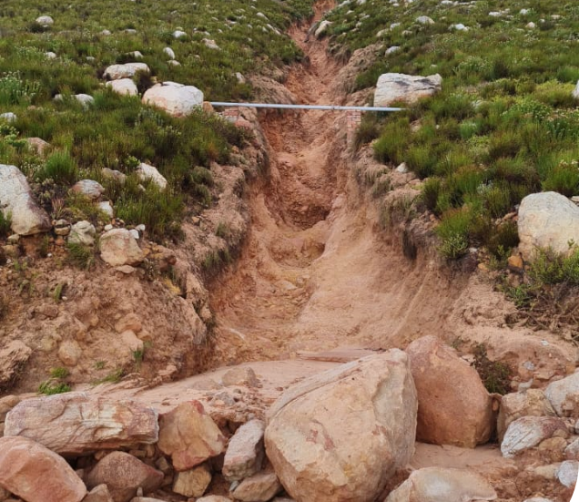
Disaster Recovery
Disaster recovery (including rehabilitation and reconstruction) focusses on the decisions and actions in the aftermath of a disaster to restore lives and livelihoods, services, infrastructure and the natural environment to the pre-disaster living conditions of the stricken community.
Disaster recovery includes:
  rehabilitation of the affected areas, communities and households;
  reconstruction of damaged and destroyed infrastructure; and
  recovery of losses sustained (including humanitarian support) during the disaster event, combined with the development of increased resistance and resilience to similar occurrences in the future.

Slide 20
Existing Disaster Grants
Disaster Grants within the NDMC have been introduced to assist in cases where the responsible organ of state are unable to deal with the effects of the disaster using only their own resources in line with the DMA
1. Funding for Emergency Response
Municipal Disaster Response Grant
Provincial Disaster Response Grant
2. Funding for Reconstruction & Rehabilitation
Municipal Disaster Recovery Grant
Provincial Disaster Recovery Grant

Slide 21
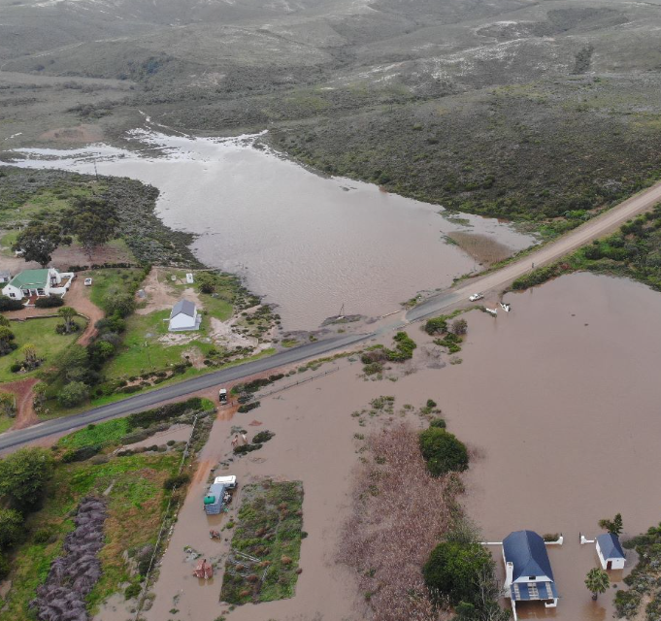
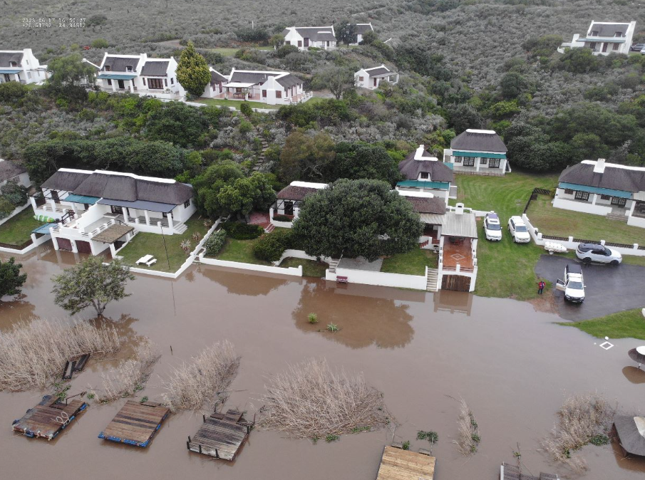
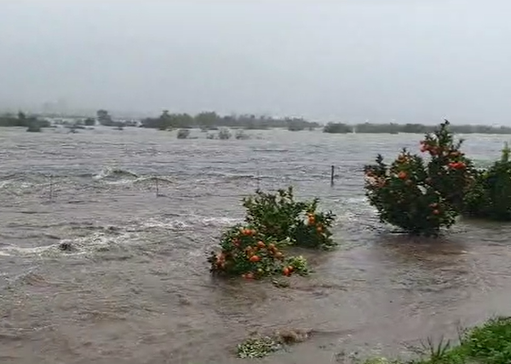
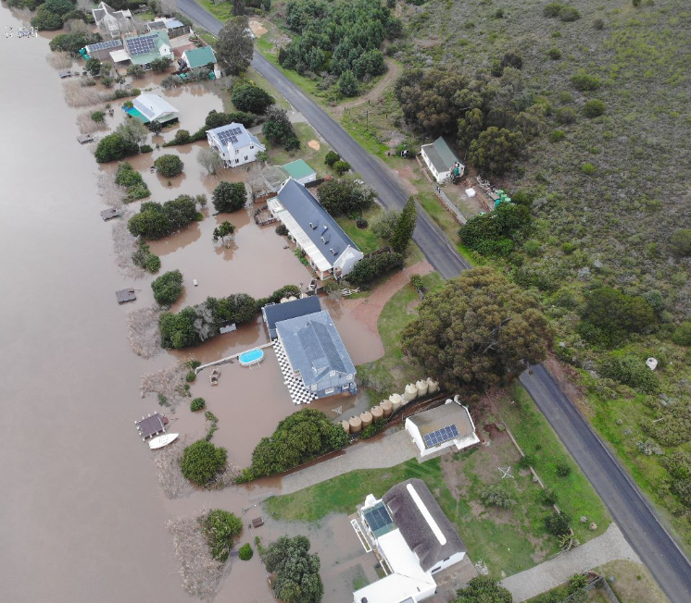
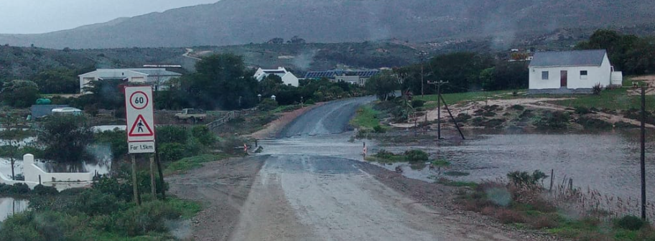
CHALLENGES
Requires Disaster Declaration.
Delay in funding allocation
Allocation often inadequate
Very short project implementation time
Capacity to complete rehabilitation projects

Slide 22
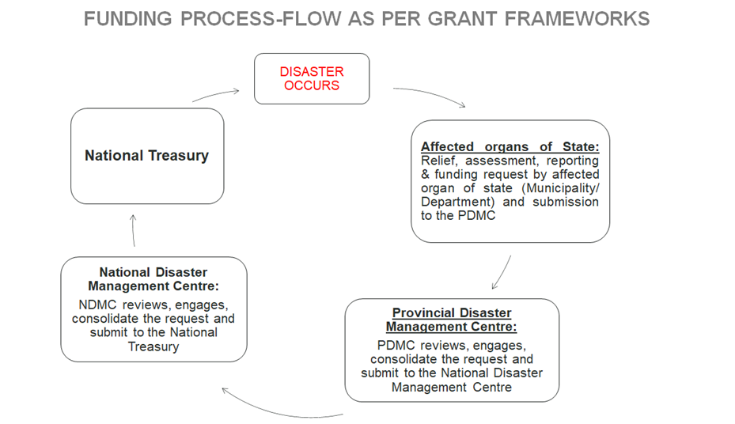
Disaster recovery funding arrangements (should additional National funding be needed) Admin process

Slide 23
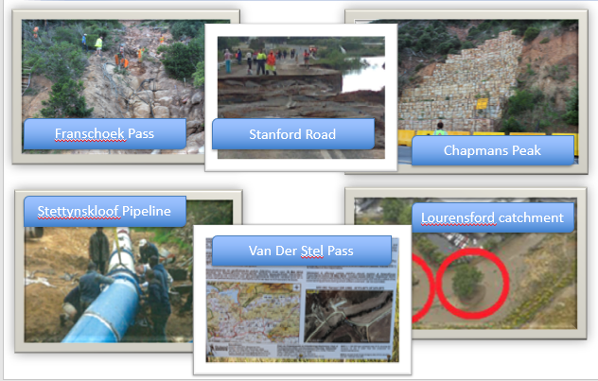
Post Disaster Recovery Projects

Slide 24
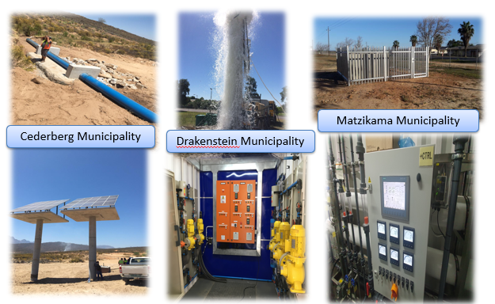
Post Disaster Recovery Projects

Slide 25
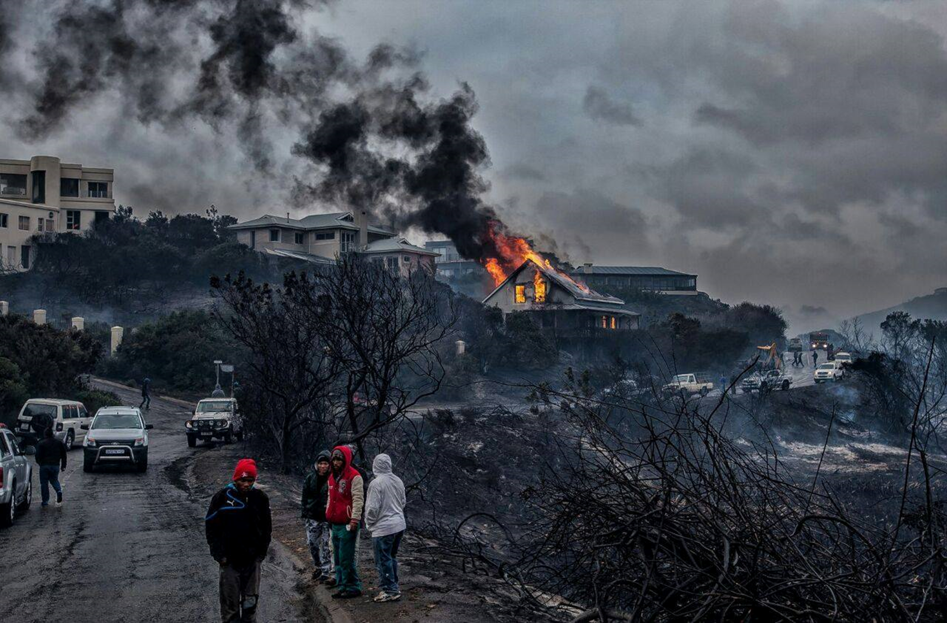
CLIMATE CHANGE
The lack of meaningful funding for climate change prevention is not just a failure of policy—it is a failure of foresight. By choosing short-term convenience over long-term survival, we are quietly authoring a future where rising seas erase nations, droughts ignite wars, and the most vulnerable among us pay the highest price for our inaction. Every dollar withheld today becomes a debt of suffering we pass to our children—a stark reminder that the true cost of apathy will be measured in lost ecosystems, broken communities, and the diminished hope of generations to come.

Slide 26
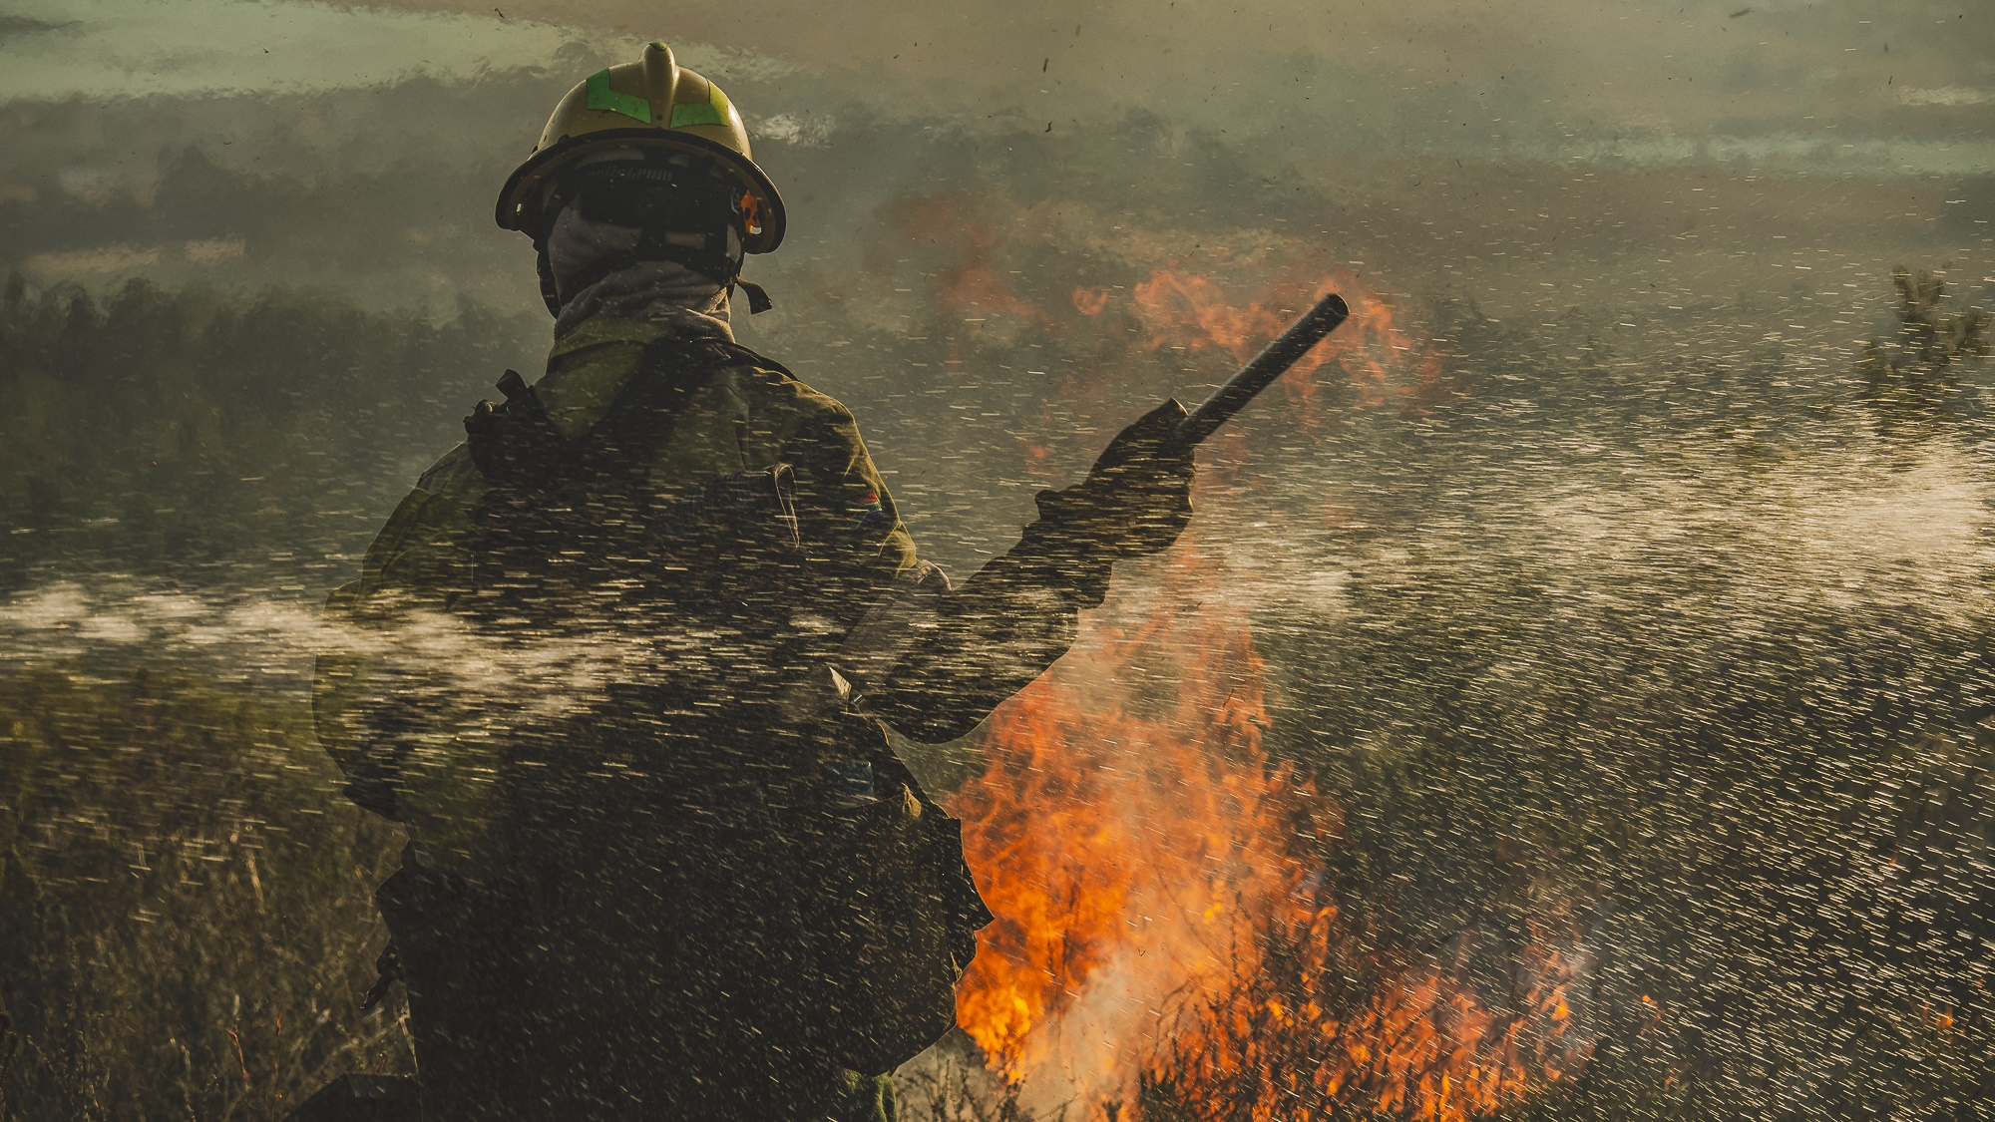
Thank you

Slide 27
Colin Deiner
Chief Director: Disaster Management & Fire and Rescue Services
+27 825506770
N/A
Colin.deiner@westerncape.gov.za
Provincial Disaster Management Centre, Grounds of Tygerberg Hospital

