Slide 1

a digital transformation journey
Belinda West
28 May 2025

Slide 2


Why undertake digital transformation?
To dial up
productivity?
Peer pressure?
It sounds strategic?
To steer the ship with greater certainty?
Still guesstimating
supply risk?
Seeking new
streams of value?
Wondering what you’re leaving on the table?
Pressure to retain talent?

Slide 3

Mature, stable non trade procurement team
“Low hanging fruit” exhausted
Diminishing ROI
Downstream tech in place (Oracle EBS)
Excessive time invested on data mining, cleaning and categorization
Spend leakage due to ad hoc/reactive contract management
Manual processes impacting transparency, auditability and efficiency
No contract repository to enable governance or quantification of risk
Context

Slide 4
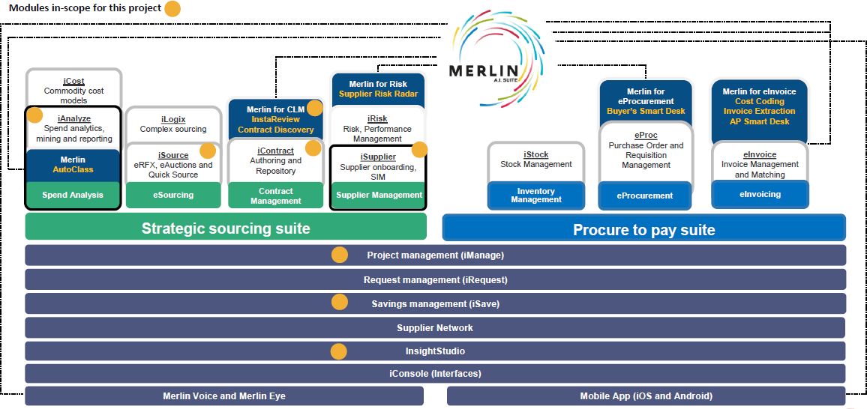
Selected upstream suite

Slide 5


New tools
reliable and timely data insights
new sourcing modalities increasing competitive tension
= incremental savings on competitively
sourced spend
New reach
reaching for more
reaching more often
= savings on incremental competitively sourced spend
Making the business case

Slide 6

Be realistic about what can be achieved
in your environment
Acknowledge there could be an upside
Consider financial and non-financial
benefits
Lobby for support from other BUs set to benefit
Sell your vision
Overcoming the funding challenge
If procurement can’t deliver the promised
ROI, you will lose credibility

Slide 7
Zycus led
Offshore implementation team (India)
No backfill for deployed resources
Kicked-off with 6-week iSource sprint
Vanilla
Change management Change management Change management
Focus on embracing best practice
Train the trainer approach
Implementation approach

Slide 8



Implementation lessons
Implementing with a 3rd party brings impartiality and deeper consulting insights
An onsite team would secure
you dedicated attention
… BUT implementing with the supplier ensures your points of pain feed directly into development
… BUT when resources aren’t a fit, it is
easier to secure a change
There is an optimal module implementation order
… BUT it’s easier to secure funding when
costs are offset in year

Slide 9
It was painful, it was hard…
Do your housekeeping ahead of
time...
If you can, backfill your team…
Don’t crunch the timeline…
Expect the unexpected…
Change Management never ends…
Include access to enabling planning info at the shortlisting stage…
Implementation lessons

Slide 10
Success stories & innovative strategies
Project 1 – an early opportunity to play in a new area Project 2 – a challenging field
Project 3 – an eAuction doesn’t signal the end!
R275m auctioned
Range of return 1% to 9.5%
Average return of 4%
R40m new reach returned 28%

Slide 11



Target FY24
Achieved FY24 Target FY25 Achieved FY25 Target FY26
In Process FY26
Are we delivering the business case?

Slide 12

Lessons learnt
Don’t run before you can walk
Auctions
  Strategize!
  Blind auctions are not a limitation
  You need to build tension in the “room”
Don’t underestimate the value of new reach

Slide 13
Our list of the top 10 benefits
commercial value of eAuctions governance / auditability speed to decision making workflow approvals
improved independence and attention of panel members contracting efficiency & certainty
RFx management
universal visibility of benefit delivery ease of launching RFx
access to clean data

Slide 14


Thank you for your attention!

